Slide 1
City of Satellite Beach Fire and Paramedic Service Mobile Integrated health care overview

Slide 2
City and Department Background
Demographics
Estimated Population 10,500
Population of 32937 Zip Code 29,000
21% of population 65 or older
Satellite Beach Fire & Paramedic Services
Full service Fire / Paramedic Agency
EMS and Patient Care a high priority component of our community
Key Performance Indicators relating to EMS
Response Times
Patient Care Delivery and Outcome
Training
Patient Satisfaction
Key Performance Indicates for Community Health include
Reduction in Fall related events
Reduction of the use of EMS and ED as primary care
Enhanced ability for senior to remain in their home

Slide 3
Traditional Fire/EMS Department with one exception

Slide 4
Community health

Slide 5
Mobile Integrated Community Health
Satellite Beach Fire Department provides two services that have positively impacted the community
Senior Fall Prevention
Community Health Medic Program.

Slide 6
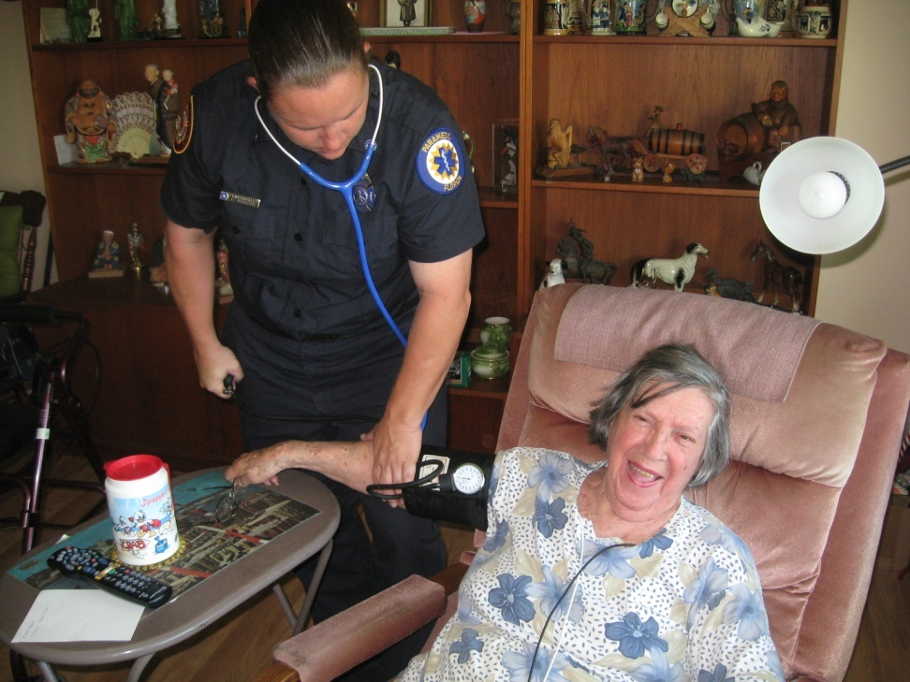
Community Health Medic Program
Satellite Beach Fire provides in-home health evaluations for older citizens who have chronic health conditions and self manage their condition
Paramedic makes appointment to visit citizens in their homes as needed to conduct physical exam and check up.

Slide 7
Community Health Medic Program
Services Provided
In-Home Paramedic exam on a weekly visit
12 Lead EGG
Vitals including weight
Blood Glucose
Oxygen Saturation
Medication review and compliance
Nutrition review and compliance
Link with Primary Care Provider to provider to provide first hand observations about the patient.

Slide 8
Community Health Medic Program
Program Expansion 2015
Evident that we needed to leverage technology to increase efficiency and effectiveness
Review of remote medical monitoring products was very costly
Made strategic decision to implementation “off the shelf” wireless home health monitoring equipment
BP / Pulse
Pulse Oxygenation
Glucose
Weight / Body Mass/ Fluid %
Through Community Donations- Purchased equipment including ipad mini with build in cellular data
Data upload to a cloud based dashboard for daily review of patient data by Paramedic

Slide 9
Community Health Medic Program
Participants were taught to use the ipad and how to take their on vital signs each day and upload it to a cloud based service
Participant age- 74-93 years of age
Data upload to a cloud based dashboard for daily review of patient data by Paramedic
This allows “Virtual” contact with the participant
Requiring the participants to do this each day gave them a sense of control and ownership on improving their on health status

Slide 10
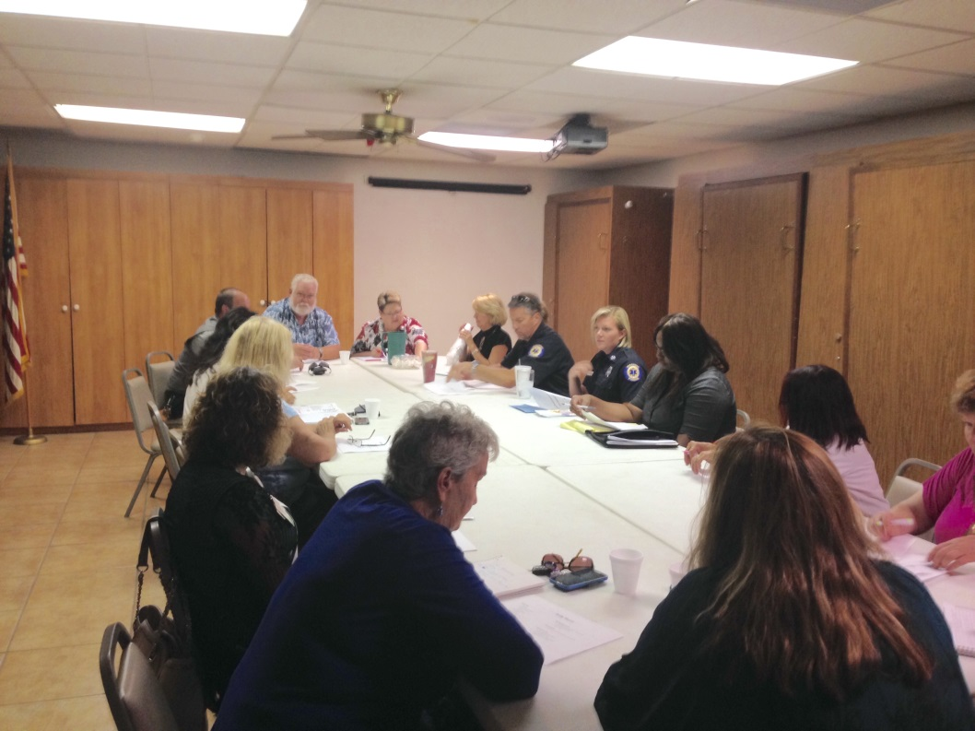
Satellite Beach Senior Care Network
Local Coalition of Health Care Providers, Hospice, Faith Based organizations, public transportation, senior adult civic groups, local government
Case-Management review of all participants
Focus it to match the needs with the appropriate solution.

Slide 11
Program Outcomes
For those patients who have been in the program, the patient has experienced
Overall Health Improvement
Greater ability to take an active role in their own health care
Reduction of 911 use
Improved overall life outlook
Hospital Readmission
120 day review
Tracked 25 SBFD 911 Patients (911-Discharge)
Community Medic was at Pt home within 24 hours of Discharge
Initiated Discharge Plan and Follow Up
Coordinated Home Health Care for Patients who were discharged without it
.08% 30 day readmission

Slide 12
Community health Paramedic
Planned Expansion
24/7 Community Medic On-Duty
Unplanned Community Health Needs
Work with Home Health Care patients in crisis
Hospital readmission diversion
Community Medic to meet discharged patient at their home in 8 hours or less 90% on-time
Pilot Program –
Video Tele-medicine with Primary Care Provider and Patient in-home facilitated by Community Medic

Slide 13
Community health Paramedic
Pilot Programs
Video Tele-Medicine
Video Link Primary Care Provider and Patient in-home facilitated by Community Medic

