Slide 1
Improving Access to Care through Telehealth for Veterans with MS and ALS
Sean C. McCoy, PhD
Veterans Rural Health Resource Center-Eastern Region
http://www.ruralhealth.va.gov/

Slide 2
Disclaimer: The views and opinions expressed in this article are those of the author and do not necessarily reflect the official policy or position of any agency of the U.S. government

Slide 3
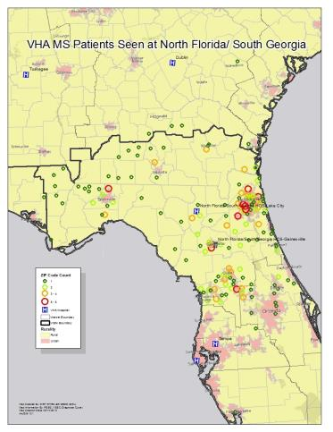
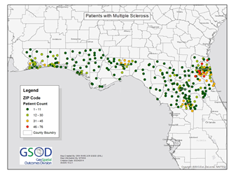
Distribution of Veteran and non-Veteran MS patients in North Central Florida
MS Patients Self-Reported to NFNMSS

Slide 4
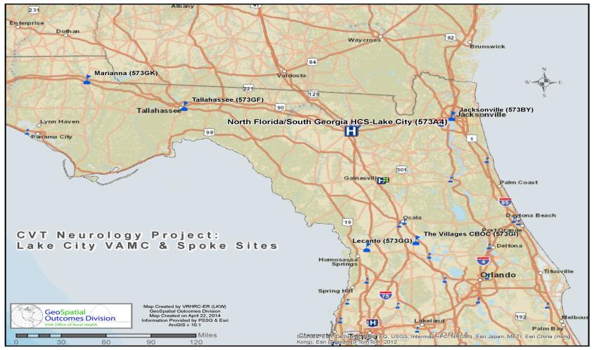
MS CVT NEUROLOGY FOLLOW-UP
Notes:
Since we began this project as a Hub to CBOC CVT follow-up visit with the Marianna CBOC, we have trained tele-presenters at all CBOCs and OPC s in NF/SGVHS to do a functional neurological exam and have conducted evaluations at Tallahassee, Jacksonville, Lecanto, and the Villages.

Slide 5
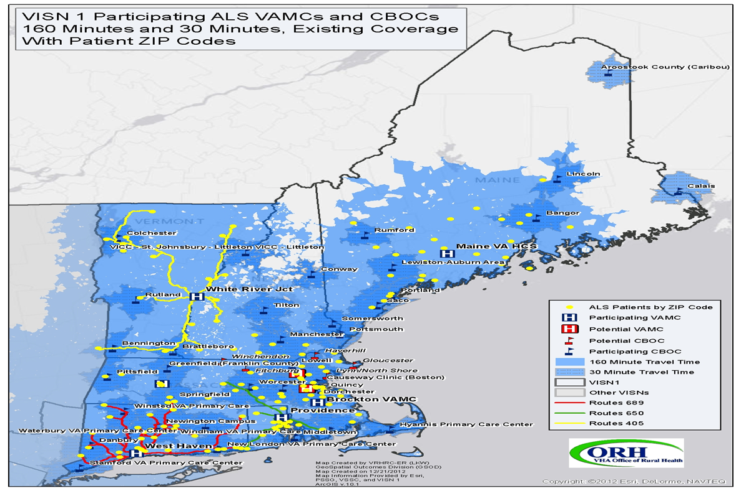
COMPREHENSIVE ALS CARE
Notes:
Since we began this project as a Hub to CBOC CVT follow-up visit with the Marianna CBOC, we have trained tele-presenters at all CBOCs and OPC s in NF/SGVHS to do a functional neurological exam and have conducted evaluations at Tallahassee, Jacksonville, Lecanto, and the Villages.

Slide 6
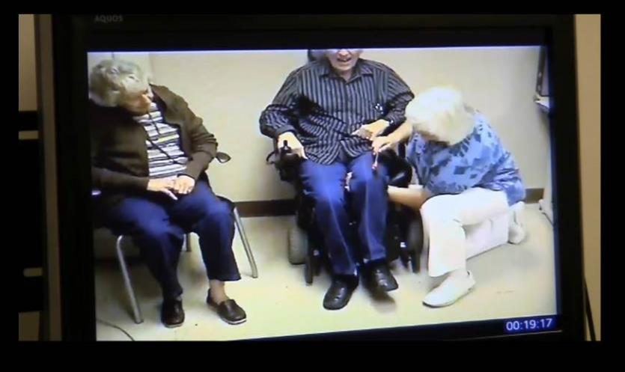
Tele-presenter Demonstrating Reflexes
Notes:
To evaluate a patient in a follow-up visit we had to train a CBOC staff member ( nurse, ARNP, PT, OT ) to perform a functional neurological exam. Having had previous examinations and an electronic medical record, the neurologist had information on previous exams immediately in front of him as he viewed the patient and presenter. Here we are reviewing the lower extremity reflexes which in this patient were extremely hyperactive but unchanged from previous exams.

Slide 7
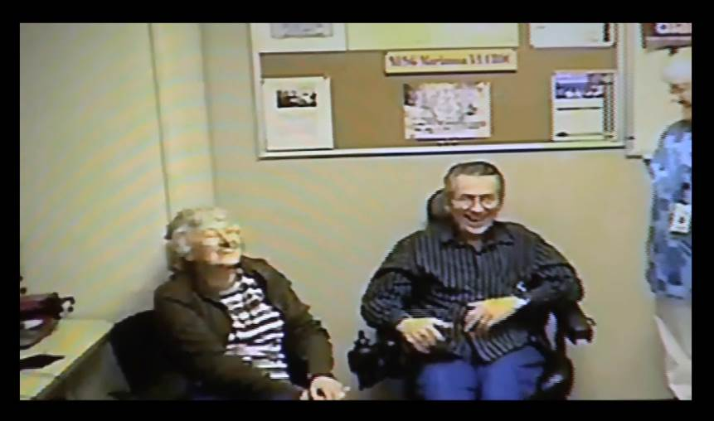
Caregiver and Patient Satisfaction
Notes:
As outcome measures, we always utilized the telehealth patient and provider satisfaction surveys. They were almost always >98% positive. Exceptions included interruptions in calls,
poor reception, and an occasional patient who preferred face-to face visits to the clinic for social interaction. An added benefit of these visits was the support to the care-giver. Although we did not quantitatively measure this benefit, it was clear from care-giver responses that they valued this visits for many different reasons.

Slide 8
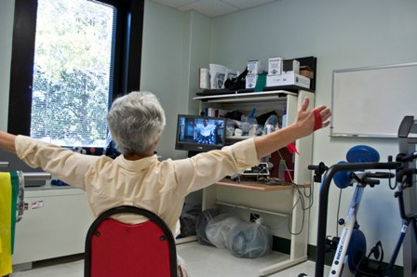
Clinical Video Telehealth (CVT)
Home-based Physical Therapy
Exercise Intervention
8
Notes:
Dr. Toni Chiara pictured here is conducting a CVT visit with a Veteran with progressive MS. The cueing that she provides in this virtual visit is an important part of the success of the therapy and allows for the correction of the exercise that DVDs can’t provide.

Slide 9
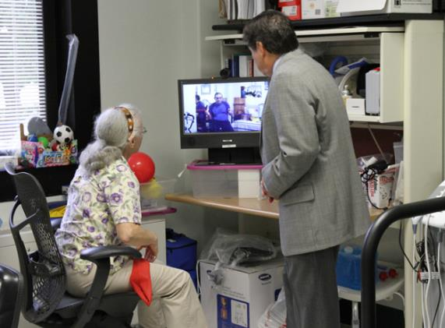
CVT-REHAB – Hub to Home
Notes:
Another advantage of the Hub to home CVT program is that it allows for physician evaluation both during the rehab visit or for additional follow-up for disabled patients who are unable to travel even to the closest CBOC. We have done this for functional evaluation where the patient has been in the HBPC program or where caregivers and/or home health aids have been trained in patient safety and tele-presentation of the functional neurological exam.

Slide 10
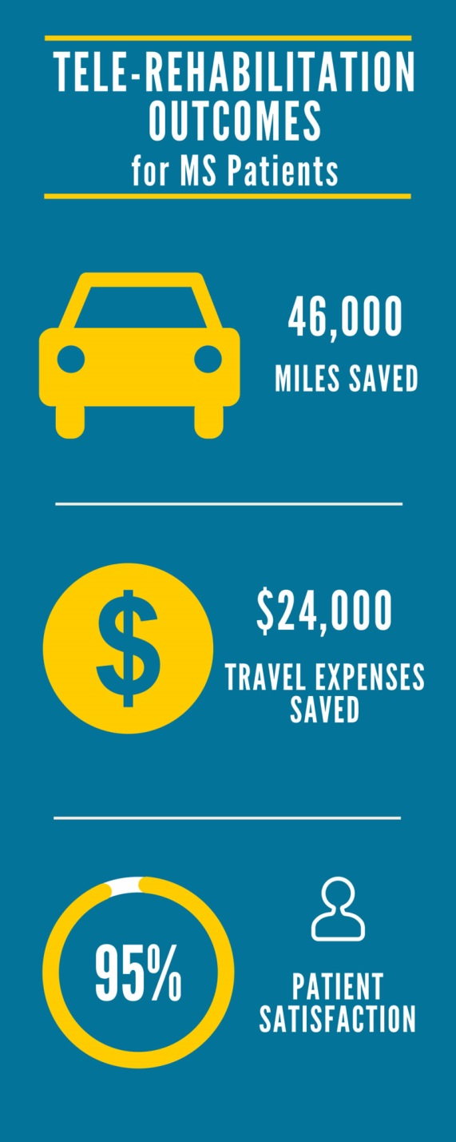

Slide 11
Clinical Challenge—Cognitive Rehabilitation
Veteran virtual medical center and Exer-games can provide screening and clinician developed rehabilitation plans
Current system captures 4 cognitive domains—Executive Function, Attention, Memory, and Visual Processing
  Uses 4G connected tablet
  Allows for access at home
  Adherence rates
https://youtu.be/p46-ytjboek

Slide 12
Why is Telehealth Important to Patients with MS and ALS?
Use of Clinical Video Televideo (CVT) can:
Provide comprehensive Care to MS and ALS patients living in rural and remote areas
Provide caregiver support
Improve compliance for MS Disease Modifying Therapy
Allow rehabilitation and wellness programs to be delivered to the home
Improve quality of life and ultimately will reduce costs for MS and ALS care
Notes:
I have shown you some of the ways that CVT can be useful to rural MS patients . This is of course true for non-rural MS patients who have similar problems with access to care because of disability and transportation issues. The Veterans Health Administration has been a leader in the use of Telehealth for providing care to care to rual, remote, and access- limited veterans.
I believe that the technology is now available and payers such as Medicare, Medicaid and some insurers are beginning to recognize the utility and long term cost-effectiveness of this technology for the care of patients with chronic medical conditions who lack access to care. MS is certainly a condition that could benefit from the VA experience with CVT technology.

Slide 13
Clinical Challenge—CVT Tele-rehabilitation
Veteran travel times limited access to in person-physical therapy
  Without CVT, therapists rely on Veterans to complete a home based program with little feedback or monitoring
  Travel to the clinic increased fatigue for many Veterans prior to initiating their sessions
  As travel time increased, Veterans cancellations and missed appointments increased
CVT allows for the direct observation of Veteran performance, and interaction with the therapist in their home
Exer-games allow for a remote quantitation of a Veterans movement, performance, and adherence
Bluetooth peripherals allow for the tracking of vital signs

Slide 14
Clinical Challenge—VA Virtual Medical Center
Veteran virtual medical center will house clinics for all disciplines
  Allows Veterans to access patient oriented information about diseases
  Interact with other Veterans in the environment
  Attend educational classes on exercise and disease management
Allows access from computers with an internet connection
Repository for all VA generated research summaries
www.vamvc.com

Slide 15
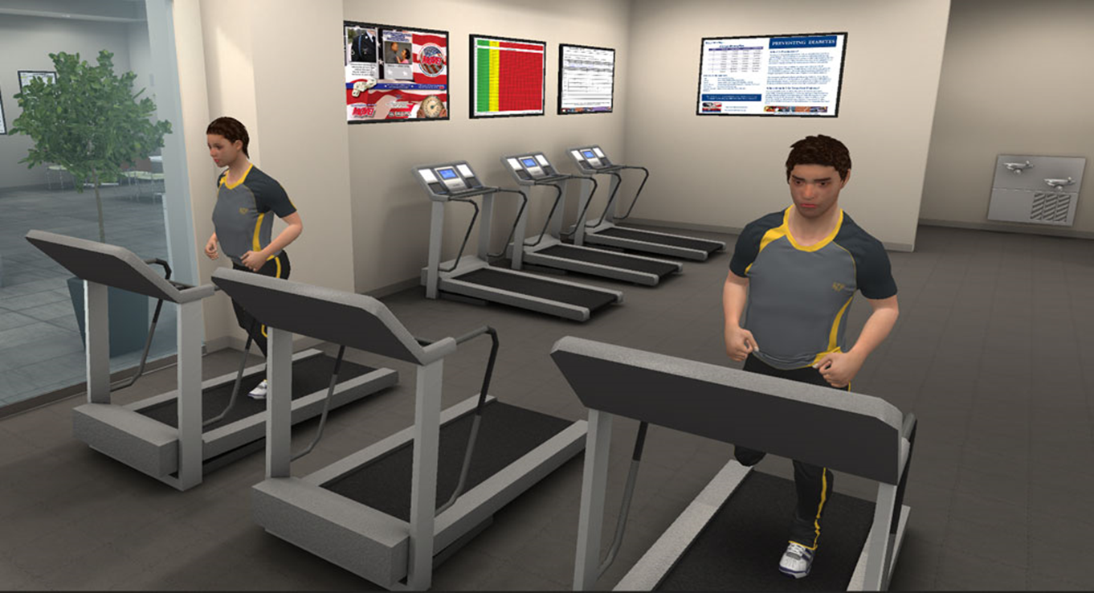
Virtual Medical Center-Fitness Center

Slide 16
Future Directions & Discussions
Using Kinect camera and televideo allows for direct capture of workload
Allows for quantitation of treatment plan progress by provider and patient
Medication adherence
Remote monitoring can allow for early detection of disease progression
Ongoing, lifelong wellness promotion for hypokinetic, neurologic, and neurodegenerative disease

Slide 17
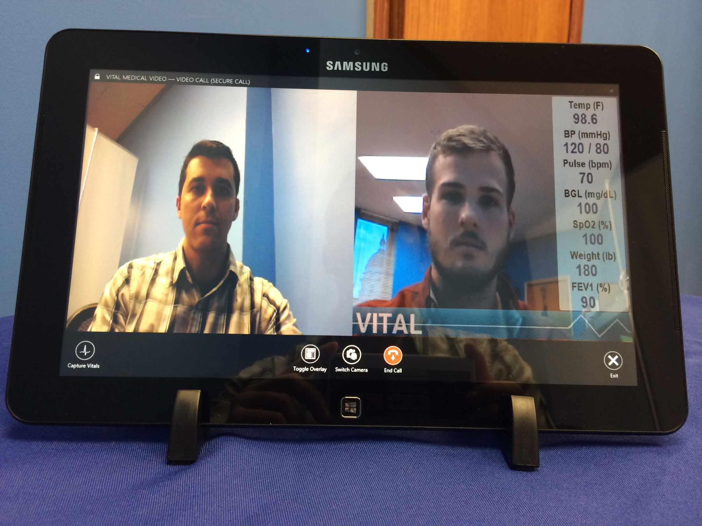

Slide 18
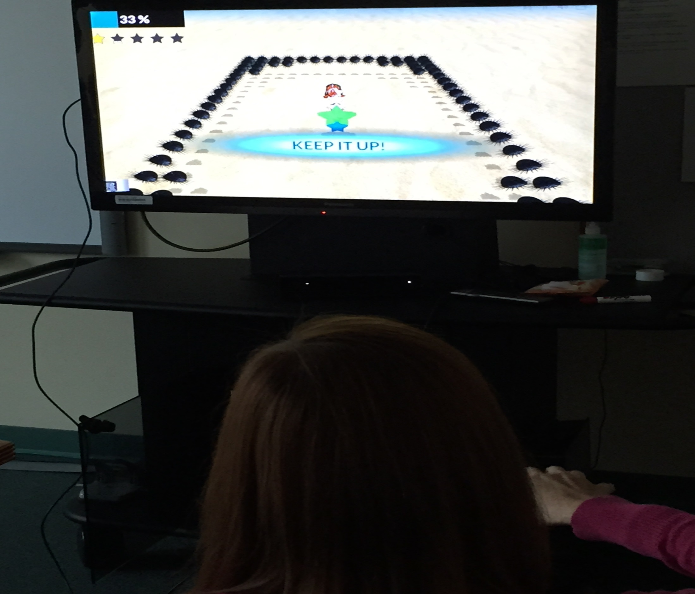
New Initiatives
VITAL+JINTRONIX

Slide 19
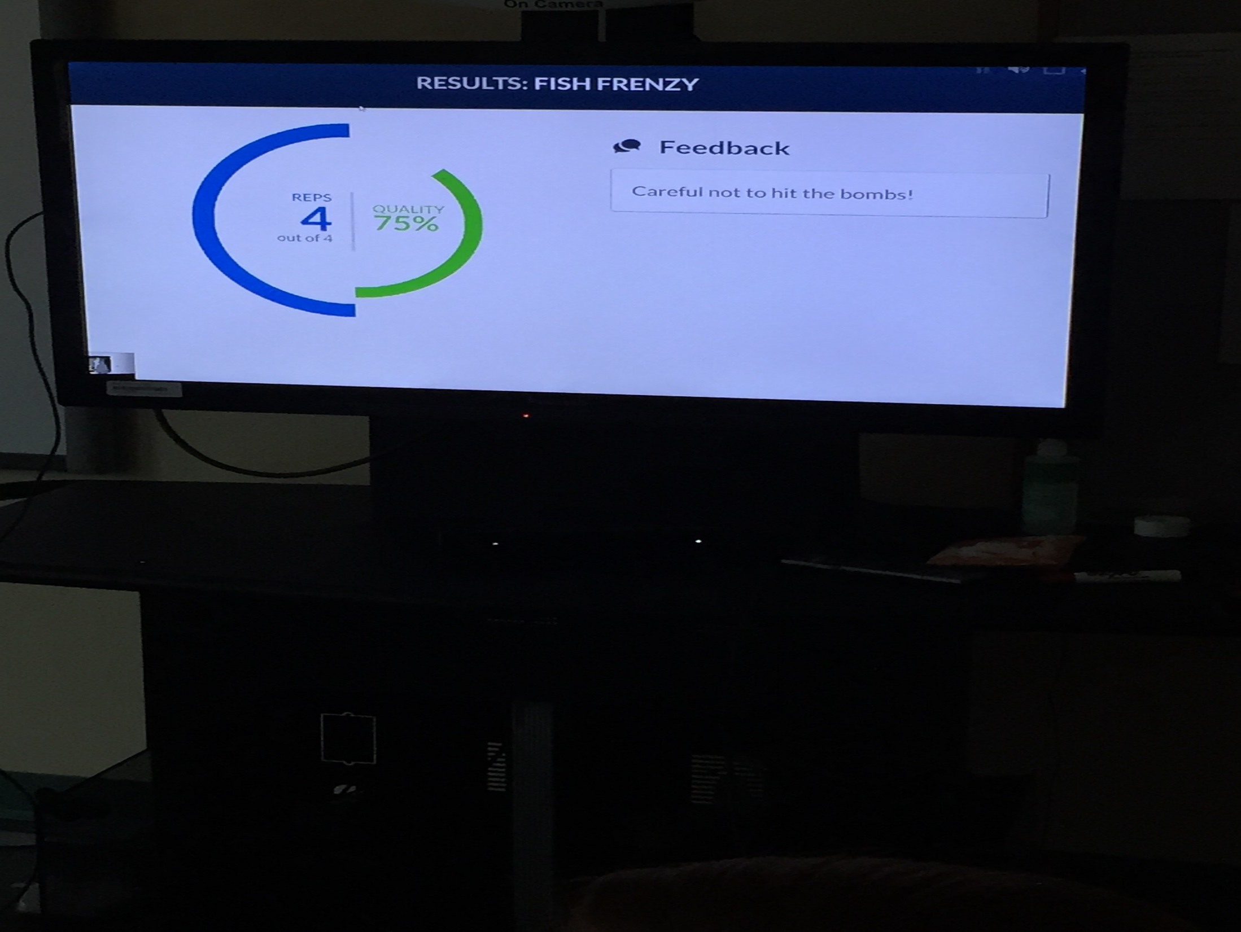
New Initiatives
VITAL+JINTRONIX

Slide 20
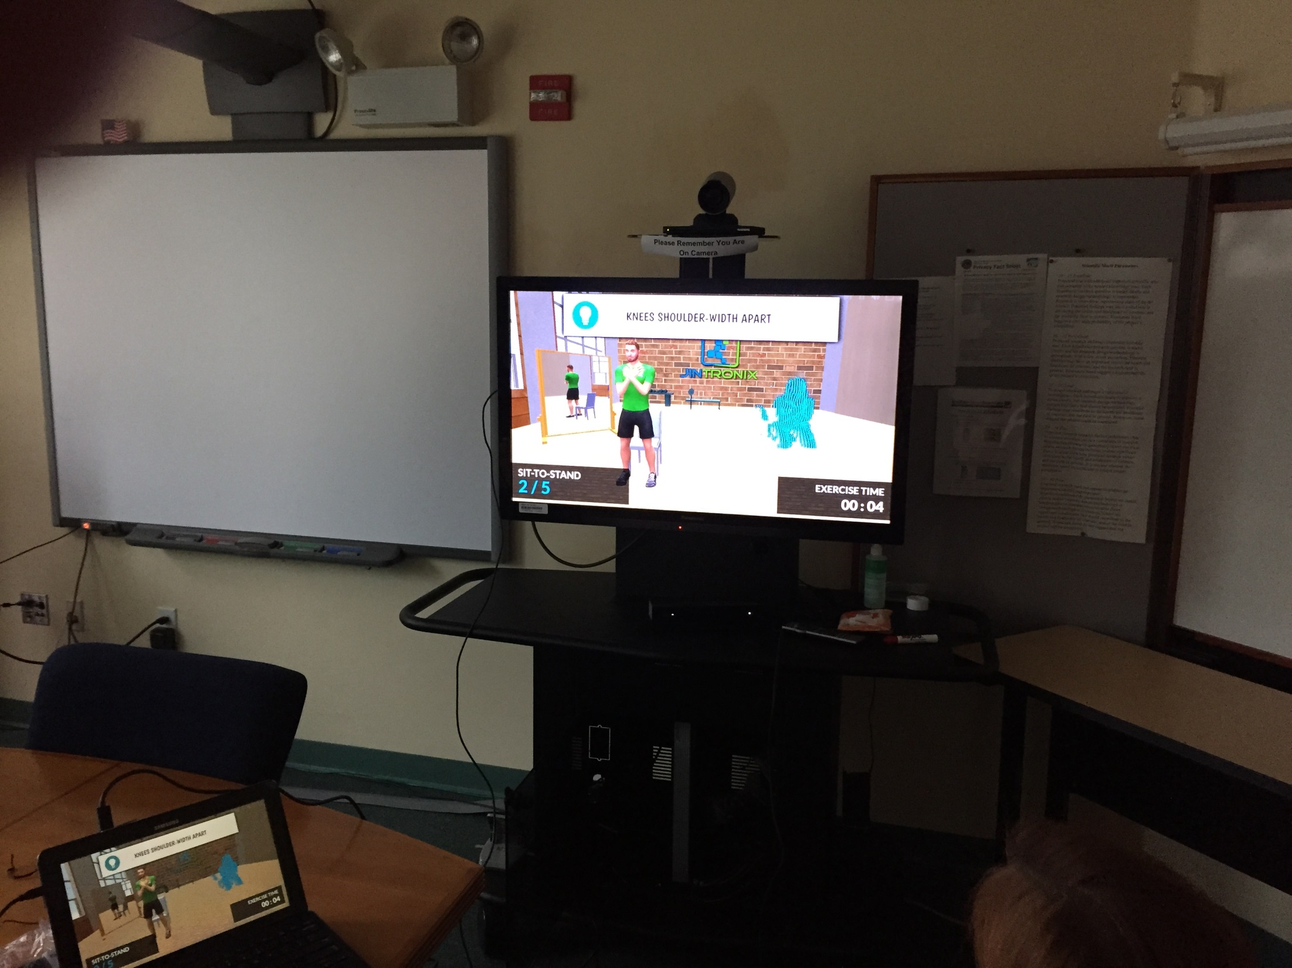
New Initiatives
VITAL+JINTRONIX

Slide 21
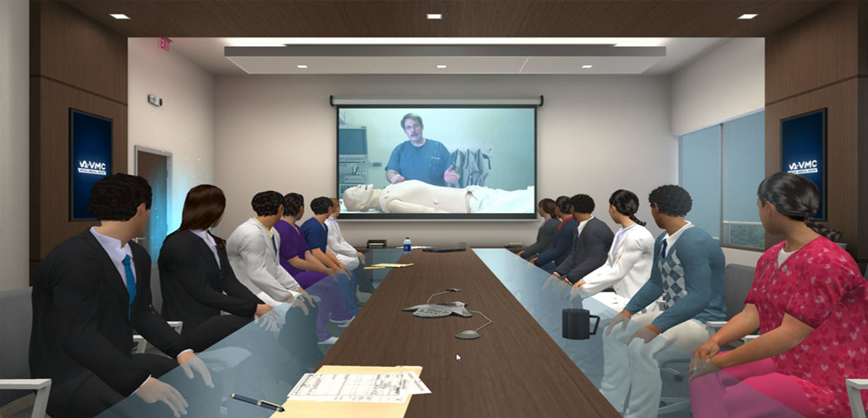
Virtual Medical Center-Conference Room

Slide 22

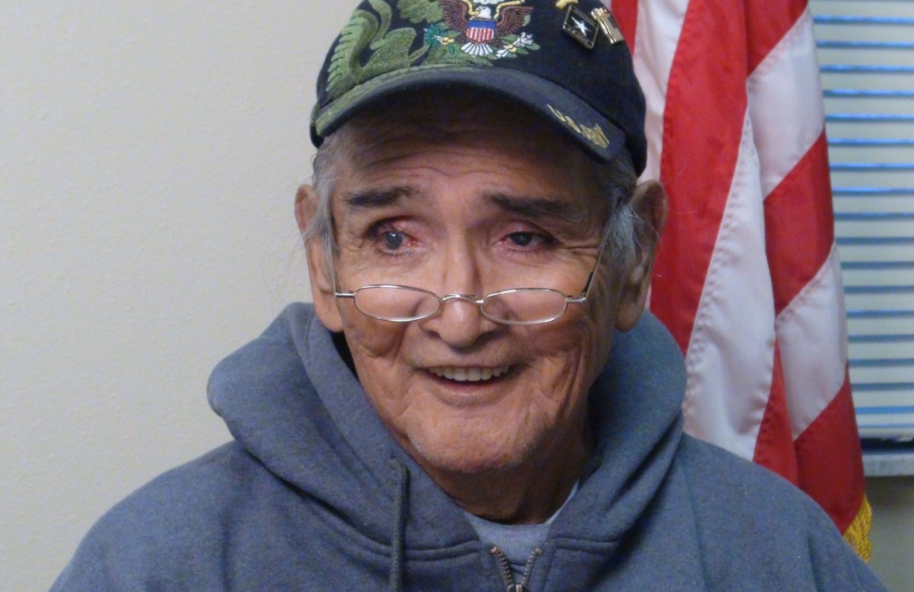
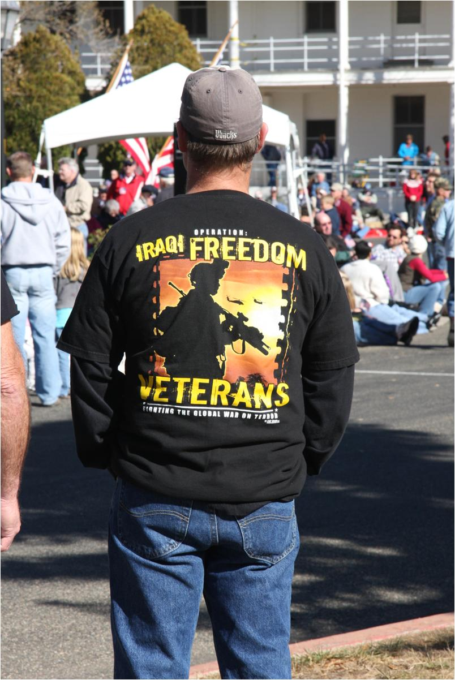

Thank You for Your Service

