Slide 1
Federal Communications Commission Task Force on Optimal PSAP Architecture
Working Group 2:
Optimal Approach to NG9-1-1
Implementation
Status Report
September 23, 2016

Slide 2
Introduction
David Holl, ENP, WG2 Chair

Slide 3
Introduction
Task Force on Optimal PSAP Architecture (TFOPA) released an Adopted Final Report January 29, 2016
Section 5 of the Report was titled “Optimal Approach to NG9-1-1 Architecture Implementation by PSAPs” and contained the initial efforts of WG2 in laying a foundational understanding of the various component parts of the Next Generation 9-1-1 environment.
Part of this work was to initiate a discussion and understanding of what we termed the
NG9-1-1 “Ecosystem”

Slide 4
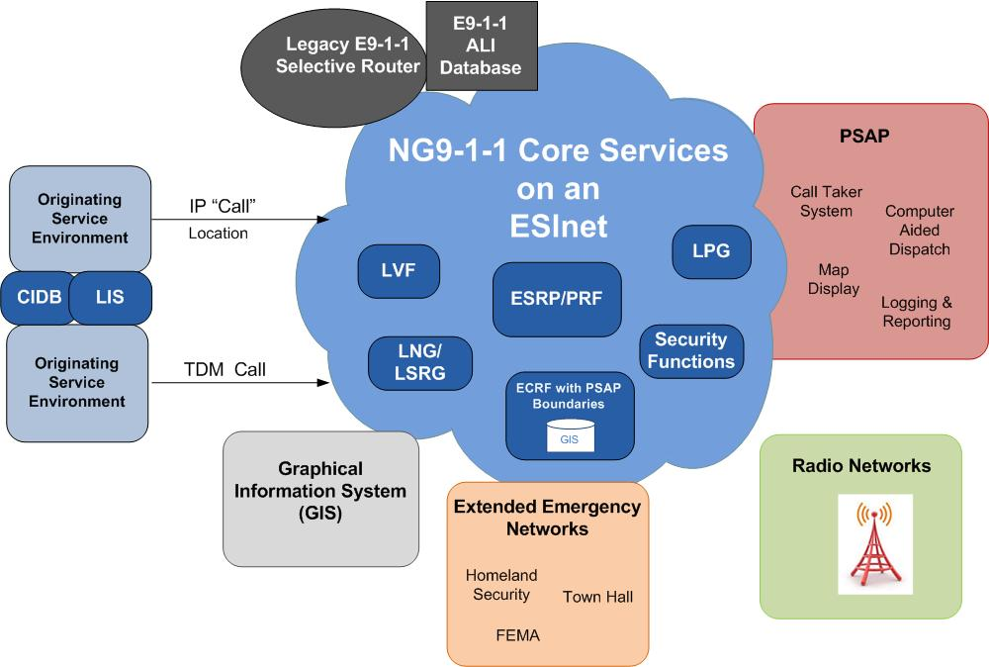
NG9-1-1
EcoSystem

Slide 5
NG9-1-1 Transition Steps

Slide 7
NG9-1-1 Foundational Elements
9-1-1 Authorities need to develop an understanding of the steps appropriate for them and their specific situation
There are three primary capabilities or “Foundation Elements” that must be established to prepare for NG9-1-1:
ESInet (transport network)
IP PSAP (i3 capable)
GIS Data Preparation
These elements do not necessarily need to be accomplished simultaneously or in any particular order, but will be driven by the 9-1-1 Authorities goals and NG9-1-1 transition plan

Slide 8
NG9-1-1 Deployment Chart
ESInet deployment
Deployed locally, operated regionally according to state standards
Integrated technology supports multiple PSAPs
Based upon NENA i3 standards
Statewide GIS Repository created for LVF & ECRF
NG9-1-1 GIS database created
Based upon NENA i3 standards
Security plan implemented and deployed
CSRIC and NGSEC integrated into state plan
Based upon NENA i3 standards
NG9-1-1 Core Services
ESRP/ECRF/PRF
Based upon NENA i3 standards
LVF when needed
Applications
Identify and deploy enhanced applications
Integrate with NG9-1-1, PSAP and other operating environments, as appropriate.
Based upon NENA i3 standards
Security
GIS data

Slide 9
NG9-1-1 Transition Planning Essential
9-1-1 Authorities need to understand that NG91-1-1 is a NEW Paradigm in 9-1-1 technology and processes
9-1-1 Authorities need to develop an in-depth NG9-1-1 transition plan
With proper planning, Next Generation 9-1-1 Core Services, as described in Working Group reporting, can be implemented in a reasonable time frame
Through economies of scale 9-1-1 Authorities can minimize transitional costs and maintain positive outcomes with maximum fiscal responsibility

Slide 10
Introduction
WG2 Subgroup Divisions
NG911 Framework
NG911 Scorecard
NG911 Training and Education
NG911 Transport - ESInet Implementation Case Studies – Lessons Learned
Each group is tasked with research, analysis, and discussions pertaining to their subject area(s) and developing drafts of the anticipated final report sections and recommendations. WG2 holds weekly conference calls to discuss subgroup work.

Slide 11
Task 2A – NG9-1-1 Planning Framework
Roger Hixson

Slide 12
Task 2A – NG Planning Framework
WG 2A members:
Roger Hixson – co-lead
Bill Mertka – co-lead
Bob Brown
Dusty Rhoads
Bernard Aboba
Mark Fletcher
Chuck Vick
Mike Nelson
Jim Goerke
Jeff Wittek

Slide 13
Task 2A – NG Planning Framework
Objectives: Expansion of Report 1’s content to support specific NG9-1-1 planning efforts by 9-1-1 Authorities
Guidance document for 911 authorities planning their transition to NG911
Implementations following state and local considerations using the TFOPA Final Report (January 2016) in planning for an optimal configuration of the necessary components
Combining narrative and diagrams
Integration with the NG9-1-1 Readiness Checklist (SG 2B)
Begin by describing current 9-1-1 environment
(support readers who do not have the basics, because they weren’t around for E9-1-1 implementations)

Slide 14
Task 2A – NG Planning Framework
Planning for Transition utilizing the 2015 Report content
Report Structure:
Readiness and Readiness Assessment
The Need for Planning and Strong Governance
OSE Access to NG9-1-1 Systems locally and nationally
Governance and Planning for NG9-1-1 central Core Services
ESInet transport network planning

Slide 15
Task 2A – NG Planning Framework
Report Structure (cont’d)
PSAP Planning and Transition (assumed part of 2B content)
Interaction with Responder Broadband Networks
Pros and Cons for County, region, State, and multi-state hosted options
Considerations and Recommendations
Appendices

Slide 16
Task 2A – NG Planning Framework
Status:
SG 2A meets weekly, and will meet as necessary as final content is developed and reviewed
About 70% of text is drafted and in review
Coordination with the SG 2B Checklist is underway
Conduct additional discussions with other Workgroups to insure alignment

Slide 17
Task 2B – NG911 Scorecard
Jeff Wittek

Slide 18
Task 2B – NG911 Scorecard
WG2B MEMBERS
Dave Holl, WG2 Chair
Mary Boyd, WG2B Subgroup Co-Chair
Jeff Wittek, WG2B Subgroup Co-Chair
Alfredo Bocanegra
April Heinze
Bob Brown
Dusty Rhoads
Laurie Flaherty
Mark Fletcher
Mike Nelson
Jim Goerke
Joe Heaps
Roger Hixson

Slide 19
Task 2B – NG911 Scorecard
TASK
Development of a NG9-1-1 Readiness Scorecard describing the operational, technical, cyber, and workforce factors that would constitute declaring a PSAP “NG911 Ready.”
From a cyber perspective the scorecard will include the minimum identity, credentialing, and access management measures (iCAM) that need to be in place for a PSAP to be considered “NG911 ready”.

Slide 20
Task 2B – NG911 Scorecard
WORK TO DATE
WG2B subgroup meeting weekly
During those meetings the subgroup has dealt with several fundamental issues;
NG911 Definition
NG911 Implementation Maturity Continuum
NG911 Implementation Maturity State Definitions
Identification of key NG911 required elements (components, functions, processes and procedures) and their placement within the NG911 Implementation Maturity Continuum
WORK PRODUCT
DRAFT NG911 Readiness Scorecard spreadsheet created

Slide 21
Task 2B – NG911 Scorecard
NEXT STEPS
Finalize certain NG911 Readiness Scorecard sections
Conduct additional discussions other Workgroups to insure alignment
Transfer NG911 Readiness Scorecard into report format

Slide 22
Task 2B – NG911 Scorecard
REPORT STRUCTURE
Introduction
Project Scope
Limitations
What is NG911?
NENA NG911 Definition
How the NG911 Readiness Scorecard further defines NG911
NG9-1-1 Transition
National 9-1-1 Program Office NG911 Implementation Maturity Model
Maturity State Definitions
NG911 Readiness Scorecard Implementation Maturity Continuum
Maturity State Definitions
Glossary of Terms

Slide 23
Task 2B – NG911 Scorecard
REPORT STRUCTURE
NG911 Readiness Scorecard & Explanation
Purpose
Benefit
Structure
Usage
Self-Assessment Matrix & Explanation
Purpose
Benefit
Structure
Usage
Appendices

Slide 24
Task 2C – Training and Education
April Heinze

Slide 25
Task 2C – Training and Education
WG2C MEMBERS
Dave Holl, WG2 Chair
Mary Boyd, WG2C Subgroup Co-Chair
April Heinze, WG2C Subgroup Co-Chair
Patti West
Alfredo Bocanegra
Mark Fletcher
Bradley Blanken

Slide 26
Task 2C – Training and Education
TASK
Study workforce challenges associated with the NG911 Architecture described in the Final Report, with special considerations to:
Potential staffing impacts and requirements for PSAPs and any shared resource facilities for NG911
Identify any operation guidelines for proper use of facilities and/or shared services that may need to be created.
Determine Cybersecurity training and education that will need to be created.

Slide 27
Task 2C – Training and Education
STAFFING IMPACTS
Technical
Alarm Processing
GIS Data
MSAG/GIS Routing
Recording
Cutover

Slide 28
Task 2C – Training and Education
OPERATIONAL CONSIDERATIONS
Project Management
Updating PSAP 9-1-1 Plans and/or Strategic Plans
Identify All Operational Impacts
Hiring Considerations
Standard Operating Procedures
Training
Ongoing Operational Review

Slide 29
Task 2C – Training and Education
TECHNICAL CONSIDERATIONS
Most PSAPs do not have their own IT or GIS employees
PSAPs must evaluate the impacts of the workload level for:
Implementation
overall system care
alarm processing
recording needs
on-going maintenance
GIS data accuracy levels
MSAG/GIS routing

Slide 30
Task 2C – Training and Education
Workgroup Progress To Date
WG2C subgroup meeting weekly
Report framework is completed
Draft is in progress
Next Steps
Will work with WG2B to incorporate necessary checklist items into the training and education document
Will work with WG1 to incorporate cybersecurity training and educational needs

Slide 31
Task 2D – ESInet Lessons Learned
Alicia Burns

Slide 32
Project OBJECTIVES
Interview various ESInet Deployment “early adopters”
Gleaning information :
Best Practices
Overall Challenges
Lessons Learned

Slide 33
PROCESS
As a separate sub-group effort :
Conduct a series of Interviews/User Case Studies
Selected Guest speakers from a variety of ‘Early Adopter’ ESInet deployment situations (statewide, regional, local, etc.).
Each Guest Speaker would address a set of common, ‘data gathering’ type questions related to areas of interest (challenges, lessons learned, and funding, architecture, cybersecurity, etc.)

Slide 34
PROCESS
All entities we spoke with, were asked the same, common set of criteria and questions.
Areas covered included:
1. Planning
2. Procurement/financials
3. Implementation
4. Ongoing Operations
If you started the project over today, what 3 things would you change?

Slide 35
UPDATE
Interviews with 5 PSAP entities have been completed
State of Maine
State of Iowa
State of Massachusetts
Palm Beach County Florida
NCTCOG – North Central Texas Council of Governments

Slide 36
UPDATE
Status
We’re finishing interviews. Remaining sites include: State of Utah, BRETSA/Boulder County CO, State of Indiana, and State of Minnesota.
Completing the summaries for each, analyzing/trending the responses we got, and drafting the executive summary for our final report.
Sharing these interviews with the entire TFOPA membership.
Coordinating with the other WG2/WG3 sub-groups, sharing information.

Slide 37
RESULTS
From the start, we recognized these ‘interviews’ would yield an incredible amount of invaluable information, for the ‘next guy’ PSAP who is getting ready.
Every one of our interviews to date, has done that, plus more!
From how they paid for it, how it went together, to what their struggles were, etc.
Collectively, our sub-group members all agree, a look into ESInet ‘early adopters/Lessons Learned is beneficial, and should be continued for some time to come. These completed interviews should be shared within the Public Safety industry, and stored in a library, available when requested.

Slide 38
WG2 Summary

Slide 39
WG2 Summary…
WG2’s continued goal is to further refine and define to component parts of the Ecosystem that is and will be Next Generation 9-1-1 to assist PSAPs, 9-1-1 Authorities, government interests, policy development groups and all parties committed to NG9-1-1 in the planning, framework, and implementation checklist (scorecard) necessary to move from legacy, to transitional, to fully deployed NG9-1-1

Slide 40
Ng9-1-1 migration and deployment planning
PSAPs should work with their 9-1-1 Authority to create an overall plan and progression chart for their particular situation
In cases where there is no established 9-1-1 Authority, PSAPs should first address their organizational approach and financial capabilities to move forward
A plan should include the basic migration steps explained above and move toward the more detailed functional capabilities and functional elements

Slide 42
Path Forward to NG9-1-1 Deployment
The overarching GOAL of WG2 in this Phase of TFOPA is to assist PSAPs, 9-1-1 Authorities, and all entities with vested interests in the advancement of NG9-1-1 Nationwide to develop a better understanding of where we are and were we need to go by putting forth a:
Planning Framework
Scorecard of NG9-1-1 Transitional Evolution
Education and Training Required for NG9-1-1
ESInet (transport medium) lessons learned

Slide 43
PSAP and 9-1-1 Authorities Challenge
The challenge for the 9-1-1 community is to openly embrace the new NG9-1-1 Paradigm and build new cooperative relationships for Planning and Implementing NG9-1-1 systems
With the tools that will be provided by this Working Group we believe conscientious members of the 9-1-1 community will continue to make progress in efficiently and effectively transitioning the 9-1-1 system from legacy to full deployment of NG9-1-1

Slide 44
Questions or Comments

