Slide 1

Federal Communications Commission
Task Force on Optimal
Public Safety
Answering Point Architecture
(TFOPA)
December 10, 2015
Working Group 2 Report:
Optimal
9-1-1 Service Architecture

Slide 2
Report Table of Contents presenters
Section 1/2: Executive Summary and Introduction
  Dave Holl
Section 3: Current PSAP Decentralized Environment
  Mary Boyd
Section 4: PSAP Optimization Environment
  Mario Derango, Jeff Wittek
Section 5: ESInet Optimization Considerations and Factors
  Chuck Vick
Section 6: Access and NG9-1-1 Core Service Implementation
  Roger Hixson
Section 7: Governance
  Laurie Flaherty
Section 8: NG9-1-1 Planning and Transition Considerations
  Dave Holl, Tony Montani
Section 9: Findings and Considerations
  Dave Holl

Slide 3
Section 1 & 2
Executive Summary and introduction
Working Group 2 Report:
Optimal
9-1-1 Service Architecture

Slide 4
Evolution of Next generation 9-1-1 Systems
Public Safety Answering Points (PSAPs) are the gateway for access to emergency services for the public
Over 5900 PSAPs nationally
More than 240 million emergency calls annually to 9-1-1 nationally
While 9-1-1 continues to perform admirably, communication technologies have evolved presenting new challenges and requirements for the 9-1-1 community

Slide 5
Current 9-1-1 System Implemented over 40 years ago
Founded on time-division multiplexing (TDM) circuit switched voice services technology, wireline phone systems managed by telephone companies are the platform for making and receiving calls to 9-1-1
Internet Protocol (IP) network based technologies are now replacing the TDM (legacy) system
Known as the “TDM-to-IP” transition, the copper infrastructure across the nation will eventually be completely replaced by IP enabled systems

Slide 6
transitions are not new in the technology realm
Estimates as of November 2013 indicated that nearly 38% of all U.S. households currently rely on wireless as their primary phone service
This reliance on wireless technology results in about 70% of all 9-1-1 calls being placed from wireless phones annually
Despite the enhanced multi-media capability of wireless and VoIP devices, a 9-1-1 caller can currently only employ the voice capability or, in limited jurisdictions, text

Slide 7
challenge for policy makers and
9-1-1 authorities
Legacy 9-1-1 systems are not capable of receiving the various forms of multi-media common among everyday telephone users today
9-1-1 Authorities have operated legacy 9-1-1 in relatively independent and isolated operational environments
Implementation of NG9-1-1 will require a significant change to current roles and responsibilities

Slide 8
Expanded nature of ng9-1-1
This report introduces the expanded nature of NG9-1-1 as including what we term the Originating Service Environment (OSE)
This environment includes IP call set-up, location determination, validation and delivery to ESInets across the country
Implementation of the NG9-1-1 architecture will require many 9-1-1 Authorities to begin evolving a vision of collaboration as they develop new models of 9-1-1 service delivery

Slide 9
WG2 Report
Developed with the intent to help clarify and educate decision-makers tasked with the critical responsibility to move from the current legacy 9-1-1 operational model to the Next Generation 9-1-1 configuration framework.
Working Group 2 divided their work into four distinct areas of the emerging NG9-1-1 environment:
  Emergency Services IP transport network (ESInet)
  Access and NG9-1-1 Core Services (NGCS),
  PSAP Terminating Equipment/Call-taking Support subsystems - Computer Aided Dispatch (CAD), Management Information Systems (MIS), Dispatching Equipment, etc.
  Governance

Slide 10
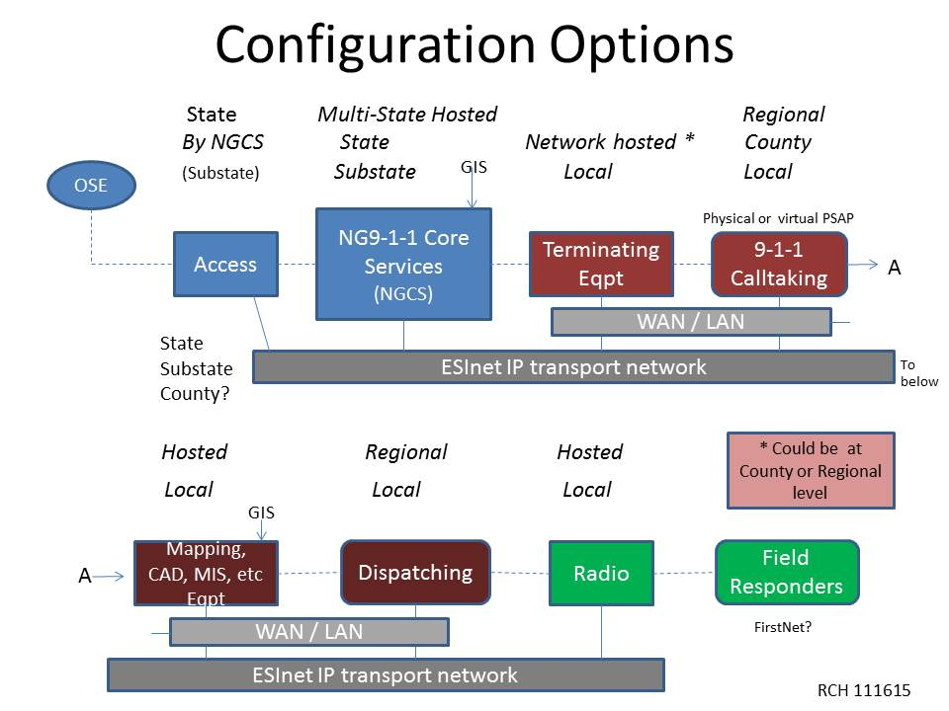

Slide 11
ultimate goal of NG9-1-1 deployment
The development and implementation of a standardized nationwide, interconnected “system of systems” for 9-1-1 emergency communications
NG9-1-1 systems in their transition and end states can allow and support significantly enhanced:
  redundancy
  real-time and alternate call routing
  improved call transfer capabilities
  multi-media capability
  additional data, and back-up improvements

Slide 12
This report
Discusses several potential architectural models for transitioning 9-1-1 Authority systems through the implementation and deployment of “Next Generation 9-1-1” (NG9-1-1) technology
It explores some of the basic operational and architectural possibilities available as well as the technical components, requirements, challenges and opportunities associated with deployment of NG9-1-1 systems, with significant focus on options for maximizing cost-effectiveness and efficiency
The new paradigm of NG9-1-1 will be based upon system roles in an emergency services ecosystem

Slide 13
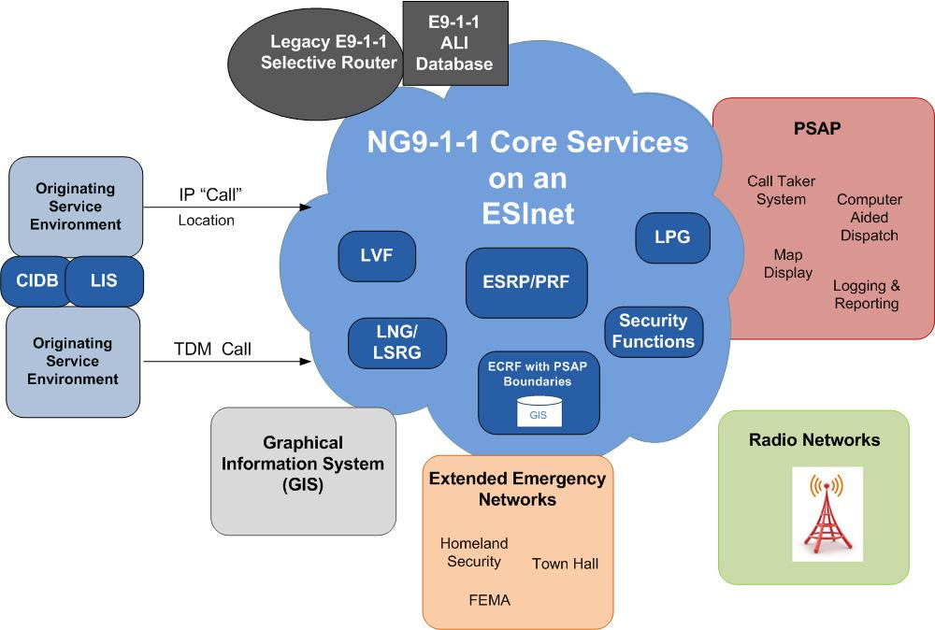
NG9-1-1
EcoSystem

Slide 14
New roles and responsibilities
Inevitably new roles and responsibilities will emerge as Originating Service Providers (OSPs) evolve to an Originating Service Environment (OSE) and Next Generation 9-1-1 Core Services (NGCS) are developed and implemented
9-1-1 Authorities, existing in the legacy environment, will also change as broadening of role and responsibilities occurs as more multi-jurisdictional, regional, statewide, or even multi-state relationships are organized

Slide 15
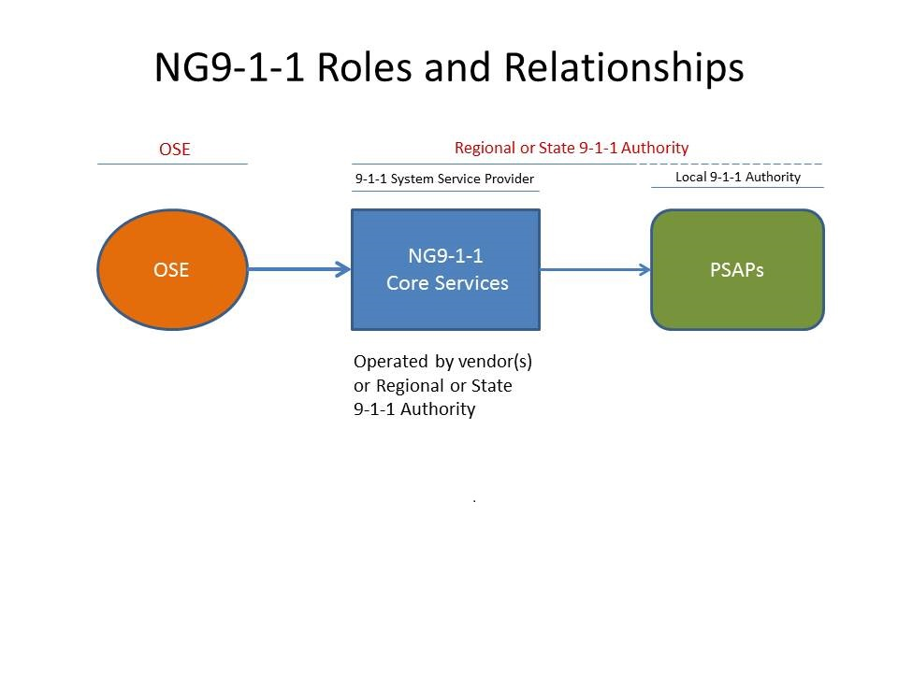

Slide 16
NG9-1-1 Deployment
Deploying Next Generation 9-1-1 capabilities is not a question of ‘if’, but rather ‘when’ the transition will occur
A primary message in this report is that NG9-1-1 architecture can be customized to support almost any configuration of PSAP operations
Factors that affect these configurations include financial, political, governmental and operational considerations

Slide 17
Section 3
Current PSAP Decentralized environment
Working Group 2 Report:
Optimal
9-1-1 Service Architecture

Slide 18
Current Decentralized PSAP legacy environment
The decentralized PSAP environment of today is prone to fragmentation and costly duplication
In the typical legacy environment, PSAP equipment and software are predominantly located within the boundary of each PSAP (though remote positions associated with a particular PSAP may be present).
A simplified diagram that follows illustrates the connections:

Slide 20
Legacy PSAPs operate independently and autonomously
In a legacy environment operations of a PSAP are typically handled within the confines of the PSAP itself and are dependent on serving those agencies identified within the PSAPs 9-1-1 Service Plan
Local telecommunications interoperability among PSAPs operating in this environment is limited to the transfer of calls to another PSAP that has been pre-identified by the PSAPs involved, and arranged through the serving Local Exchange Company (LEC)

Slide 21
PSAP Optimization Considerations
Optimization: Making the best, of anything.
A lot of people think PSAP optimization means consolidation. However, in a decentralized environment PSAPs can make the best of that environment in several ways. They can judge that decision based on:
Does it make sense:
  Operationally
  Financially
  Politically
Done correctly, they can optimize operations by:
  Sharing systems
  Joint purchasing
  Shared networks
  Shared staff

Slide 22
Section 4
PSAP optimization environment
Working Group 2 Report:
Optimal
9-1-1 Service Architecture

Slide 23
Basis of PSAP optimization
Assumes that Next Generation 9-1-1 Core Services and the ESInet have been considered
Whether deployed at the County, Regional or State level, the NG9-1-1 environment provides PSAP’s the flexibility to configure call flow and applications in a manner not previously available
It is not necessary for the Customer Processing Equipment (CPE) to be of the same manufacturer, and in larger deployments; e.g., regional or State, it is assumed that numerous CPE vendors will be in use

Slide 24
Optimized psap operational models
As NG9-1-1 becomes a reality, it will allow PSAPs the capability to organize and dynamically utilize partner PSAPs to assist during heavy call traffic situations and/or outages
Several optimization models are discussed in the report:
  Shared Services (Centralized)
  Hybrid
  Centralized Call Taking Center
  Consolidation by Discipline
  Virtual

Slide 25
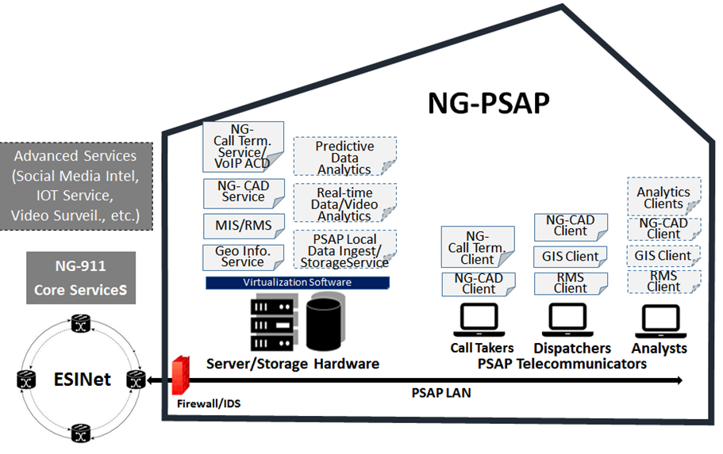
On-Premise Dedicated Infrastructure Architecture Model Example

Slide 26
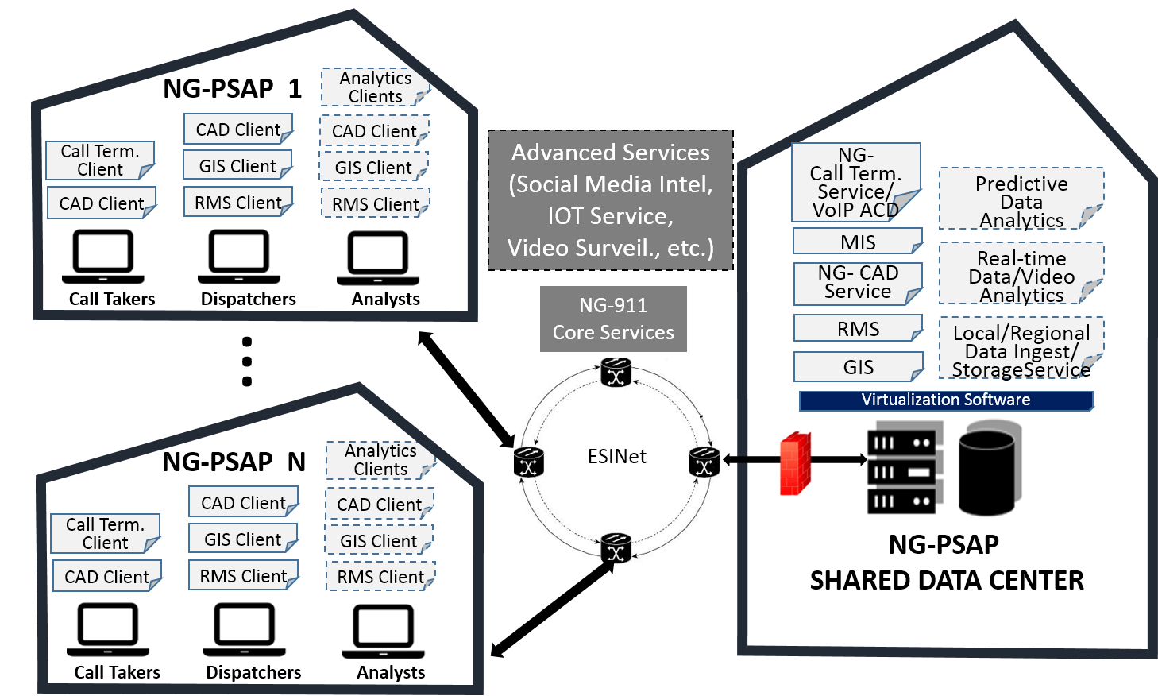
Sample Hosted, Shared Infrastructure Architecture Model

Slide 27
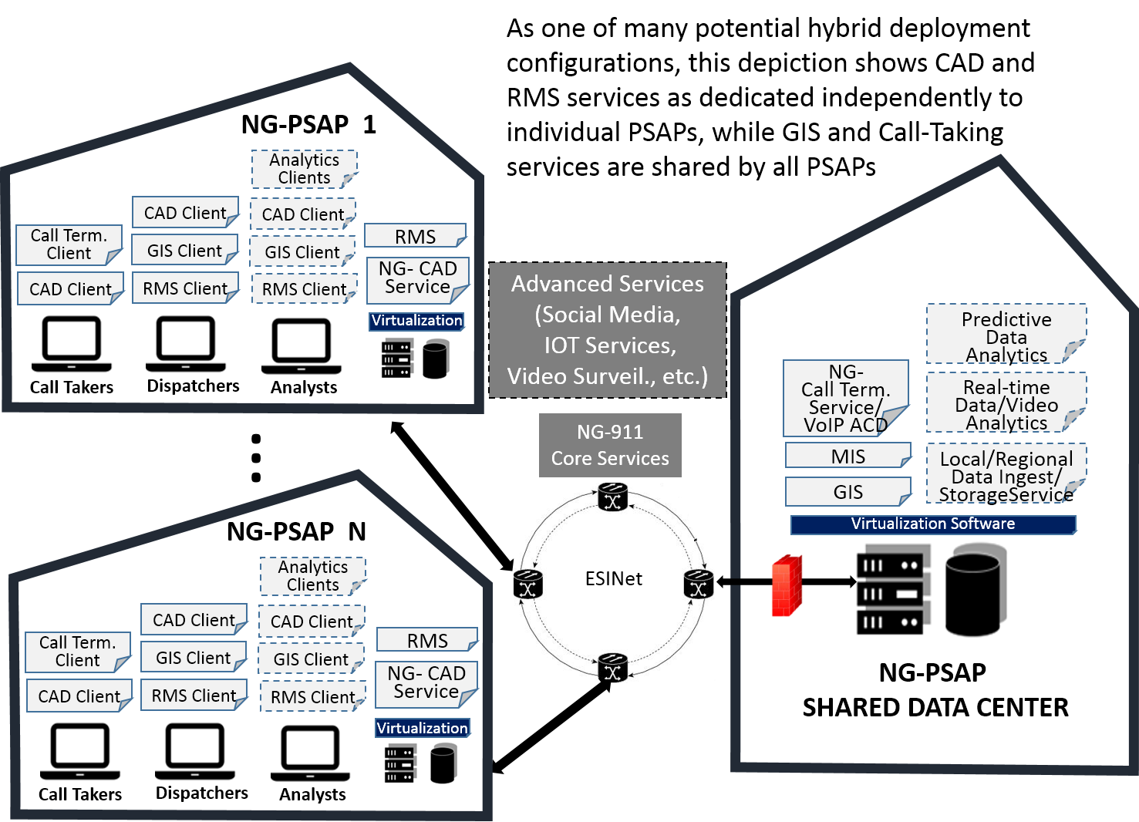
combining dedicated on-premise and shared services

Slide 28
Key optimization factors in a jurisdiction’s consideration of the optimization models
Financial
  Solution costs (e.g., equipment, capital expenditure/operational expense)
Interoperability
  Functional interoperability
  Geographic interoperability: local, county, multi-county, state, national
  Data sharing
Survivability/Reliability (Operational)
  Level of service redundancy
  Level of geo-diversity

Slide 29
Cont…
Elasticity/ Scalability
  Ability to adapt to unanticipated peak loads
  Ability to bring on additional jurisdictions without re-architecting
Security
  Information Security
  Cyber-attack resiliency
Operational Staffing
  Technical Support

Slide 30
Section 5
ESInet optimization considerations and factors
Working Group 2 Report:
Optimal
9-1-1 Service Architecture

Slide 31
ESINET
“An ESInet is a managed IP network that is used for emergency services communications, and which can be shared by all public safety agencies. It provides the IP transport infrastructure upon which independent application platforms and core functional processes can be deployed, including, but not restricted to, those necessary for providing NG9-1-1 services…”
  NENA document 08-506 “Emergency Services IP Network Design”

Slide 32
ESInet evolution
ESInets deployed today are primarily used for delivery of limited NG9-1-1 Services such as legacy Selective Router and ALI replacement
This limited ESInet Architecture norm will change as the NENA i3 vision is realized with Originating Service Providers (OSPs) providing data feeds, enhanced service providers establish interconnections with ESInets across the United States and ESInets become interconnected

Slide 33
ESInet categories of capability
ESInets consist of the following categories of capabilities. For the purposes of ESInet discussions and brevity, these categories are abstracted from generally accepted networking models:
  Transport
  Internet Protocol (IP) Services
  Management Infrastructure
  Security Infrastructure

Slide 34
ESInet Use cases
Local ESInet - local authority elects to host Next Generation Core Services (NGCS) within existing PSAP datacenters or facilities and maintains their own ESInet
Shared-Hosted ESInet - a regional entity authority (group of PSAPs, county, multiple counties or state) elects to host Next Generation Core Services (NGCS) on a shared ESInet
Hybrid ESInet - some elements of the Shared Hosted ESInet are combined with elements that are contracted
Contracted, Managed ESInet - This is a “shared” network between multiple served PSAP tenants, which could scale from small region to nationwide. The ESInet managed service vendor builds and maintains the ESInet

Slide 35
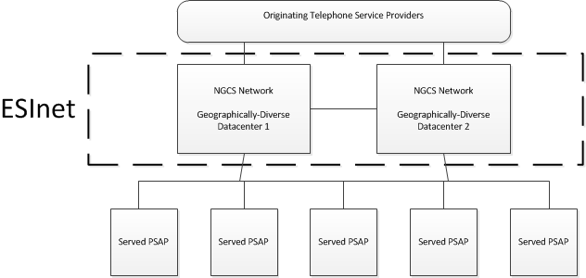
Hosted ShareD ESInet Deployment Models

Slide 36
Network Monitoring &
Operational Metrics
The ESInet should be monitored 24x7 by a Network Operations Center with visibility across the network
Network elements should be alarmed
Priority should be established for network alarms with service impacts taking top priority
Potential service disruptions such as the loss of redundancy should also be prioritized
Clear rules and responsibilities need to be established and to the extent possible one party have accountability for coordinating across these entities for maintenance and restoral efforts

Slide 37
ESInet reliability
Emergency communication networks strive to be reliable with high availability
Five nine’s (99.999%) is the goal for availability of these networks and is achieved through various means focused on diversity, redundancy, and alternate routing
While five nine’s is the generally accepted minimum availability service level, it should be noted that this equates to only 5.26 minutes of unscheduled downtime or service unavailability annually

Slide 38
Section 6
Access and ng911 core service implementation
Working Group 2 Report:
Optimal
9-1-1 Service Architecture

Slide 39
NG9-1-1 Service System
NG9-1-1 implies routing a call based on a caller’s location information as provided by the Originating Service Environments (OSE) (a combination of Originating Service Provider, Network Access Provider, Location Information Provider and SmartPhone Apps provider).
A 9-1-1 service system in its simplest form is illustrated in the following diagram:

Slide 40
9-1-1 service system in its simplest form

Slide 41
9-1-1 service system covering multiple authority regions
Additional complexity is added when it is necessary to determine the responsible Public Safety Authority, as illustrated below (e.g., where the OSP’s territory potentially covers multiple PSAPs or Public Safety Authority regions)

Slide 42
where the OSP’s territory potentially covers multiple PSAPs or Public Safety Authority regions

Slide 43
Specific ng9-1-1 ACCESS IMPLEMENTATION OPTIONS
NG9-1-1 architecture concepts and functional services do not assume that the Originating Service Environment (OSE) necessarily knows who the PSAP and/or 9-1-1 Authority is for a given geographic area
In the legacy model the service area of TDM switches was coincident with one (or a few) PSAP(s)
In an IP based world, the user could be in any PSAP and 9-1-1 Authority’s jurisdiction

Slide 44
Specific ng9-1-1 ACCESS IMPLEMENTATION OPTIONS
NG9-1-1 requires services that make it possible to determine the appropriate 9-1-1 Authority’s NG9-1-1 network, in order to then be routed to the appropriate PSAP within that NG9-1-1 system
The OSE has several operations that require interaction with a Public Safety Authority:
  Validate Location Information
  Determine the appropriate Public Safety Authority to receive a 9-1-1 call or message
  Obtain a copy of the rules to validate location information (LVF function)

Slide 45
Call routing and forest guides
In order to determine the appropriate Public Safety Authority an NG9-1-1 service (i.e., Forest Guide) is provided that allows OSEs to query and determine the responsible Public Safety Authority or representative of the Public Safety Authority
The general Forest Guide concept is a tree structure where an OSE queries at the level for which they know the subscriber/user resides.

Slide 46
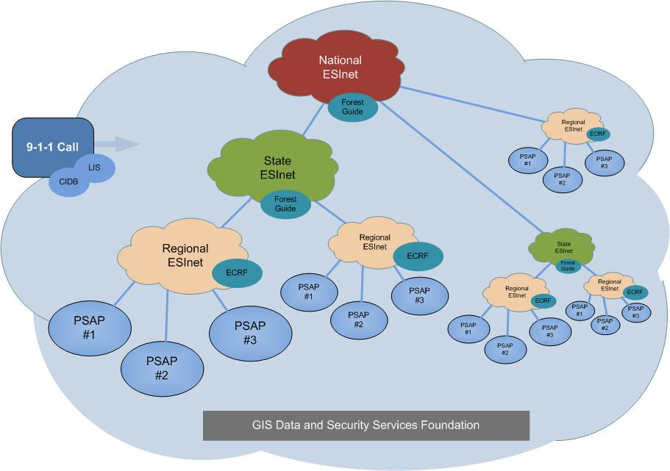
GIS Data and Security Services Foundation

Slide 47
Cooperative sharing of geographic polygons
The concept of Forest Guides requires cooperative sharing of the respective geographic polygons that define Public Safety Authority’s service area
These mechanisms are complex and have many issues to resolve with respect to sharing and change management
The need to dynamically determine responsible Public Safety Authorities is a NENA i3 end-state architecture requirement

Slide 48
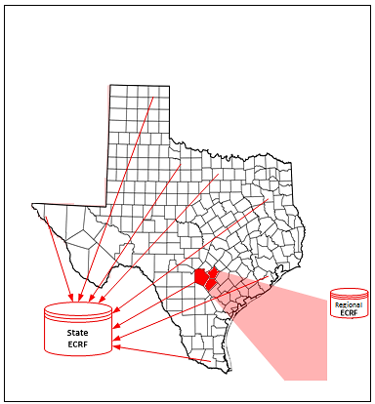
State Forest Guide Hierarchical Roll Up

Slide 49
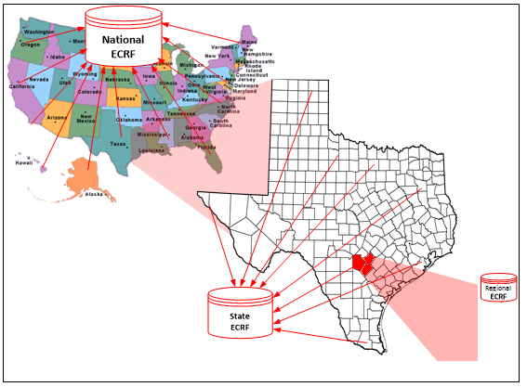
Forest Guide Hierarchical
Data Roll Up

Slide 50
NENA i3 Vision
The NENA i3 vision Long Term architecture standard changes the processing model for 9-1-1 calls and defines different responsibilities for both the 9-1-1 Service Provider and the OSE
The biggest changes evolve around the use of Geographical Information System (GIS) technology and the OSE providing the caller’s location

Slide 51
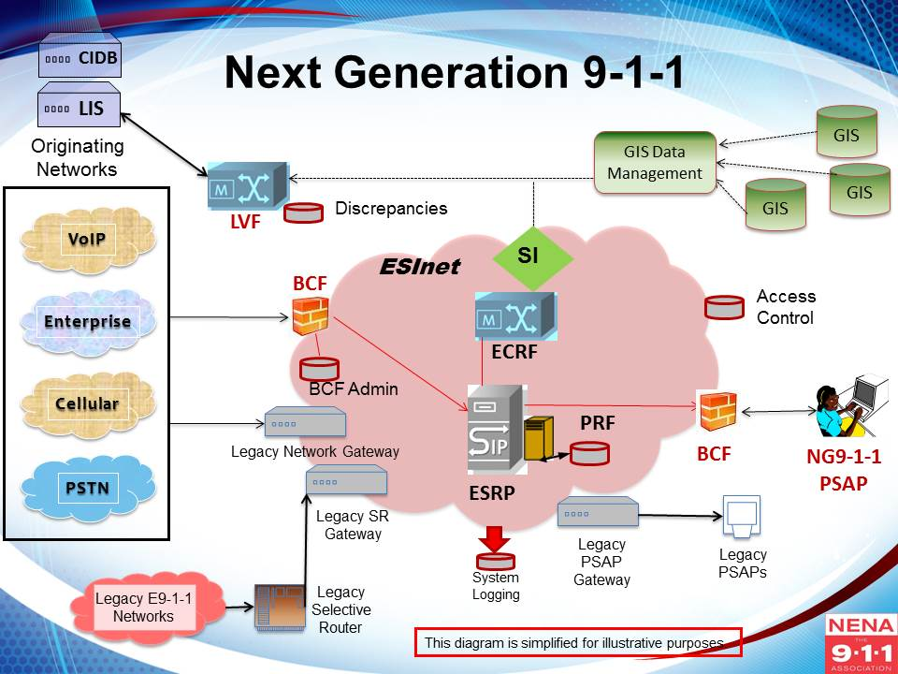
NENA i3 NG9-1-1 Vision

Slide 52
Section 7 governance
Working Group 2 Report:
Optimal
9-1-1 Service Architecture

Slide 53
Moving from Independent to Interconnected 9-1-1
The first 9-1-1 systems were responsible for a specific area or region and operated independent of each other, governance was naturally decentralized
The advent of NG9-1-1 will change the 9-1-1 governance model and basic elements of the 911 “culture”
NG9-1-1 increases the opportunity for PSAPs to share resources and to cooperate and collaborate at multiple levels with potentially greater economic and technical efficiencies

Slide 54
Moving from Independent to Interconnected 9-1-1
The extent to which any jurisdiction can address resource sharing is dependent on its willingness to share not only resources, but also dedicated control of infrastructure and operations.
NG9-1-1 supports standardized operational models that promote resource sharing and interoperability.
With migration to NG9-1-1, many more combinations and permutations of roles, relationships, and considerations are required

Slide 55
Moving the Sharing Process Forward
PSAP managers, 9-1-1 Authorities and their governing bodies, will ultimately have to decide whether to remain independent or share resources, and are responsible for the consequences of those decisions
If they decide that for certain technical, operational or financial aspects, there’s value in working together, it will become important to establish the parameters and processes of their business relationship

Slide 56
NG9-1-1 Sharing Opportunities Analysis
NG9-1-1 decision-makers have competing priorities and limited funds. As a result, an analysis of those costs and benefits can assist in making the best implementation choice for their jurisdiction
Some of the factors in this cost benefit analysis process may include infrastructure design, quality of service, resiliency, redundancy, reliability, and operational efficiency
Best practices in these elements are in place and/or evolving

Slide 57
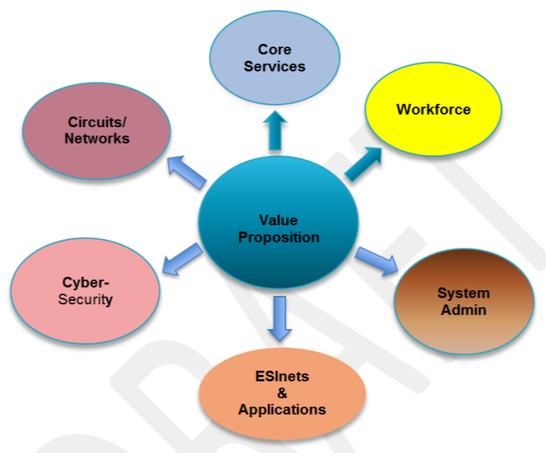
Value Proposition considerations

Slide 58
9-1-1 Authorities
NENA describes a “9-1-1 Authority” as a:
  . . . State, County, Regional or other governmental entity responsible for 9-1-1 service operations. For example, this could be a county/parish or city government, a special 9-1-1 or Emergency Communications District, a Council of Governments or other similar body.

Slide 59
Multiple 9-1-1 Authority Arrangements
Single 9-1-1 Authority – can provision a NG9-1-1 system. Then governance, oversight and operation of the system is logically the responsibility of that entity.
Multiple 9-1-1 Authorities - multiple 9-1-1 authorities may be engaged, and new intergovernmental arrangements must be developed to oversee the service environment desired – arrangements that provide a fair and equal role for all the 9-1-1 authority stakeholders involved.

Slide 60
New Forms of 9-1-1 Authority Benefits
Migration to NG9-1-1 provides the opportunity for PSAPs and jurisdictions to share resources at a level not possible in the legacy environment
The nature of existing governance models, and the relationships between and among jurisdictions, will directly impact how, and to what extent, the NG9-1-1 model is deployed and the extent to which their citizens will realize its benefits

Slide 61
Section 8
NG9-1-1 planning and transition considerations
Working Group 2 Report:
Optimal
9-1-1 Service Architecture

Slide 62
NG9-1-1 Transition
The movement toward nationwide Next Generation 9-1-1 continues to be an evolving process
Most PSAPs continue to function in ‘Legacy 9-1-1’ configurations, a number can be considered to be ‘Transitional’
As of the time of this report no 9-1-1 Authority has attained a ‘Fully Functional NG9-1-1’ implementation

Slide 63
NG9-1-1 Transition Steps

Slide 64
NG9-1-1 system services environment
The operating domains - OSE, NG9-1-1 Core Services Providers, and PSAPs operate together to provide complete 9-1-1 services
OSE delivers “calls” to NG9-1-1 Core Services Providers who route those requests for assistance to the proper PSAPs
These operating domains are interconnected via the ESInet, which provides IP transport and other networking services
A diagram of this NG9-1-1 Services System Environment follows:

Slide 65
NG9-1-1 System Services environment

Slide 66
New Collaborative PSAP Authorities Will Need to emerge
Ultimately, 9-1-1 Authorities need to make decisions necessary to begin the transition process
In most cases, these governance decisions will not be made by single PSAP Authorities even though they currently may have self-contained legacy 9-1-1 systems
Instead, new coalitions and collaborations of cooperative PSAP Authorities, at various levels, will need to evolve and work together to achieve economies of scale

Slide 67
The escalated cost of delayed evolution to ng9-1-1
The evolution strategy from legacy 9-1-1 to NG9-1-1 is critical to 9-1-1 Authorities due to the complexities involved and costs imposed by duplication
Conversion delays, which create a combined legacy network and Next Generation 9-1-1 architecture, will require funding overlapping systems
The 9-1-1 Authority will bear larger costs while the two-system hybrid architecture remains in place

Slide 68
dual environment where the legacy Selective Router is maintained and PSAPs are served by either the legacy Selective Router or NG9-1-1 Core Services

Slide 69
Transitional ng9-1-1
An important understanding in this transition planning process will be for the 9-1-1 Authority to have a true appreciation for what is involved in the NG9-1-1 ecosystem from a technology and functionality position
In NG9-1-1 configurations, through the establishment of Emergency Services IP networks, NG9-1-1 Core Services can reside anywhere on the network and can be economically shared in collaborative environments as depicted in the following diagram:

Slide 70
Transition TO NG9-1-1

Slide 71
NG9-1-1 Transition Planning essential
9-1-1 Authorities should develop an in-depth NG9-1-1 transition plan
With proper planning, Next Generation 9-1-1 Core Services, as described in Working Group 2’s report, can be implemented in a reasonable time frame
Through economies of scale 9-1-1 Authorities can minimize transitional costs and maintain positive outcomes with maximum fiscal responsibility

Slide 72
NG9-1-1 Foundational elements
9-1-1 Authorities need to develop an understanding of the steps appropriate for them and their specific situation
There are three primary capabilities or “Foundation Elements” that must be established:
  ESInet
  IP PSAP
  GIS Data Preparation
These elements do not necessarily need to be accomplished simultaneously or in any particular order, but will be driven by the 9-1-1 Authorities goals and NG9-1-1 transition plan

Slide 74
NG9-1-1 Deployment chart
ESInet deployment
Deployed locally, operated regionally according to state standards
Integrated technology supports multiple PSAPs
Based upon NENA i3 standards
Statewide GIS Repository created for LVF & ECRF
NG9-1-1 GIS database created
Based upon NENA i3 standards
Security plan implemented and deployed
CSRIC and NGSEC integrated into state plan
Based upon NENA i3 standards
NG9-1-1 Core Services
ESRP/ECRF/PRF
Based upon NENA i3 standards
LVF when needed
Applications
Identify and deploy enhanced applications
Integrate with NG9-1-1, PSAP and other operating environments, as appropriate.
Based upon NENA i3 standards
Security
GIS data

Slide 75
Ng9-1-1 migration and deployment planning
PSAPs should work with their 9-1-1 Authority to create an overall plan and progression chart for their particular situation
In cases where there is no established 9-1-1 Authority, PSAPs should first address their organizational approach and financial capabilities to move forward
A plan should include the basic migration steps explained above and move toward the more detailed functional capabilities and functional elements

Slide 76
Section 9 summary, FINDINGS, CONSIDERATIONS, and conclusion
Working Group 2 Report:
Optimal
9-1-1 Service Architecture

Slide 77
Summary
This work is not exhaustive
Additional guidance needs to be developed to best make use of this information, and we encourage the Federal Communications Commission to charter such efforts as part of the 2016 TFOPA initiative
Potential topics to be explored could be:
  potential costs of transition
  comparative early developer use cases
  additional study of access for people with speech and hearing disabilities
  integration of applications which provide access to the 9-1-1 system

Slide 78
Summary
The Working Group is aware that communications and communications technologies like the Internet of Things (IoT), Over The Top apps (OTT), analytics, and other new networking technologies continue to rapidly evolve and will eventually become part of the public safety ecosystem
As the public safety technology ecosystem expands, how the new technologies and capabilities will be integrated into the NG9-1-1 environment and effect emergency responses will be an important consideration for future study and analysis

Slide 79
The ng9-1-1 challenge
As Working Group 2’s report illustrates, the aspects of transitioning 9-1-1 services from the current legacy environment to the NG9-1-1 environment will present a myriad of technical, operational, and political choices for both governments and the public safety community at all levels
The deployments of NG9-1-1 will require increased coordination and partnerships among governments and public safety stakeholders

Slide 80
The ng9-1-1 challenge
An overall goal of the report was to educate 9-1-1 Authorities and policy officials so they have an understanding of NG9-1-1, its components, capabilities, deployment options, and potential benefits
Factors that affect these configurations include financial, political, governmental and operational considerations

Slide 81
Current roles and responsibilities will be impacted with new choices
As NG9-1-1 accelerates and matures, current roles and responsibilities among all entities involved in providing 9-1-1 services will be impacted by the impending technology choices and changes
Effective communications and coordination with political and public safety agency leadership and the general public will be important in addressing concerns and managing expectations

Slide 82
Findings & CONSIDERATIONS
Armed with this understanding, 9-1-1 Authorities and decision-makers will be able to apply that knowledge to ongoing objective and collaborative dialogues that will enable them to craft a NG9-1-1 plan that meets the needs of their jurisdictions, ensuring all citizens including persons with disabilities have direct access to 9-1-1
It was not the intent of the Working Group to recommend a particular configuration for the deployment of NG9-1-1, therefore the report is absent a “one-size fits all” architectural recommendation

Slide 83
Findings & CONSIDERATIONS
A primary message in this report is that NG9-1-1 architecture can be customized to support almost any configuration of PSAP operations
The Working Group did feel it important to identify key “Findings and Considerations” contained in the report that 9-1-1 Authorities might consider to assist in the planning and deployment of a NG9-1-1 system
The following represents an outline of the highlights of those twenty-nine (29) considerations:

Slide 84
Findings & CONSIDERATIONS
Policy/Regulation (7)
  Impacts of the changing roles from Legacy to Next Generation 9-1-1
Governance (7)
  The need to evolve new governance structures
Architectural/Technical (6)
  Adopt and implement new infrastructure
Standard/Best Practices (6)
  Continue and accelerate standard development
Education/Training (3)
  Comprehensive outreach and education is needed

Slide 85

Questions or comments

