Slide 1
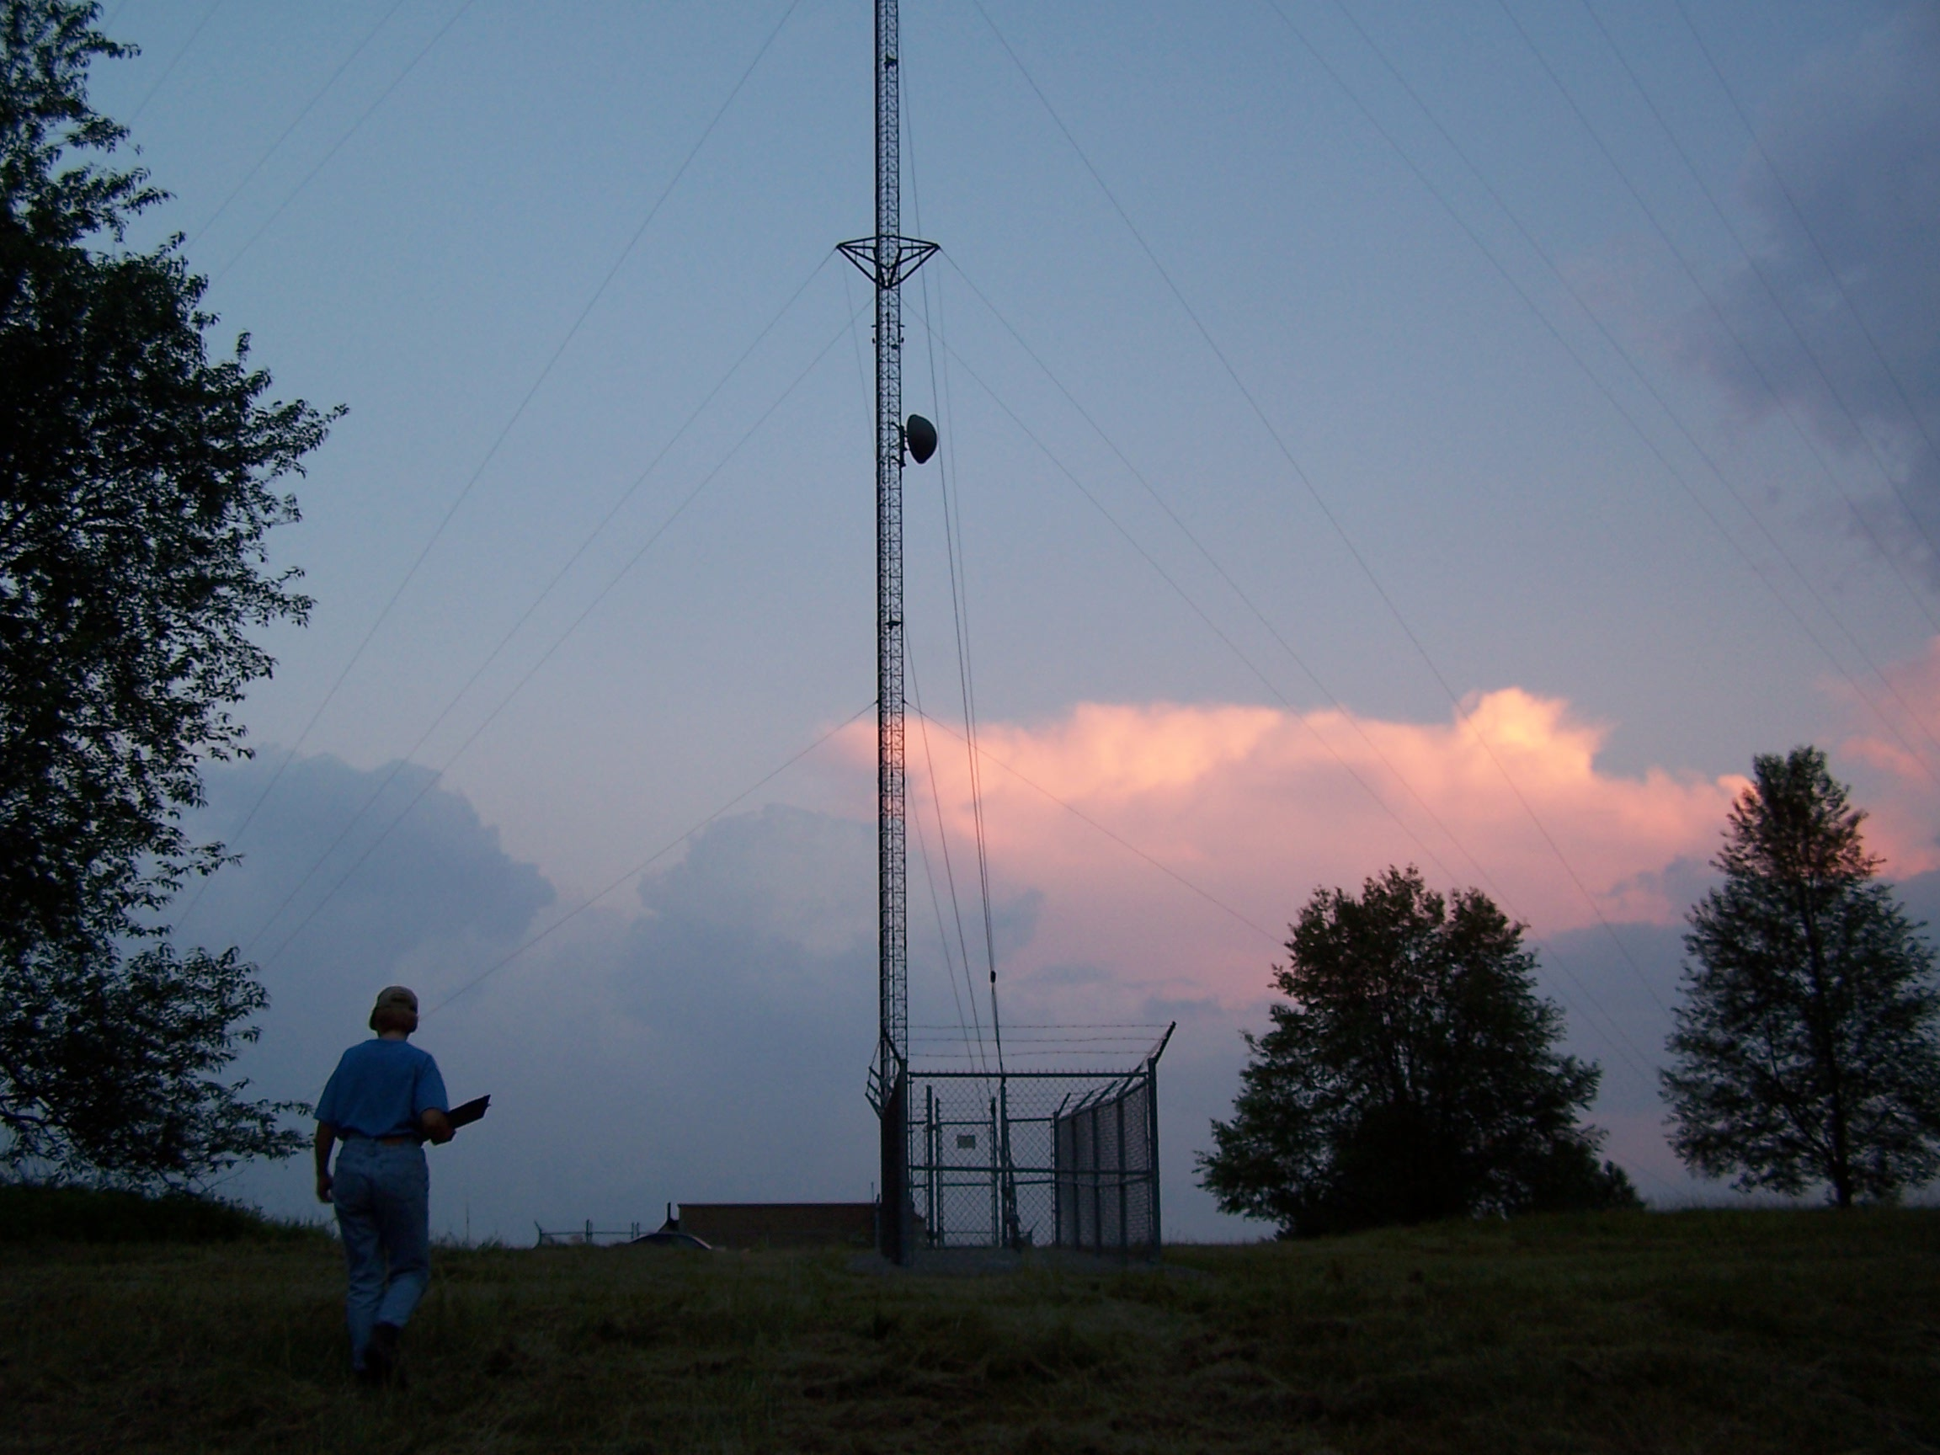
Biological Reviews
JOELLE L. GEHRING, Ph.D.
Federal Communications Commission

Slide 2
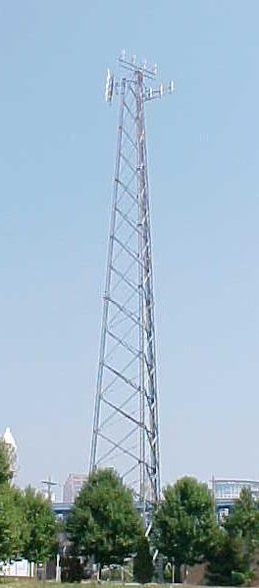
Biological Review Considerations
  Wetlands
  Threatened and Endangered Species
  Migratory birds
  Bald Eagles and Golden Eagles
Notes:
**Revised to include wetlands.

Slide 3
Biological Review Considerations
http://wireless.fcc.gov/nepa/EA_checklist.pdf
Located in: Wilderness Area, Wildlife Preserve, Floodplain, or Wetland?
  If no, provide documentation (maps, etc.)
  If yes, provide appropriate approvals, permits, or grants
Notes:
Refer to Erica’s talk as she will be covering some of this.

Slide 4
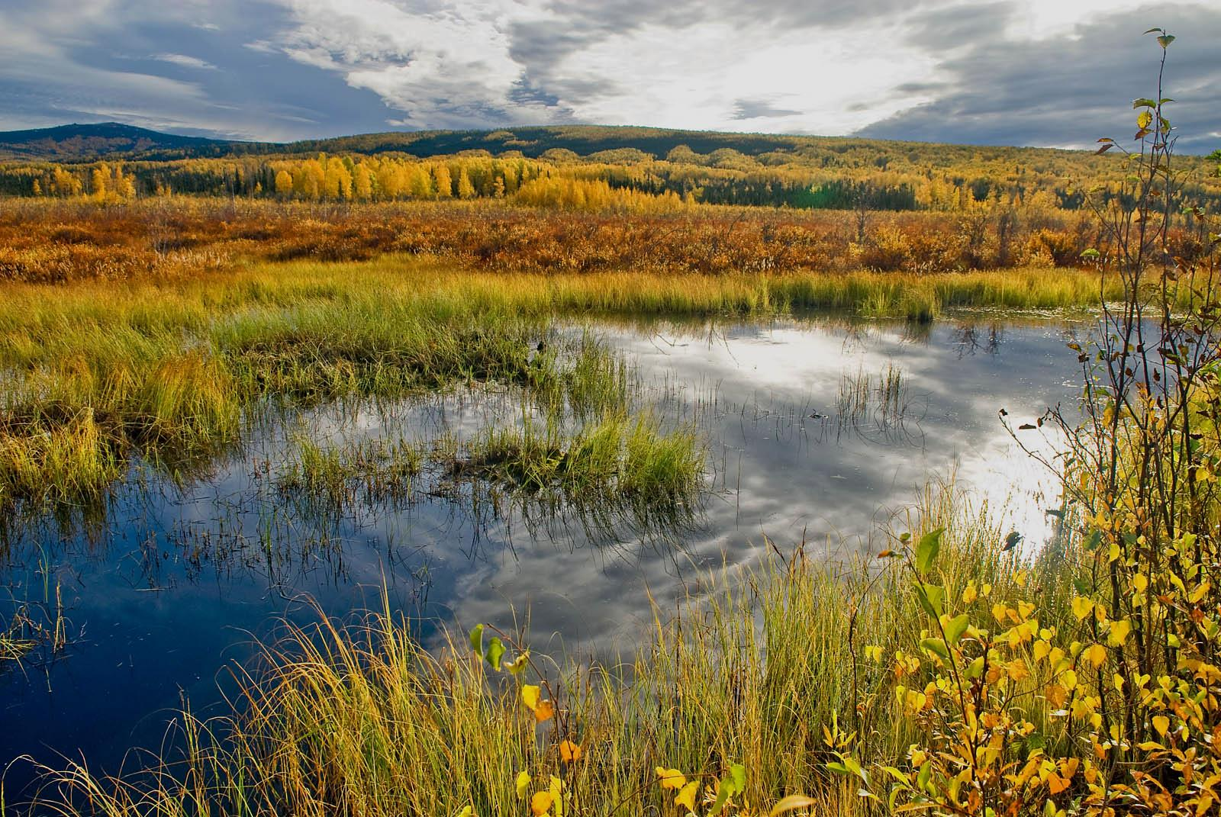
The Value of Wetlands
Flood control
Water quality -transform nutrients & pollutants
Diversity of wetland plants, wildlife and ecosystems
Recreation (hunting, fishing, bird watching)
Natural heritage
USACE
Notes:
*** new slide
Let’s consider wetlands in more depth. Clean Water Act refers to wetlands as “areas that are inundated or saturated by surface or ground water at a frequency and duration sufficient to support, and that under normal circumstances do support, a prevalence of vegetation typically adapted for life in saturated soil conditions. Wetlands generally include swamps, marshes, bogs, and similar areas.”
Ecological function and value:
Flood control (storage of water (hydrology), recharging ground water, reducing the flow velocity
water quality (Transformation of nutrients and pollutants, catches sediment)
Diversity (“habitat”, they provide food, water, and shelter for fish, shellfish, birds, and mammals, and they serve as a breeding ground and nursery for numerous species. Many endangered plant and animal species are dependent on wetland habitats for their survival. Different wetlands have different values even those flooded only a portion of the year.
Recreation
Natural heritage (historical values, also current collection and value of wild products by native people, such as wild rice)

Slide 5
Wetlands
Wetlands’ ecological value is recognized in international law (RAMSAR), federal and state law, Executive Orders, programs, and local policies and regulations.
  Clean Water Act, Section 404 regulates dredging and filling of wetlands
  US Army Corps of Engineers
  Permits and/or other authorization may be required
Notes:
*** new slide
An individual permit is required for potentially significant impacts. However, for most discharges that will have only minimal adverse effects, a general permit may be suitable. General permits are issued on a nationwide, regional, or State basis for particular categories of activities. The general permit process eliminates individual review and allows certain activities to proceed with little or no delay, provided that the general or specific conditions for the general permit are met.
Some state and local governments require additional permits or authorizations.

Slide 6
Wetlands
If the proposed facility would be located in a wetland, provide a copy of the permit from the U.S. Army Corps of Engineers permitting the construction of the proposed antenna structure and a U.S. Army Corps map.
If not in wetland, indicate in application materials and maintain maps for your records.
Notes:
*** new slide
Wetland vegetation, hydrology, and hydric soils must be present in order to be a wetland. Work with a wetland specialist and/or the USACE office to determine if your project site is in a wetland and which permits are required.

Slide 7
Biological Review Considerations
  Wetlands
  Threatened and Endangered Species
  Migratory birds
  Bald Eagles and Golden Eagles
Notes:
**Revised to include wetlands.

Slide 8
Threatened & Endangered Species
Section 1.1307(a)(3) of the Commission’s rules, 47 C.F.R. §1.1307(a)(3), requires applicants, licensees, & tower owners to consider the impact of proposed facilities under the Endangered Species Act (ESA), 16 U.S.C. §1531 et seq.
Applicants must determine whether any proposed facilities may affect listed, threatened or endangered species or designated critical habitats, or are likely to jeopardize the continued existence of any proposed threatened or endangered species or designated critical habitats. Applicants are also required to notify the FCC & file an environmental assessment if any of these conditions exist.

Slide 9
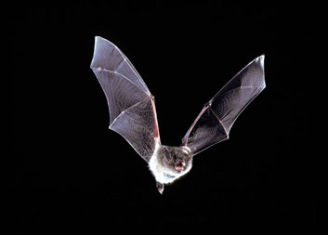
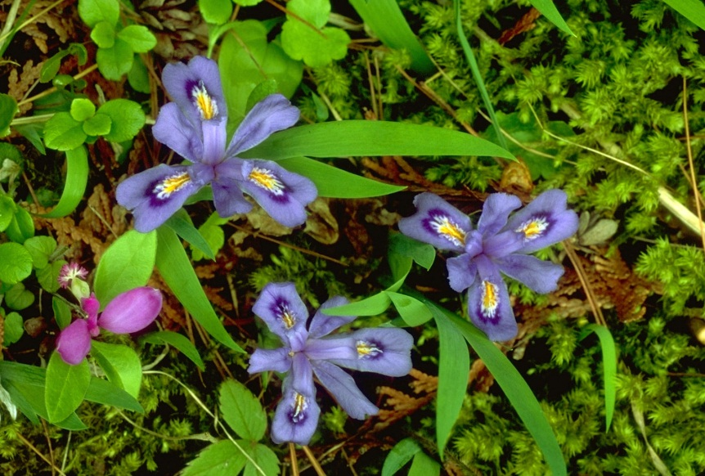
Threatened & Endangered Species
  Plants and animals
  Determine if T&E species at your proposed facility site

Slide 10
Threatened & Endangered Species
Information, Planning, and Conservation (IPaC)
  USFWS tool
  Provides species lists, critical habitat designations
  http://ecos.fws.gov/ipac/

Slide 11
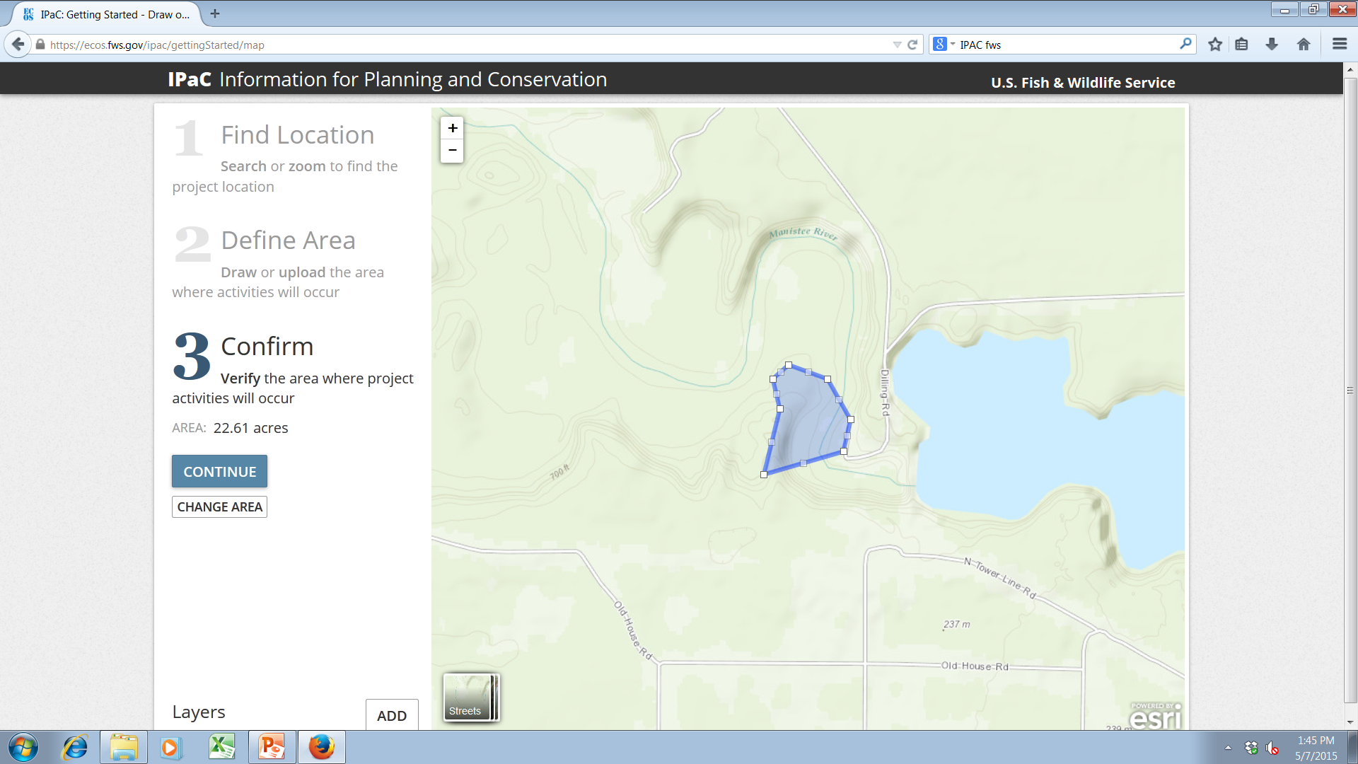
Threatened and Endangered Species
Notes:
***Updated with new screen shots (IPaC has updated the tool appearance)

Slide 12
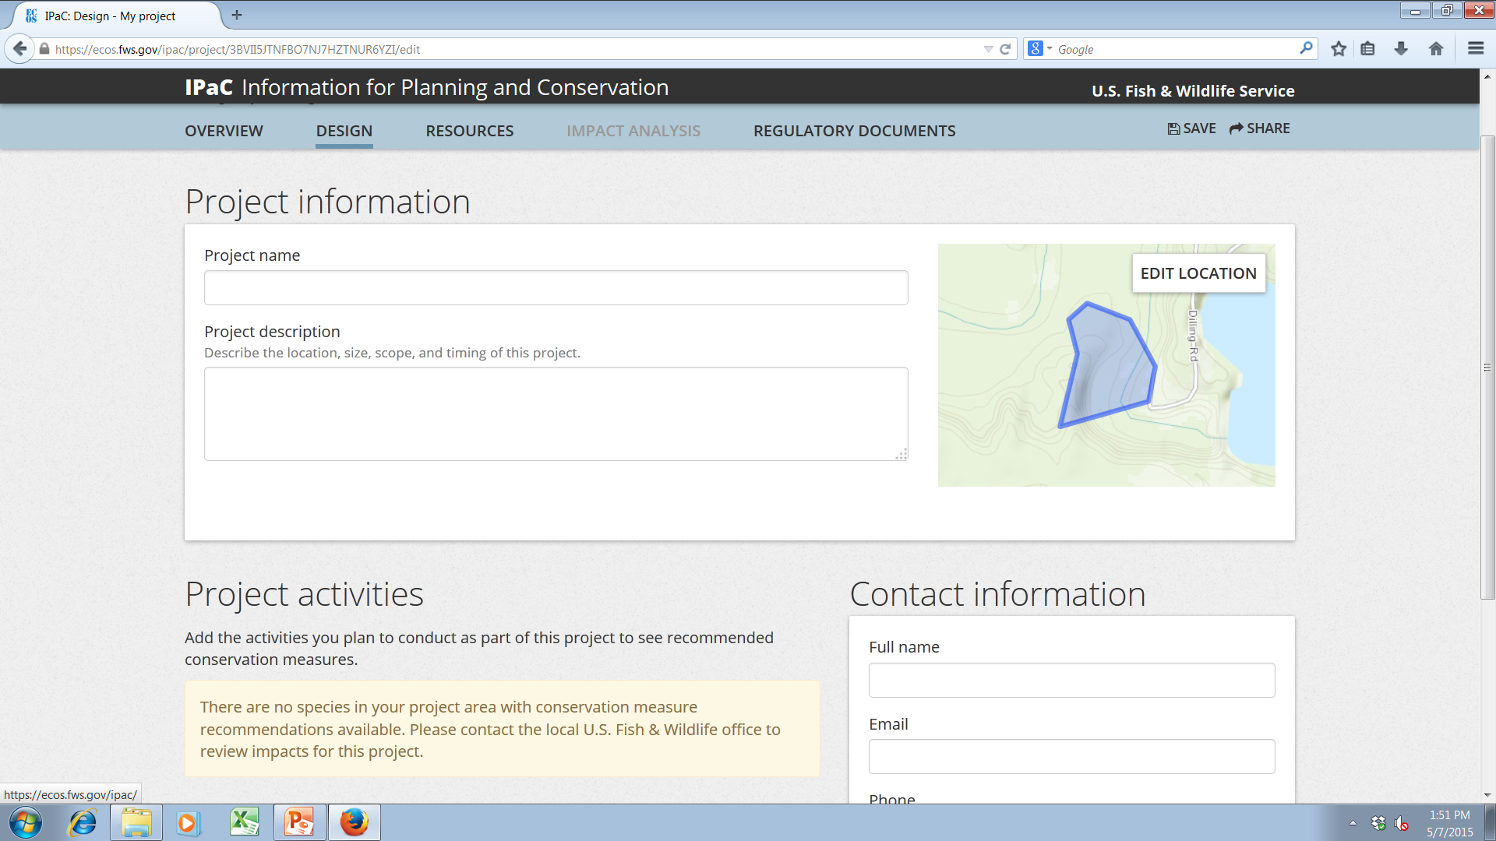
Threatened and Endangered Species
Notes:
***Updated with new screen shots (IPaC has updated the tool appearance)

Slide 13
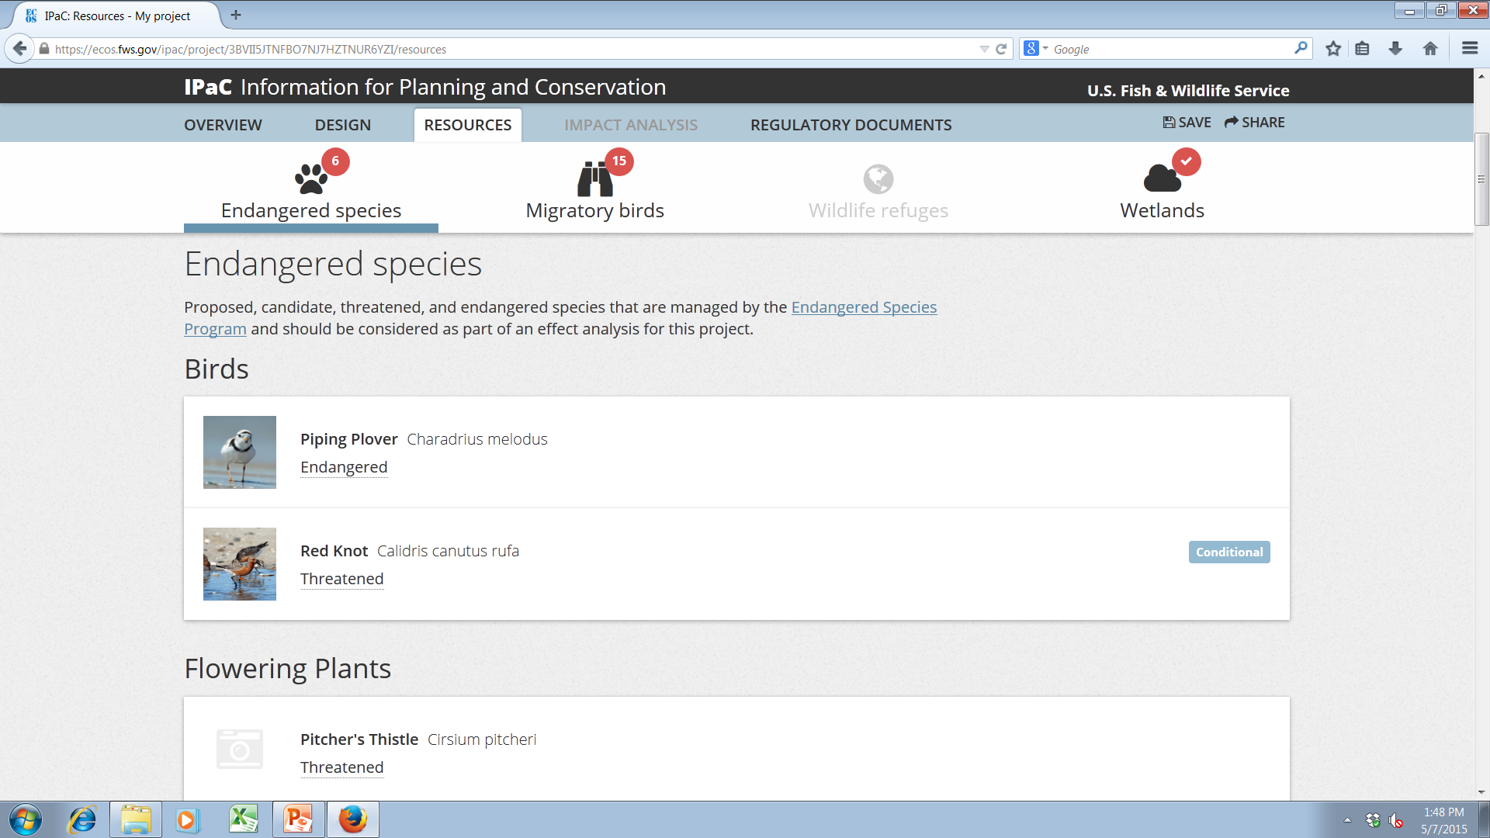
Threatened and Endangered Species
Notes:
***Updated with new screen shots (IPaC has updated the tool appearance)

Slide 14
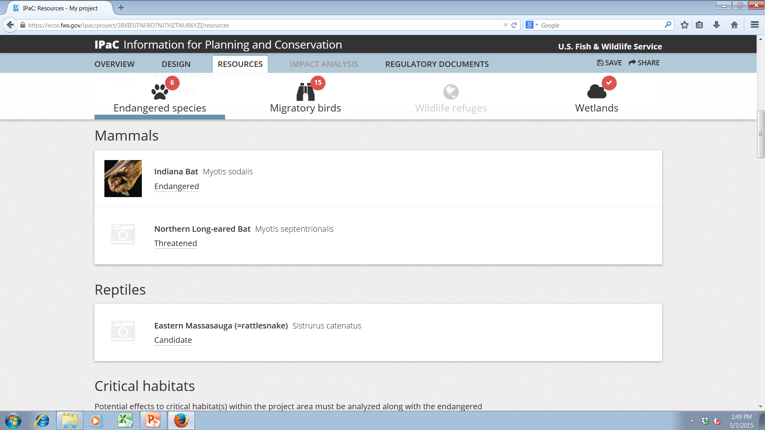
Threatened and Endangered Species
Notes:
***Updated with new screen shots (IPaC has updated the tool appearance)

Slide 15
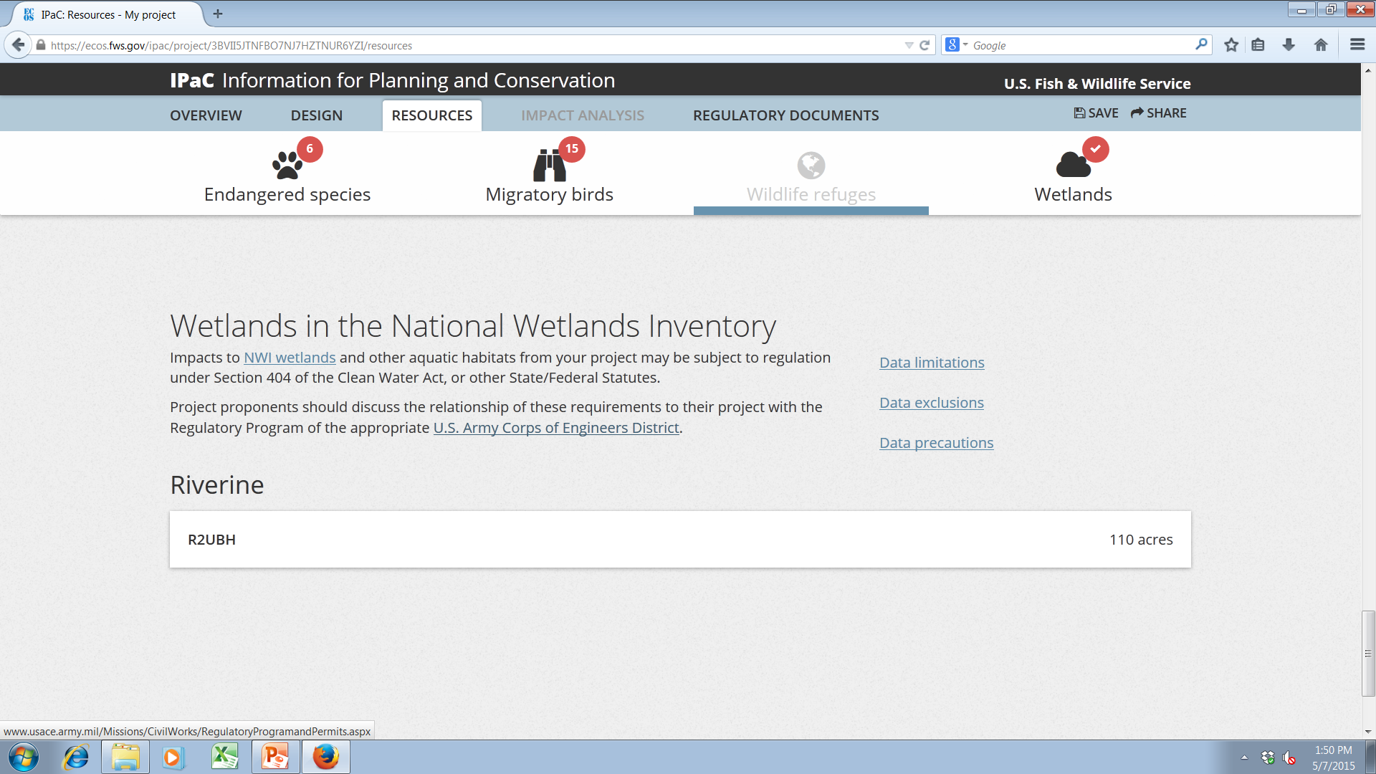
Threatened and Endangered Species
Notes:
***Updated with new screen shots (IPaC has updated the tool appearance)

Slide 16
Threatened & Endangered Species
If listed or proposed threatened or endangered species or designated or proposed critical habitats are present in the county or counties where the “action” is located and would not be affected by the proposed antenna structure:
  Explain how the applicant determined that there would be no effect and provide the materials (with citations) that formed the basis for this determination (e.g., maps or lists from relevant FWS databases.)

Slide 17
Threatened & Endangered Species
If the proposed antenna structure may affect, but is not likely to adversely affect, listed or proposed threatened or endangered species or designated or proposed critical habitats in the action area:
  Provide a letter from FWS concurring with the applicant’s informal biological assessment. If any measures are proposed to mitigate any effects on species or habitats, the assessment must outline those measures with FWS concurrence.
  e.g., Indiana bat

Slide 18
Threatened & Endangered Species
If present and if the proposed antenna structure may affect, and is likely to adversely affect, listed or proposed threatened or endangered species or listed or proposed designated critical habitats in the action area
  Prepare a formal biological assessment as outlined in 50 C.F.R. § 402.01 et seq. The applicant should provide the formal biological assessment to the FCC for formal consultation with the FWS.

Slide 19
Threatened & Endangered Species
Protected species not present
  Relevant documentation (e.g., IPaC)
Protected species present, but not affected
  Determination by USFWS or qualified biologist
Not likely to Adversely Affect protected species
  USFWS concurrence
Likely to Adversely Affect protected species
  USFWS incidental take statement
Notes:
***Summary text from Jill’s California slides

Slide 20
Biological Review Considerations
  Wetlands
  Threatened and Endangered Species
  Migratory birds
  Bald Eagles and Golden Eagles
Notes:
**Revised to include wetlands.

Slide 21
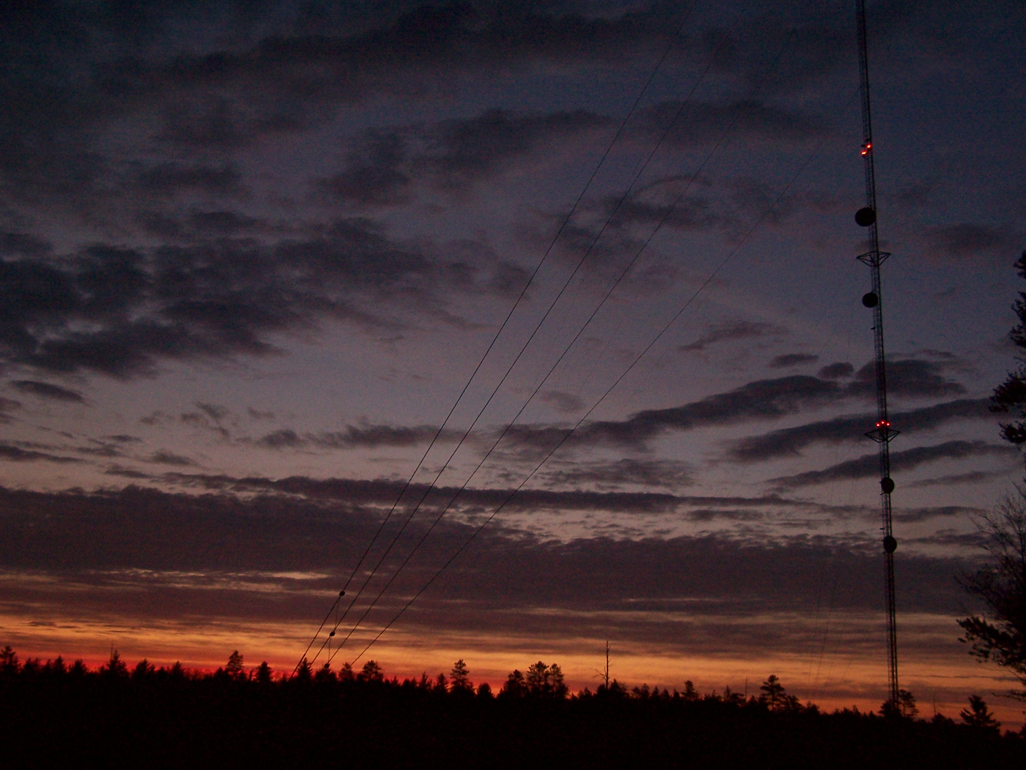
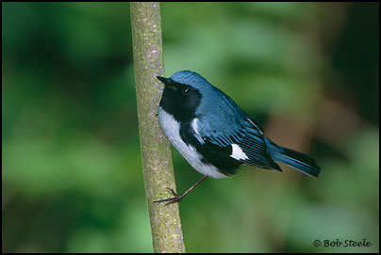
Estimated 4 million – 50 million bird fatalities at communication towers annually in U.S.
Almost all are considered violations of the Migratory Bird
Treaty Act.

Slide 22
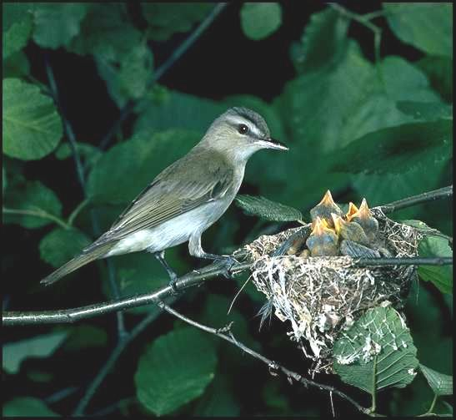
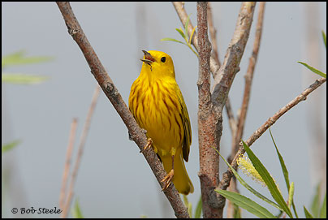
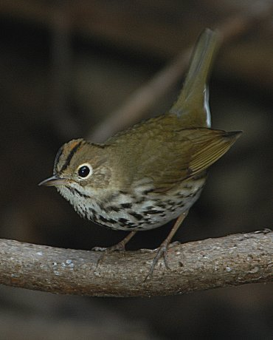
Detected Bird Mortality
I. Jeklin
Most frequently detected
  Songbirds
    Vireos
    Warblers
    Thrushes
    Sparrows
  Shorebirds
  Waterfowl
G. Beaton

Slide 23
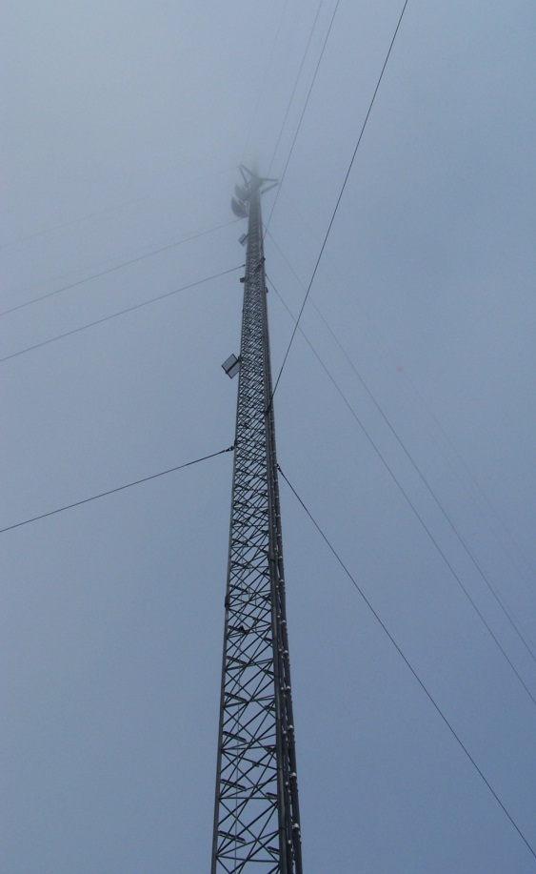
Variables Related to Bird Collisions
  Weather
  Location in the landscape
  Tower support systems
  Tower heights
  Tower lighting systems
Notes:
*** bullets rearranged

Slide 24
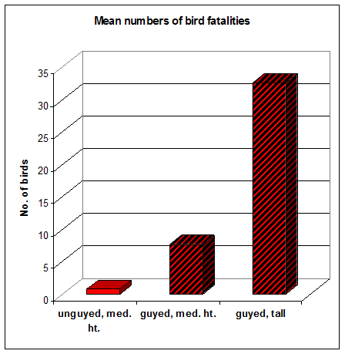
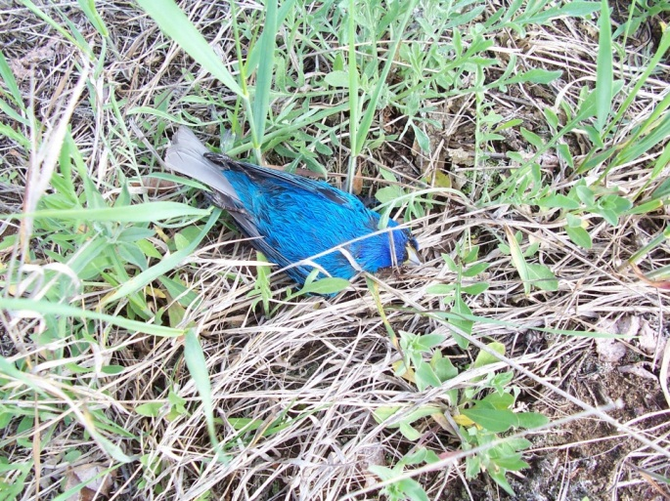
Towers with guy wires result in higher levels of avian mortality than towers without guy wires.

Slide 25
Taller towers result in higher levels of avian mortality than shorter towers.

Slide 26
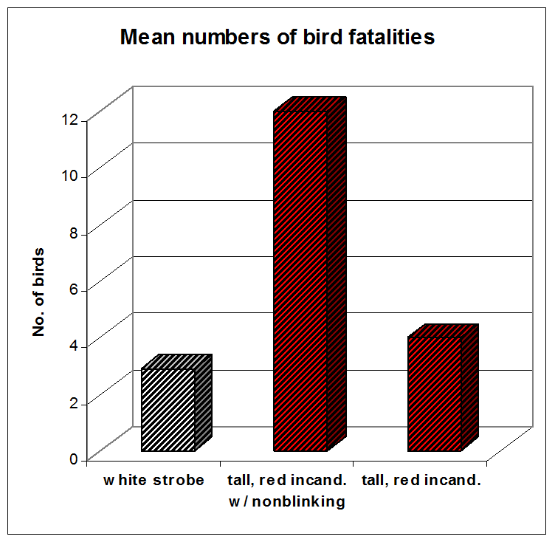
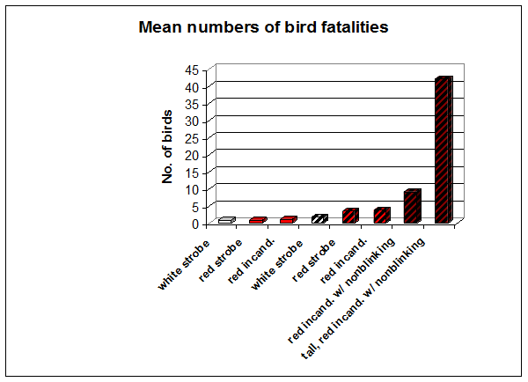

Steady-burning lights on towers result in higher levels of avian mortality than flashing lights.

Slide 27
50-70% reduction in fatalities via
elimination of non-flashing lights
L-865
L-864
L-864
L-864 and L-810

Slide 28
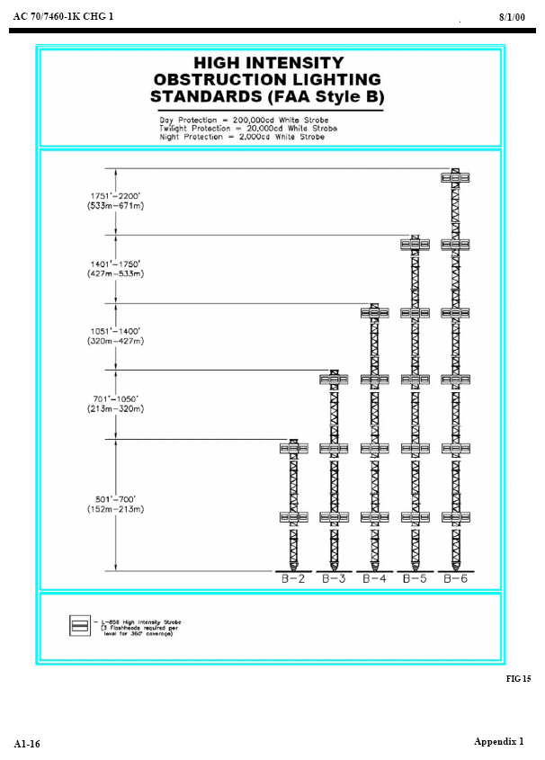
L-865 flashing white
NO non-flashing

Slide 29
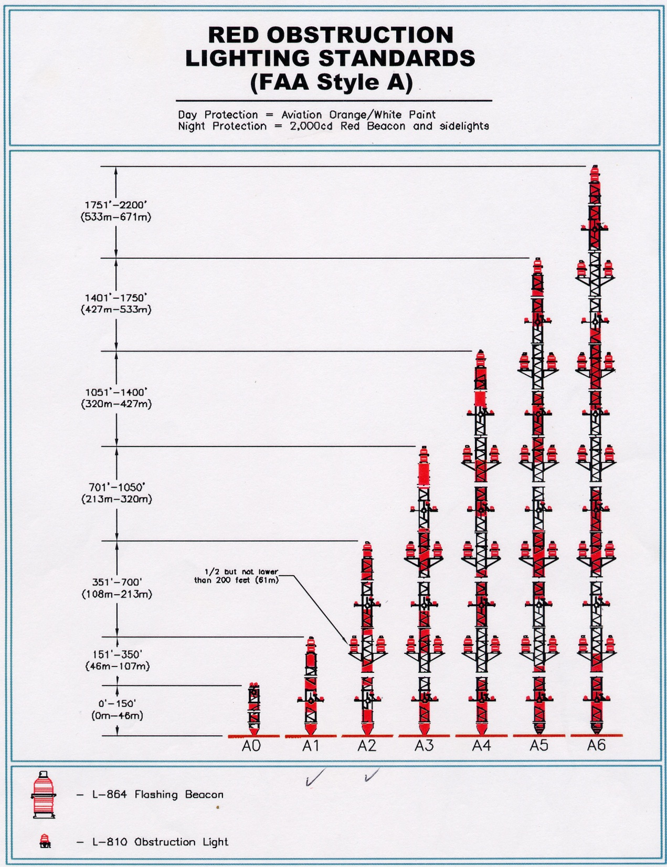
L-864 flashing red
L-810 non-flashing red

Slide 30
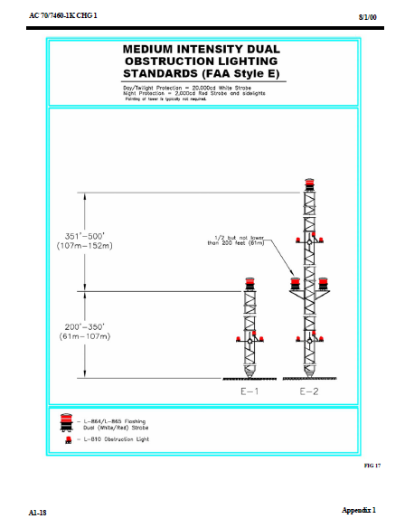
L-864 flashing red
L-810 non-flashing red

Slide 31
L-864 flashing red
L-810 non-flashing red

Slide 32
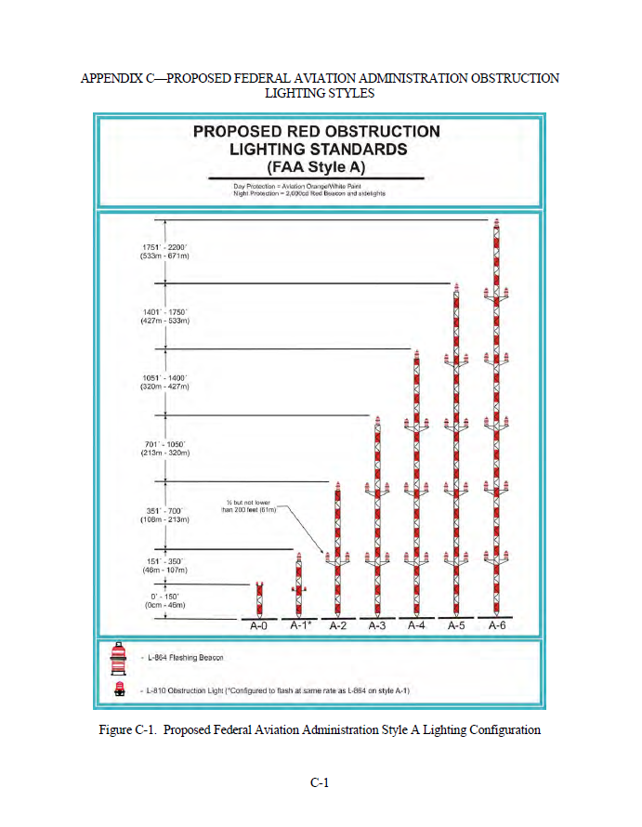

Option to extinguish non-flashing lights from towers >350 ft. AGL which reduces tower lighting costs

Slide 33
new and existing towers
Option to extinguish non-flashing lights from towers >350 ft. AGL which reduces tower lighting costs

Slide 34
Lighting Deviation Process
To extinguish or eliminate the L-810 tower lights/side-markers on an existing registered tower, or to request use of flashing red lights only on a proposed new tower, you must take the following steps:
  File a Marking and Lighting study electronically with the FAA on Form 7460-1, Notice of Proposed Construction or Alteration (https://oeaaa.faa.gov/oeaaa/external/portal.jsp) requesting the elimination or omission of steady-burning lights (L-810). Designate structure type: "Deviation from Red Obstruction Light Standards".
Notes:
Detailed explanation of lighting deviation process- handout included in audience materials.

Slide 35
Lighting Deviation Process
  Once the FAA has approved the request and assigned a FAA Study Number, submit an online eSupport request (https://esupport.fcc.gov/request.htm) asking the FCC to verify that our records of this FAA Study Number reflect the FAA-approved bird lighting deviation.
Notes:
Detailed explanation of lighting deviation process- handout included in audience materials.

Slide 36
Lighting Deviation Process
  After receiving an FCC record confirming that the FAA study has been updated, file Form 854 with the FCC via the ASR System. For an existing registered tower, select “MD – Modification”, update the Lighting to “Option 3 – Other”, and provide a description (Ex: Style E w/ Red Light Deviation). The FCC will typically approve the application and modify the registration within 24 hours. For a proposed new tower enter the Lighting as “Option 3 – Other,” and provide a description. FCC approval for a proposed tower is subject to the procedures and time periods described at http://www.fcc.gov/help/environmental-notification-process-registration-antenna-structures-overview.
Notes:
Detailed explanation of lighting deviation process- handout included in audience materials.

Slide 37
Lighting Deviation Process
  When the lighting change for an existing tower has been granted by the FCC via ASR, the steady-burning, side-marker, L-810 tower lights can be extinguished. This is typically accomplished in the tower transmission building and does not ordinarily require climbing the tower. For new towers, once the registration is granted, simply construct the tower without installing L-810 lights.
Notes:
Detailed explanation of lighting deviation process- handout included in audience materials.

Slide 38
Migratory Birds
  Towers > 450 ft. (137 m) AGL
  Prepare an Environmental Assessment including a section specifically addressing potential migratory bird impacts and efforts to reduce those impacts (e.g., tower lights, building lights, bird flight diverters)
  Seek comment from the FWS on migratory birds
  No red-steady lights
  Motion-detector lighting on out buildings recommended

Slide 39
Migratory Birds
  Towers 350-450 ft. (107-137 m) AGL
      No red-steady lights and motion-detector lighting on out buildings recommended

Slide 40
Biological Review Considerations
  Wetlands
  Threatened and Endangered Species
  Migratory birds
  Bald Eagles and Golden Eagles
Notes:
**Revised to include wetlands.

Slide 41
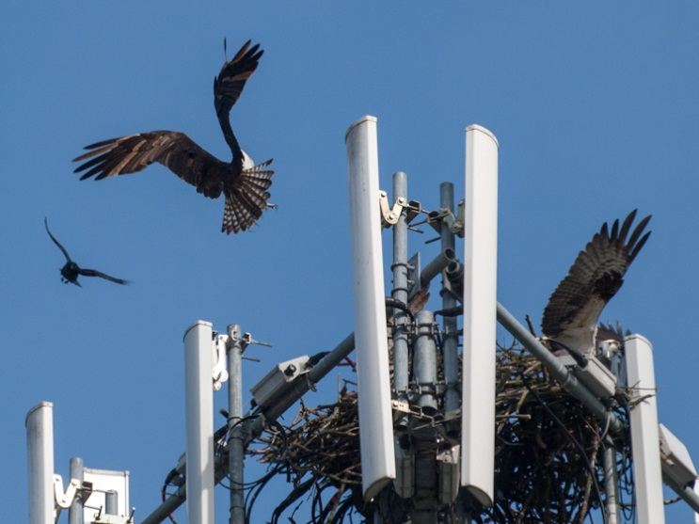
Eagles and other Raptors
  Bald and Golden Eagle Protection Act (BGEPA), MBTA, and some state protection
  Number of nests on towers is increasing.
  Contact USFWS & state natural resource agency before construction or maintenance activities on towers with nests. May require permits. Nest exclusion devices can be used.
  Raptors can become entangled in antenna wires or twine used as nesting material. Minimize excess wires, securely attach wires to tower, and shrink wrap or tape wires together to reduce the risk of entanglement. Contact state natural resources protection agency & USFWS if bird entanglement occurs.
©ingridtaylar
Notes:
**** added from USFS / BLM prsentation
In addition to the USFWS guidelines for nest buffers, you may also want to consider this information. Note that Eagle nests may not be included in the IPaC output and other databases may need to be included in your review (e.g., AKN).

Slide 42
Notes:
Bring it all together

Slide 43
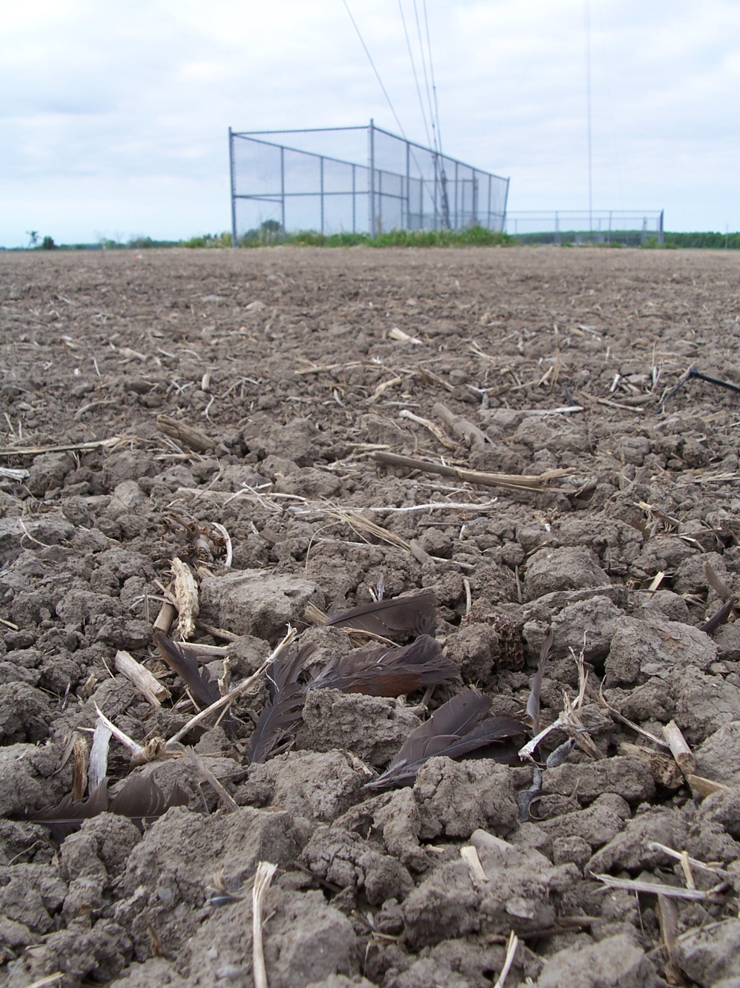
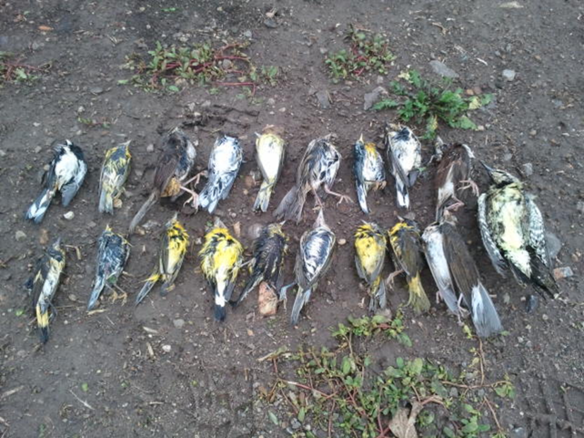
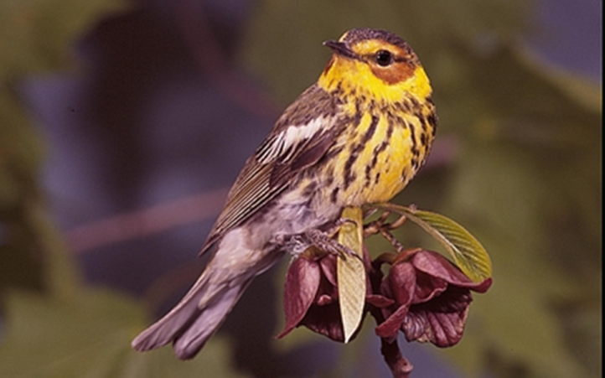
For more information contact:
Joelle.Gehring@FCC.gov

