Slide 1
What would you do?
Leverage the City of Ammon’s existing ‘fiber to the address’ research and development network by establishing a partnership between the Idaho National Lab and the City of Ammon to develop and install a wireless access point in all the Ammon R&D FFTx Broadband Gateways which are capable of securely extending the dynamic virtualization capabilities through wireless, while at the same time researching and developing a wireless edge device capable of supporting these same security and dynamic virtualization capabilities.

Slide 2
Why?
Next generation networking and Smart City functionality will demand network intelligence and virtualization all the way to the end user’s wireless device in order to support the required degree of dynamic automation and security while still maintaining the carrier transparency desired by the user.
An expected benefit to this approach is the transition from dedicated specialized wireless edge devices to commodity hardware agnostic to either operator or service provided that the user and device have proper security authentication.

Slide 3
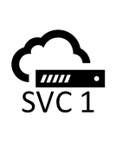
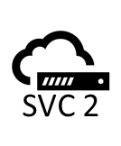
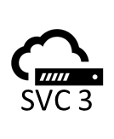
How would you do it?
Wireless Edge Device
ONT
WIRELESS
SVC 1
Software Defined Radio
+
Software Defined Networking
SVC 2
Dynamic Control:
Openflow
SVC 3
802.1Q VLAN tagging
802.1AD QinQ tagging
802.1AH Provider Backbone Bridging
MPLS Label tagging

