Slide 1
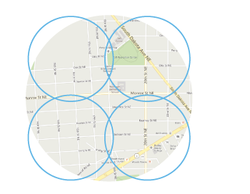
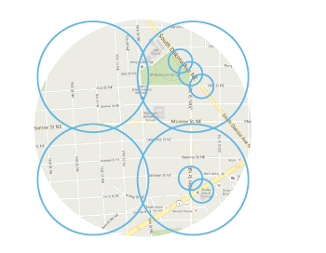
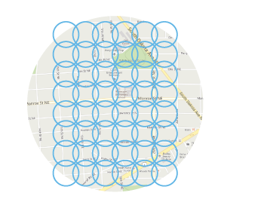
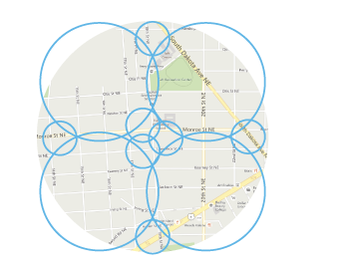
Infrastructure Deployment to Meet Increasing Demand and Enable Efficient Spectrum Use
Macro
Underlay
Small
Fill-In
Small Cells to add capacity in the most dense areas
Small Cells cover areas not well covered by macro sites

Slide 2
A Model City Should Have Local Policies Favorable to Wireless Broadband Deployment
Coverage and capacity solutions require local policies that incentivize deployment
Necessary policies:
Favorable zoning laws
Access to rights-of-way
Pole attachments
As an additional incentive, localities implementing necessary policies can be rewarded with priority funding for federal programs (such as CAF, BTOP, E-rate, etc)

Slide 3
A Model City Should Have Local Policies Favorable to Wireless Broadband Deployment
Public-private partnership efforts have been successful in providing guidance to cities on implementing policies and adhering to federal laws that expedite deployment of wireless broadband infrastructure
Example: PCIA partnered with CTIA, NACo, NATOA, and NLC to release, this March, a model local ordinance chapter and wireless facility siting application checklist

Slide 4
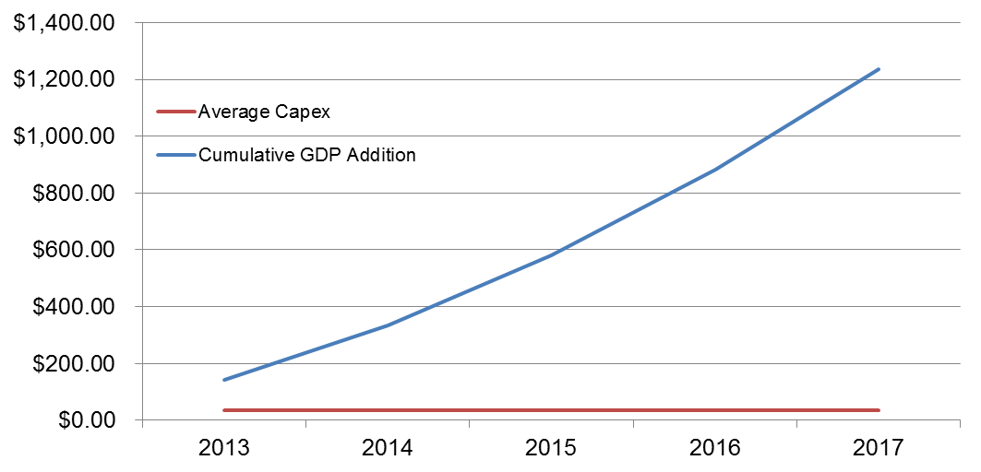
Net Effects of Streamlined Wireless Infrastructure Deployment
1.3 million net new jobs by 2017
Meet future IoT demands
Enable the development of Smart Grid technology
Support the expansion of entertainment platforms
Broadband public safety network deployment
Enable Positive Train Control

