Slide 1
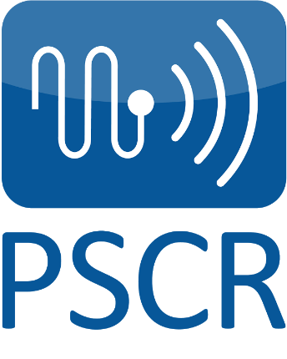
Public Safety Communications Research Program
A joint program between NIST’s Communications Technology Laboratory & NTIA’s Institute for Telecommunication Sciences
Department of Commerce Laboratories - Boulder, Colorado
Contact dereck.orr@nist.gov for information about PSCR

Slide 2
PSCR Vision & Mission
Vision:
Through the use of advanced communications technologies, the public safety community can more effectively carry out their vital mission to protect lives and property—from day-to-day operations to large events and emergencies.
Mission:
To fulfill this vision, the PSCR program acts as an objective technical advisor and laboratory for the public safety community to accelerate the adoption and implementation of only the most critical public safety communication technologies.
Requirements Gathering
Standards Development
Research & Development
Testing & Evaluation
Modeling & Simulation
PSCR Portfolio:

Slide 3
PSCR Portfolio
Requirements | Standards | Modeling & Simulation | Research & Development | Testing & Evaluation | Security Research
Priority, Pre-emption, Quality of Service | Direct Mode (Proximity Services) | Device-to-device modeling | Location Based Services | Indoor/In-building | Mobile Application Security
Local Control | Push-to-talk over LTE | Nationwide modeling | Public Safety Analytics | Extended Range | Identity Management
Deployables | Group Communications | Resiliency research and modeling | UI/UX | Next Generation Network (NGN) Wireless Priority Services (WPS) | LTE Security Integration
 | Video Standards |  |  | Priority, Pre-emption, Quality of Service
 |  |  |  | Deployables
 |  |  |  | Local Control
 |  |  |  | Audio Quality
 |  |  |  | P25 CAP
 |  |  |  | Bridging LMR to LTE
Notes:
3

Slide 4
PSCR Stakeholder Base
Public Safety
International Collaboration
Industry
Federal Sponsors & Partners
Academia

Slide 5
PSCR Collaboration Efforts
PSCR is a public safety practitioner-driven program
Who:
Public Safety Practitioners/First Responders
Public Safety Agencies and Associations
NPSTC, APCO, PSAC, etc.
State and Local Government officials/agencies
How:
PSCR brings public safety practitioners into the labs for subjective testing on research projects such as Audio Quality and Video Quality
Some research projects are introduced directly by the first responder community
PSCR sponsors public safety user travel to communications technology events and conferences that they otherwise would not be able to participate in
PSCR leads Working Groups and facilitates Workshops aimed at documenting public safety’s unique requirements
November 2013 Public Safety Broadband R&D Roadmapping Workshop
Brought together 150 representatives from across PSCR’s Stakeholder base to develop a prioritized list of cross-disciplinary R&D areas for future public safety comms efforts

Slide 6
PSCR Collaboration Efforts (cont.)
PSCR collaborates closely with Industry partners
Who:
Vendors, manufacturers, and network carriers in the communications technology and RDT&E environment
How:
Cooperative Research and Development Agreements (CRADAs)
PSCR deployed the 700 MHZ Public Safety Broadband Demonstration Network in cooperation with over 75 CRADA partners
Tens of millions of dollars worth of hardware and software to test & evaluate LTE technologies and features
Industry engagements include conferences, workshops, and other events
PSCR’s annual Public Safety Broadband Stakeholder Conference
PSCR leverages expertise in the Academic community through joint-projects such as the Indoor-In-building Testing effort in conjunction with the University of Colorado Boulder

Slide 7
PSCR Collaboration Efforts (cont.)
PSCR is sponsored by the Department of Homeland Security’s Office of Interoperability and Compatibility, Department of Homeland Security’s Office of Emergency Communications, and FirstNet to perform the following:
Requirements Gathering & Standards Development
Research & Development
Testing & Evaluation
Modeling & Simulation
PSCR engages with Federal Partners at the White House, Congress, FCC, DOJ, NTIA, etc.
PSCR also collaborates with foreign governments and international organizations on issues related to public safety communications via 3GPP, CITIG, NPSTC, and more

Slide 8
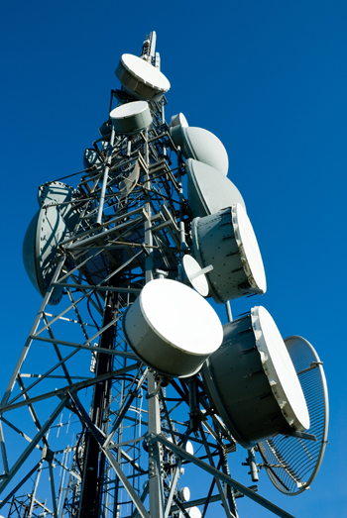
National Advanced Spectrum and Communications Test Network (NASCTN)
NASCTN’s mission is to increase commercial and Federal access to the spectrum by helping to accelerate the design and deployment of spectrum-sharing technologies through accurate testing and modeling.
NASCTN is a capability within the joint NIST/NTIA’s Center for Advanced Communication and was established with the signing of an MOA between NIST, NTIA and the DOD CIO in March of 2015.
Testing and modeling is performed by members (Federal agencies, industry and academia) of the NASCTN network.
Credit: ©italianestro/Shutterstock
Contact Michael.Janezic@nist.gov for information about NASCTN.

Slide 9
NASCTN Key Functions
Facilitate and coordinate spectrum sharing and engineering capabilities,
Create a trusted capability for evaluating spectrum-sharing technologies,
Perform outreach activities to identify spectrum-related testing and modeling needs, and
Protect proprietary, classified and sensitive information while facilitating maximum dissemination.

