Slide 1
FCC GIGABIT CITY CHALLENGE
March 27, 2013

Slide 2

“Build the next-generation Internet and they will come, but not without encouragement and a willingness
to be surprised.
In the 1970s, many doubted there were uses for even 50-kilobit-per-second Internet. But soon application explorers came up with remote login, file transfer, email and
Bob Metcalfe
Ethernet Inventor
new worlds in telephony, television, publishing, commerce and social interactivity.
Today, while investing in gigabit generations of Internet, we are again sending out our application explorers.”

Slide 3
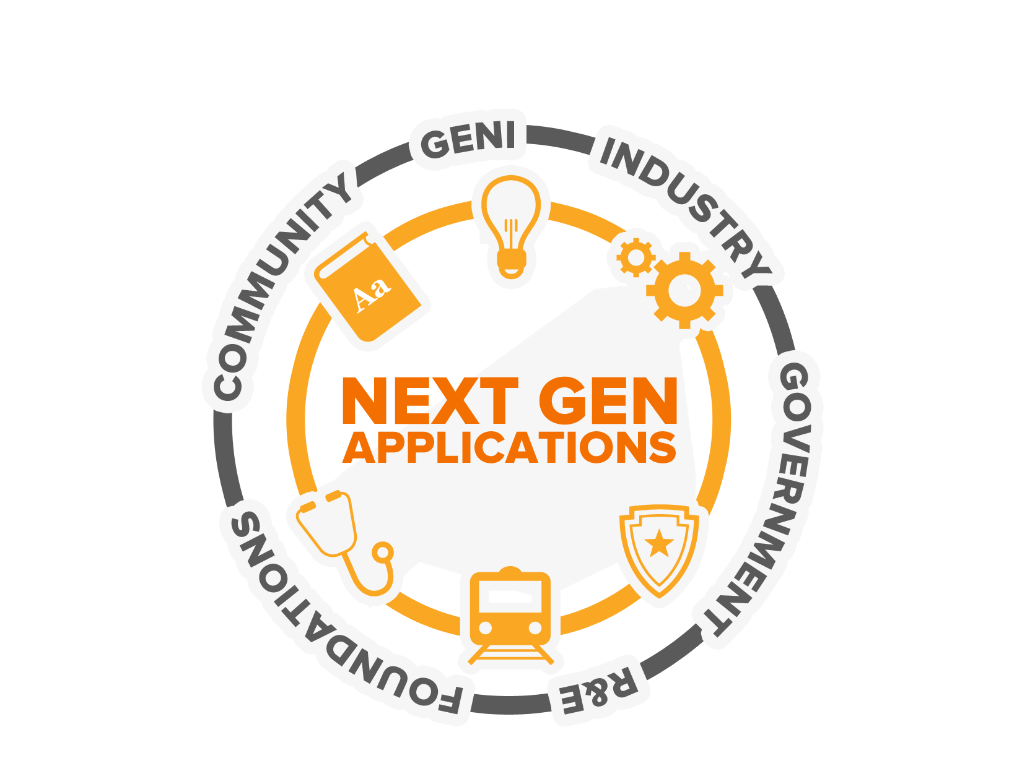
Public-private partnership
501(c)(3)
Notes:
We’re at a time in our country’s history when we need to build the interstate system all over again. But if we truly built the internet’s ultrafast interstate now, it would be like having an auto interstate for a population that only drives horses and buggies or Tin Lizzies. We aim to “ignite” and connect the various parties in building truly compelling, next-gen applications that can run on top of the ultra-fast networks.
To do this, US Ignite is the “+”s in this equation.
We are the conveners of the communities and their needs with the providers of new technologies that address those needs – and we coordinate to help match the right resources to create the applications
US Ignite’s priority areas are healthcare, education, advanced manufacturing, energy, and

Slide 4
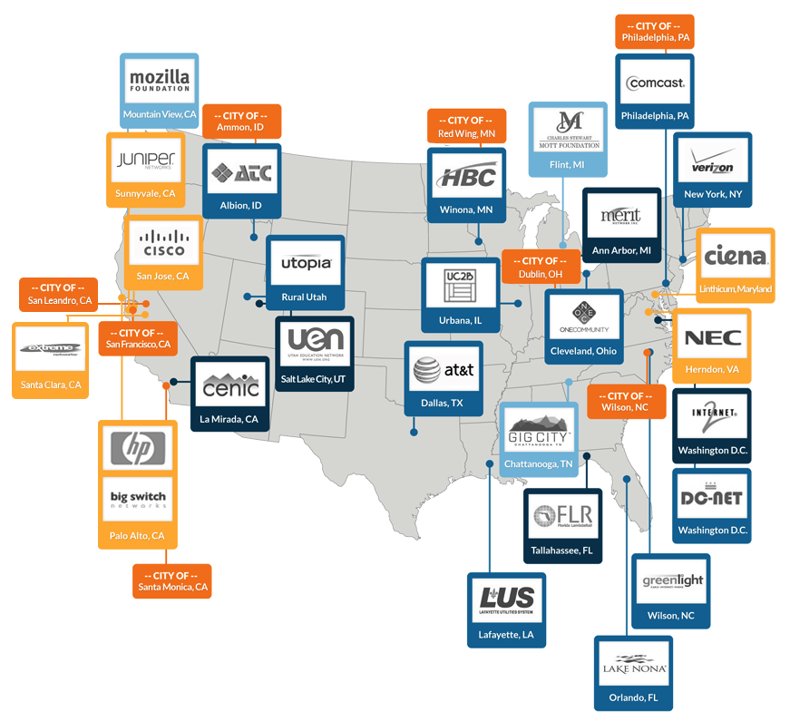





Equipment Manufacturers
Research and Education Networks
Network Operators
Foundations & Nonprofits
Municipalities

Slide 5
Our Goals
1
60 next-generation applications
Infrastructure
2
200 community test beds
Next-Gen Applications
Economic Leadership
3
Coordinate best practices

Slide 6
Next-Gen Infrastructure
Infrastructure
Software-defined networks
Neighborhood Cloud (US Ignite Racks)
Gigabit to the end user
1
Next-Gen Applications
2
Economic Leadership
3

Slide 7
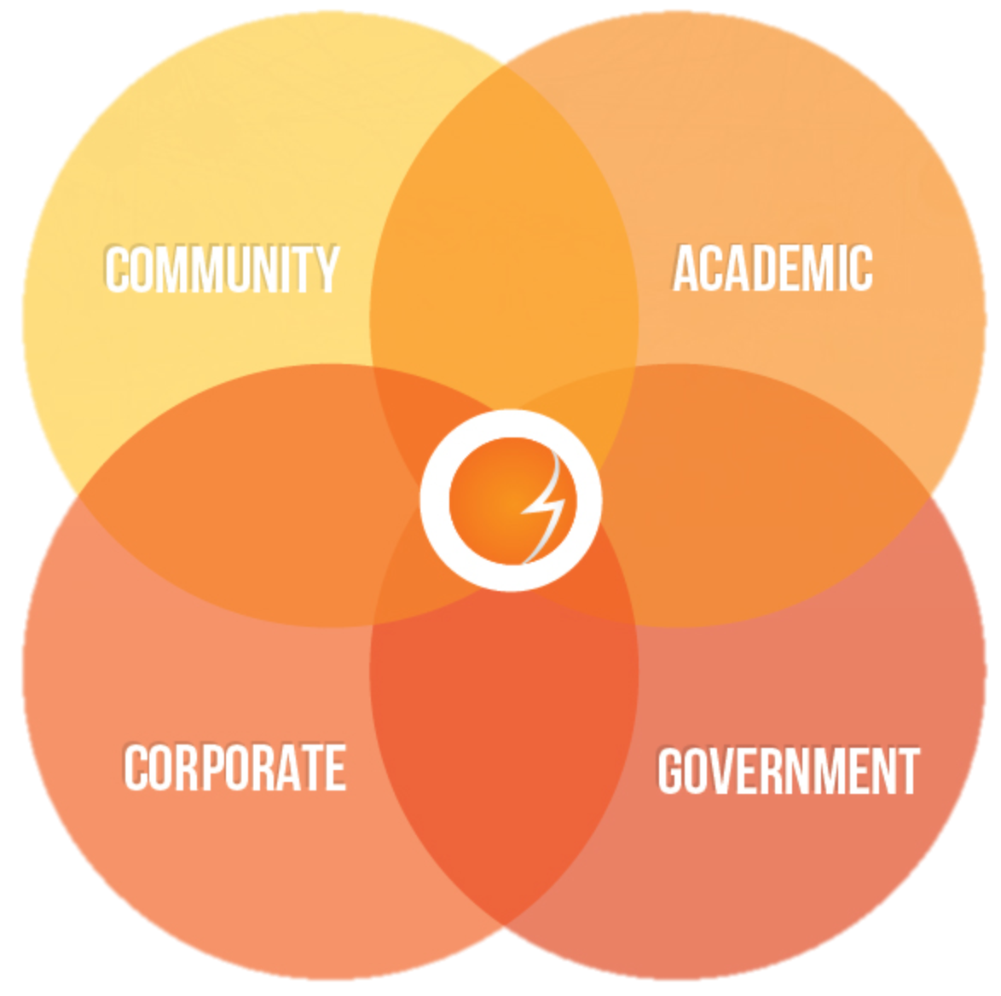
US Ignite Ecosystem Coordination
Community Supporters
Foundations and Non-profits
Mozilla Ignite Challenge
Economic Development Organizations
Academic Community
Universities and Colleges
  Faculty Research
  Student Projects
  GENI Research
Research & Education Networks
Industry Partners
Corporate Sponsors and Labs
Entrepreneurs and VCs
Accelerators and Incubators
Small Businesses
Government Partners
National Science Foundation
Mission Agencies
Government Labs
State and Local Government

Slide 8



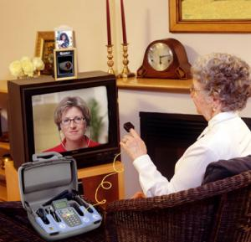

Connected Collaboration

Slide 9
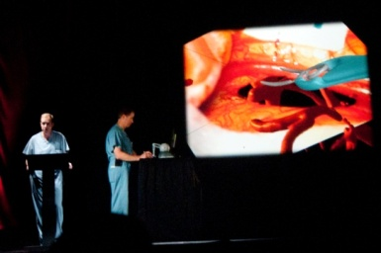
Remote Surgery

Slide 10
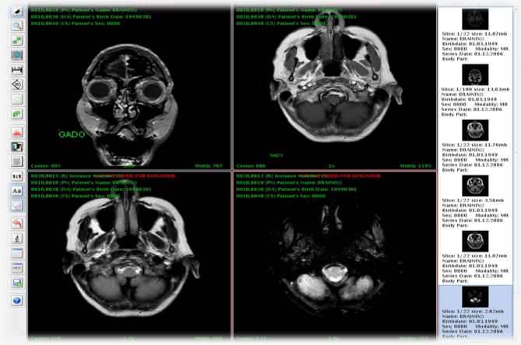
Remote Radiology

Slide 11
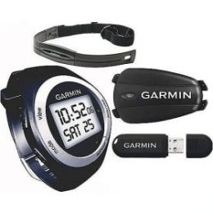
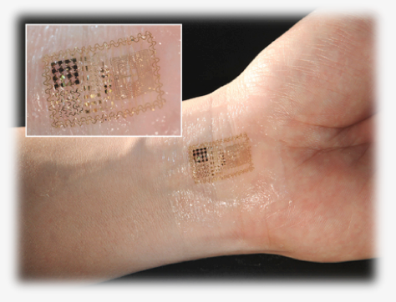

Personal Sensor Networks

Slide 12
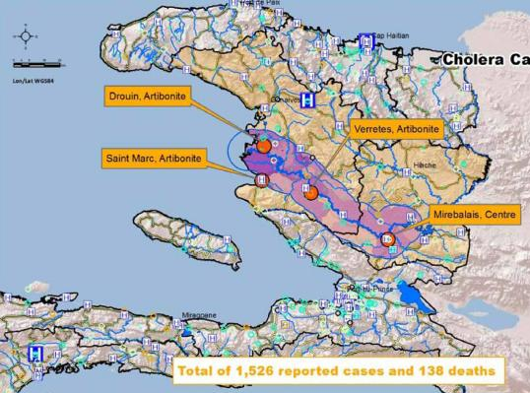
Big Data
Genomes and personalized health
Evidence-based personalized medicine
Longitudinal monitoring and sensors
High quality medical photos and videos
Public health dynamics

Slide 13
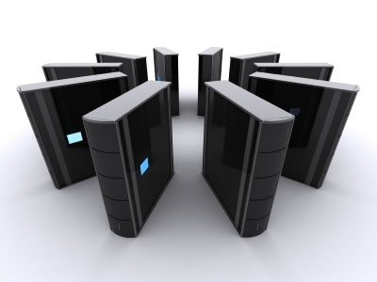
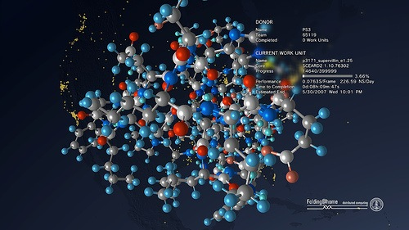

Virtual
Community Supercomputer

Slide 14


Public Apps Library

Slide 15
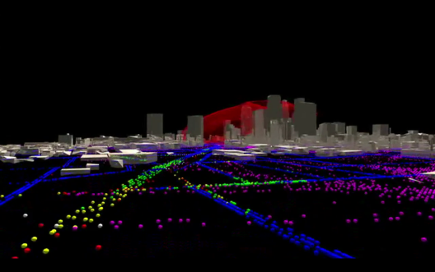
SimCenter
VIDEO: us-ignite.org/Chattanooga-story

Slide 16
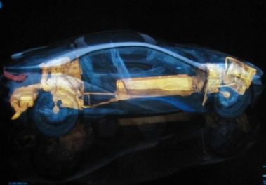
Remote Process Control

Slide 17

Software-Defined Home
Wireless Micronode Backhaul
Secure Banking
On-demand healthcare
VoIP
Plain Old Internet Connection

Slide 18
