Slide 1
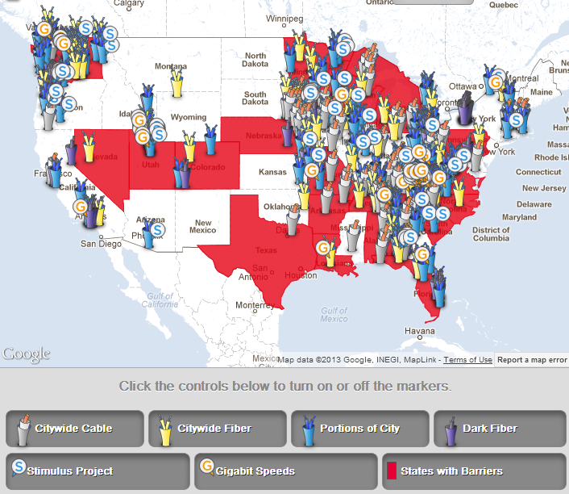
Communities with Publicly Owned Networks
MuniNetworks.org/communitymap

