Slide 1
FCC Gigabit Communities Workshop
Blair Levin
Executive Director, Gig.U
March 27, 2013

Slide 2
National Broadband Plan recommended the nation needed a critical mass of ultra-high speed test beds

Slide 3
National Broadband Plan called for a strategic bandwidth advantage
A Bandwidth Advantage
A Strategic Bandwidth Advantage
More bandwidth everywhere, at prices such that the average person has more bandwidth than in other countries
What we used to have; What Korea, Japan and others have now; What we are unlikely to ever have ever again
Fast enough and cheap enough bandwidth to the right places to provide an advantage over other countries in driving bandwidth based innovation and economic growth
What University R&E networks gave us in the first two decades of the Public Internet; what our country can achieve; what our communities want

Slide 4
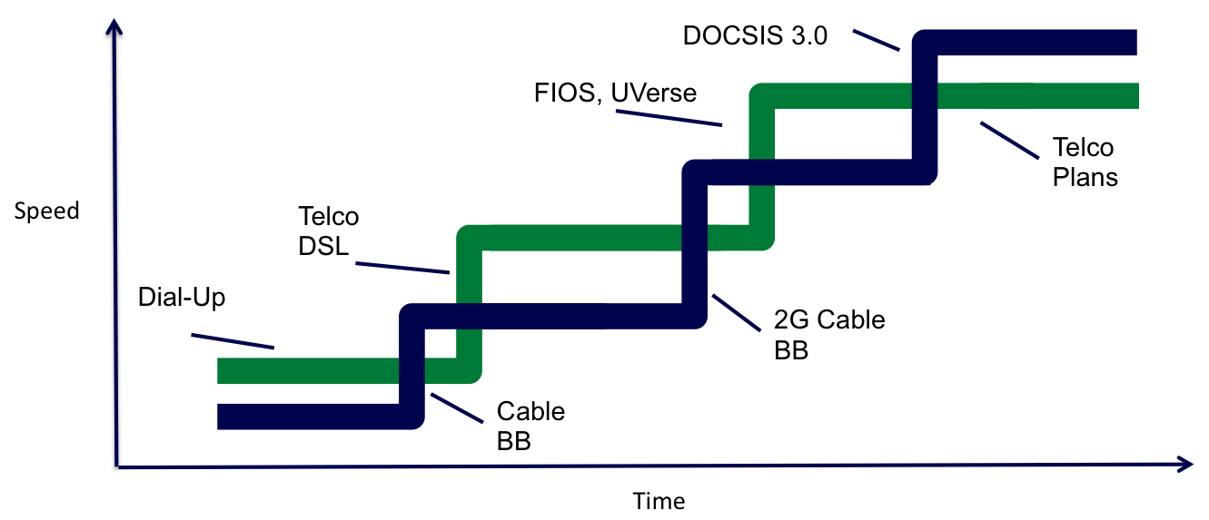
CITI/NBP report analyzed all public plans for deployment; no world leading networks in sight
Report suggested, and experience has confirmed, current market forces will not drive deployment of world leading wireline networks in the United States.
For the first time since the mass market Internet, there is not a national wireline carrier with plans to broadly deploy a better network than the current best available network.

Slide 5
The basic equations
Benefits accruing to:
Investor in the network
Content and applications
Local community
The region
The country
Total
benefits
of
high speed networks

Slide 6
The only benefits that matter for the investment are benefits to the investor
Benefits accruing to:
Investor in the network
Content and applications
Local community
The region
The country
Total
benefits
of
high speed networks
And as to those…

Slide 7
The returns for the investor do not justify the investment
For the investor, the equation usually looks like this:
C + O > (1-r)R + SB + (-CL)
Costs
Benefits
C – Capital Expenditures
O– Operating Expenditures
r – Risk
R- Revenues
SB- System Benefits
(Benefits that drive increased revenues outside the communities where the new or incremental investments are made.)
CL- Losses due to competition

Slide 8
The path forward: change the math
C + O < (1-r)R + SB + (-CL)
But how do we do that?

Slide 9
Historically, investments are made when policy – generally with federal leadership – alters equation
Sector /opportunity | Ecosystem change | CapEx | OpEx | Risk | Revenue | Competitive Losses
Telco | Grant of monopoly |  |  | Lower | Raise
Cable | Grant of monopoly, pole attachment law, compulsory broadcast license |  |  | Lower | Raise
Rural areas | USF | Lower | Lower
Wireless | Limited # of licenses |  |  | Lower
DBS | Limited # of licenses, program access |  |  | Lower | Raise
Broadband upgrade | Deregulation, two wire policy |  |  |  | Raise | Raise
Wireless upgrade | More licenses, lowered TAC, oversight of siting authority |  | Lower |  | Raise | Raise
Broadcast television to digital | Provide 2nd channel for transmission of content | Lower |  | Lower | Raise

Slide 10
Which, as recent projects demonstrate, can also be driven by forces within the local community
Sector /opportunity | Ecosystem change | CapEx | OpEx | Risk | Revenue | System Benefits
Google | Deals with City, State, and Utilities | Lower | Lower | Lower | Raise | Raise
Which is also what Seattle and Chicago did and other Gig.U communities are in the process of doing

Slide 11
There are many beneficiaries of improved networks who have a role in improving the math
State and Local governments
Anchor Institutions
Federal government

Slide 12
There are many beneficiaries of improved networks who have a role in improving the math
State and Local governments
Involved in current projects
Anchor Institutions
Involved in current projects
Federal government
What can it do?

