Slide 1

Broadband Needs, Challenges, and Opportunities in Rural America
Presented to the
Rural Broadband Workshop
Federal Communications Commission
March 19, 2014
Washington, DC
Charles W. Fluharty
President & CEO
Rural Policy Research Institute

Slide 2
Rural and Urban Definitions
No definition adequately captures rural and urban population dynamics
  Official Census Bureau definition of urban includes places from 2,500 to several million
  OMB Core Based Statistical Areas include some very rural counties in metro areas, because of commuting patterns
Neither categorical definition captures the continuum.

Slide 3
Urban and Rural Areas
The U.S. Census Bureau defines urban areas:
  Core blocks and block groups with population density of 1,000 people per square mile.
  Surrounding blocks with overall density of 500 ppmi²
  Range in size from 2,500 people to over 18 million people.
  Rural is everything that is not urban.
Based on the 2010 Decennial Census:
  59 million people live in rural areas (19%)
  249 million people live in urban areas (81%)

Slide 4
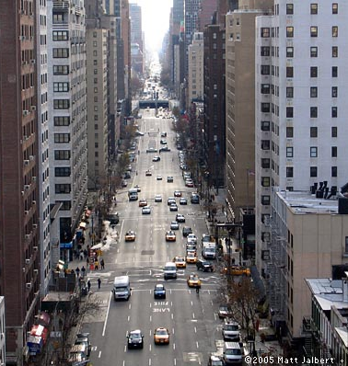
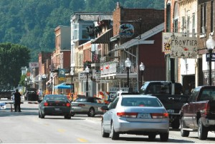
Urban is very diverse, however:
New York-Newark
Population 18 million
Bellevue, IA
Population 2,543

Slide 5
Core Based Statistical Areas
Defined by the Office of Management and Budget.
Designed as functional regions around urban centers.
County classification:
  Metropolitan
  Nonmetropolitan counties are divided into two types:
    Micropolitan
    Noncore

Slide 6
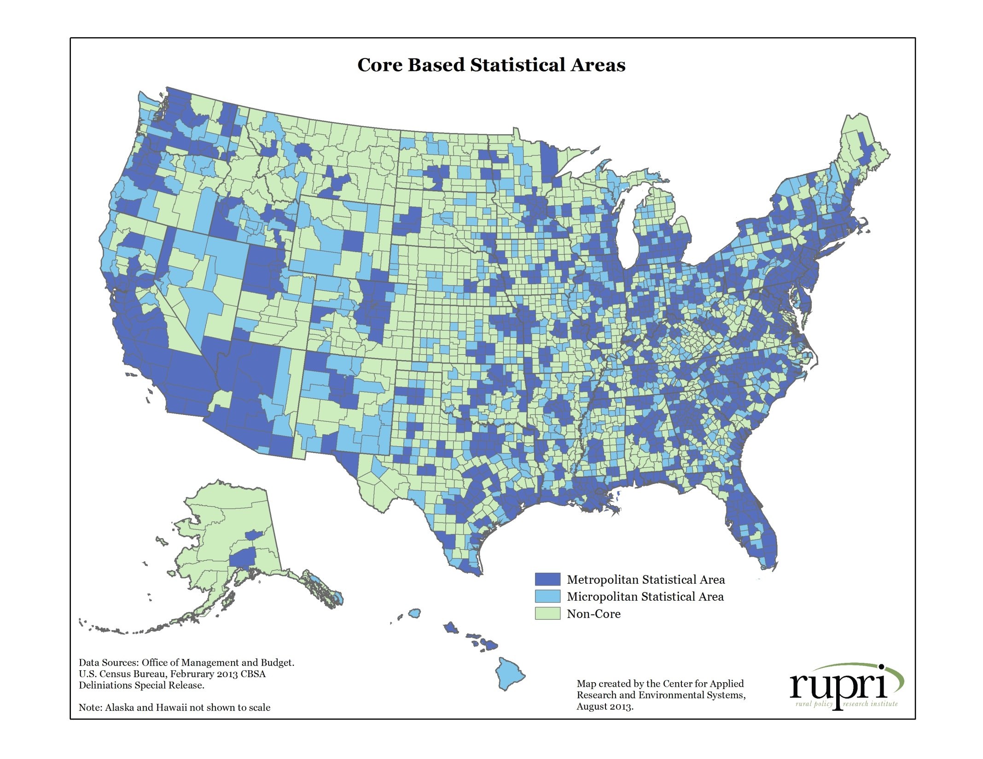

Slide 7
Usually, metropolitan is equated with urban and nonmetropolitan with rural.
But, if metropolitan is urban, then…

Slide 8
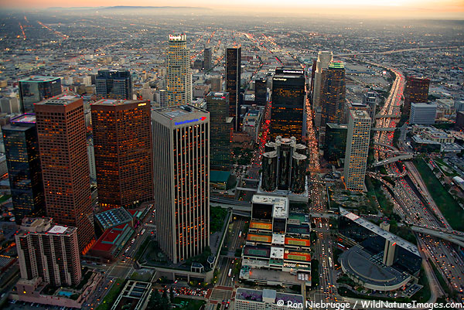
This is urban:
Los Angeles-Long Beach-Santa Ana, CA Metro Area
Population 12.8 million

Slide 9
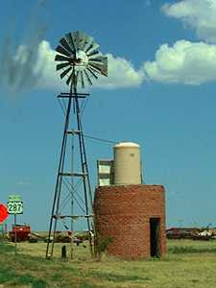
And so is this:
Armstrong County, Texas
Population 1,901
Part of the Amarillo Texas Metropolitan Area

Slide 10
And if nonmetropolitan is rural, then…

Slide 11
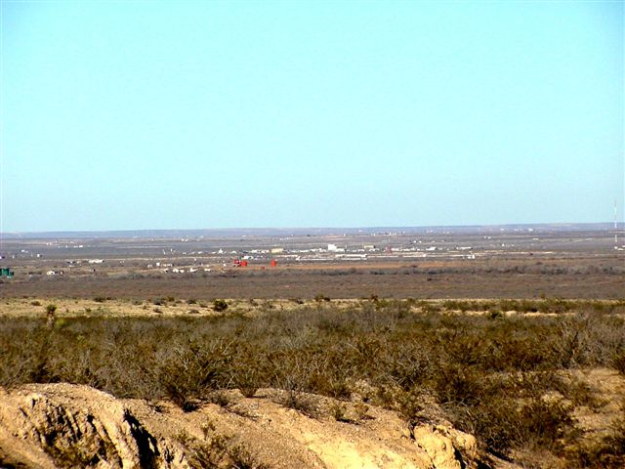
This is rural:
Loving County, Texas
Population 82

Slide 12
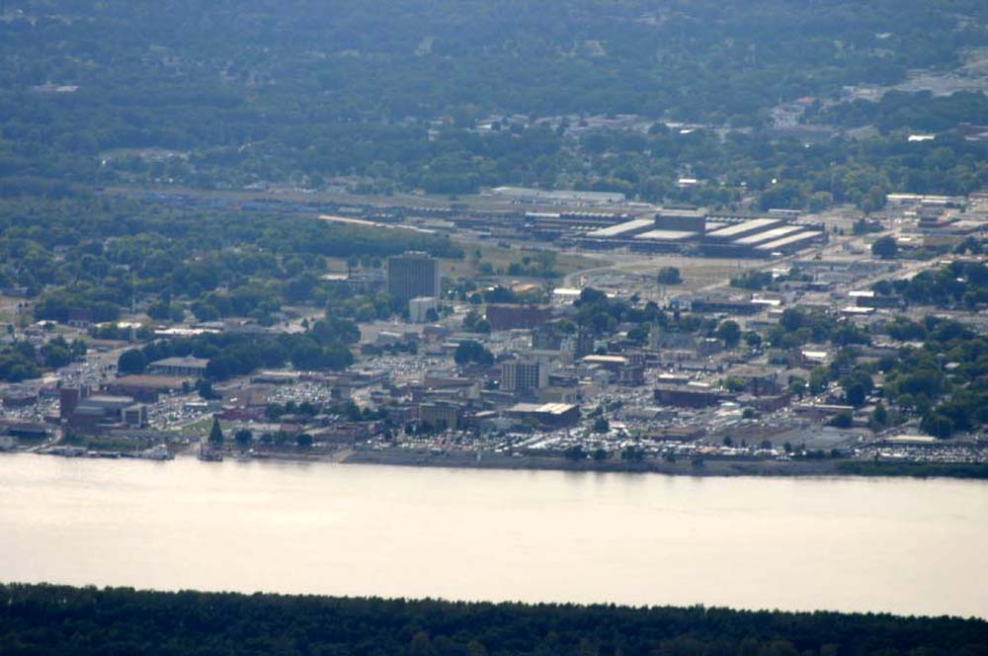
But so is this:
Paducah, Kentucky
Population 48,791

Slide 13

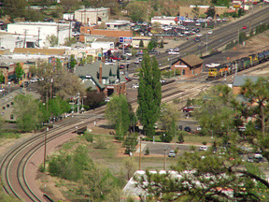
Most Counties are Urban and Rural!
Coconino County, Arizona
Population 134,421
Flagstaff Metro Area

Slide 14
In fact…
Over half of all rural people live in metropolitan counties!

Slide 15
Population Dynamics, 2010

Slide 16
Changes in Population Dynamics
58 counties became relatively less urban
105 counties became relatively more urban

Slide 17
Rural Americans Are Older
The median age in noncore counties is over 40.
In noncore counties, 18% of the population is over 65, compared to 13% in metropolitan counties.
Data: U.S. Census Bureau, American Community Survey, 2012 Annual Estimates

Slide 18
Rural Americans Are Less Educated
Data: U.S. Census Bureau, American Community Survey, 2012 Annual Estimates

Slide 19
Therefore, Non-Metropolitan Workers Are Far Less Likely
to Work in Technical and Management Occupations
Data: U.S. Census Bureau, American Community Survey, 2012 Annual Estimates

Slide 20
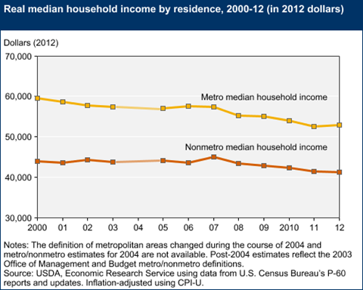
So, Rural Americans Earn Less

Slide 21
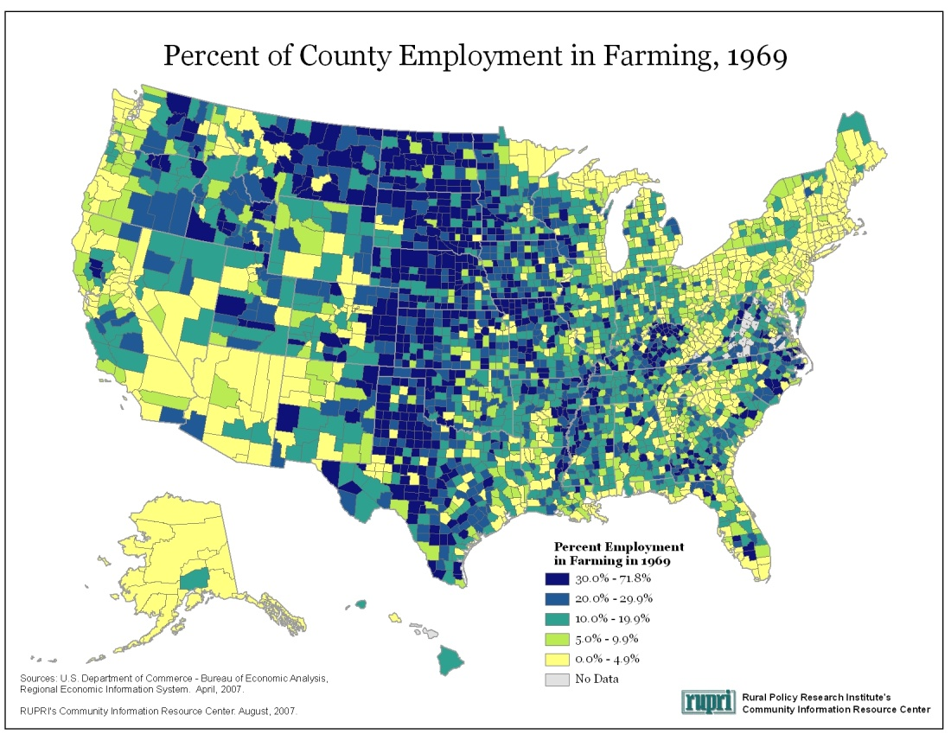
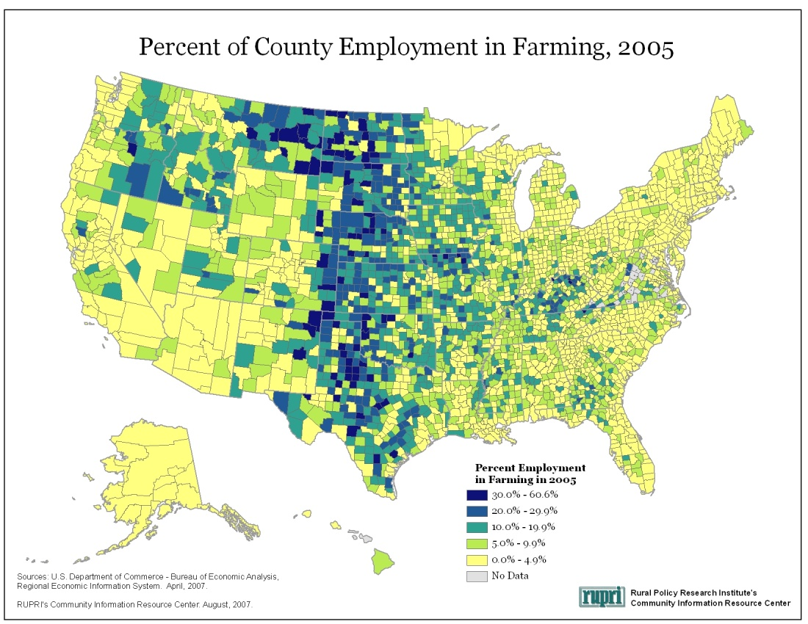
Farming’s Importance to Rural Employment Is Declining

Slide 22
But the Broader Rural Economy Is Now Very
Important to Farm Household Income
Source: ERS Agricultural Resource Management Survey, 2012

Slide 23
Rural Americans Face Challenges in Health Care
In noncore counties, nearly 18% of the population has a disability, compared to only 11% of the metro population.
A higher percentage of the noncore population lacks health insurance.
Data: U.S. Census Bureau, American Community Survey, 2012 Annual Estimates

Slide 24
Rural Health Care Challenges
Rural America contains 20 percent of the population, but only 10 percent of physicians.
Rural residents have greater transportation difficulties reaching health care providers, often travelling great distances to reach a doctor or hospital.
Two-thirds of deaths due to vehicular accidents occur in rural areas.
The suicide rate among rural men is significantly higher than in urban areas.
Alcohol abuse and smokeless tobacco use is a significant problem among rural youth.
Source: National Rural Health Association, “What’s Different About Rural Health Care?” http://www.ruralhealthweb.org/go/left/about-rural-health/what-s-different-about-rural-health-care/what-s-different-about-rural-health-care

Slide 25
Rural Americans Are Poorer
Data: U.S. Census Bureau, American Community Survey, 2012 Annual Estimates

Slide 26
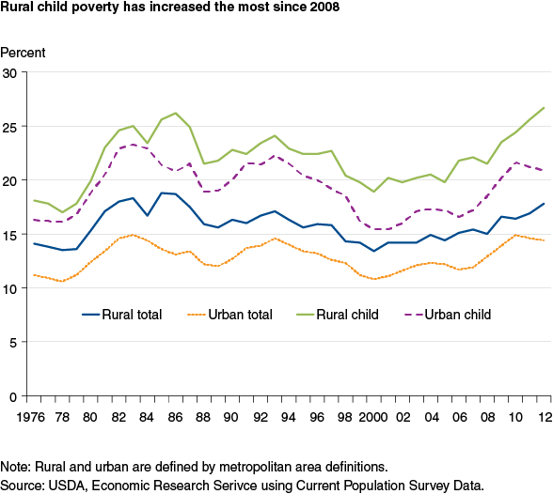
Rural Children Are Far More
Likely to Live In Poverty

Slide 27
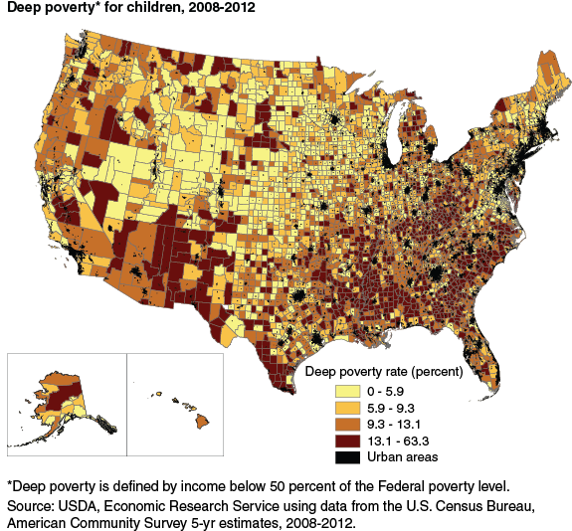
Deep poverty* for children, 2008-2012

Slide 28
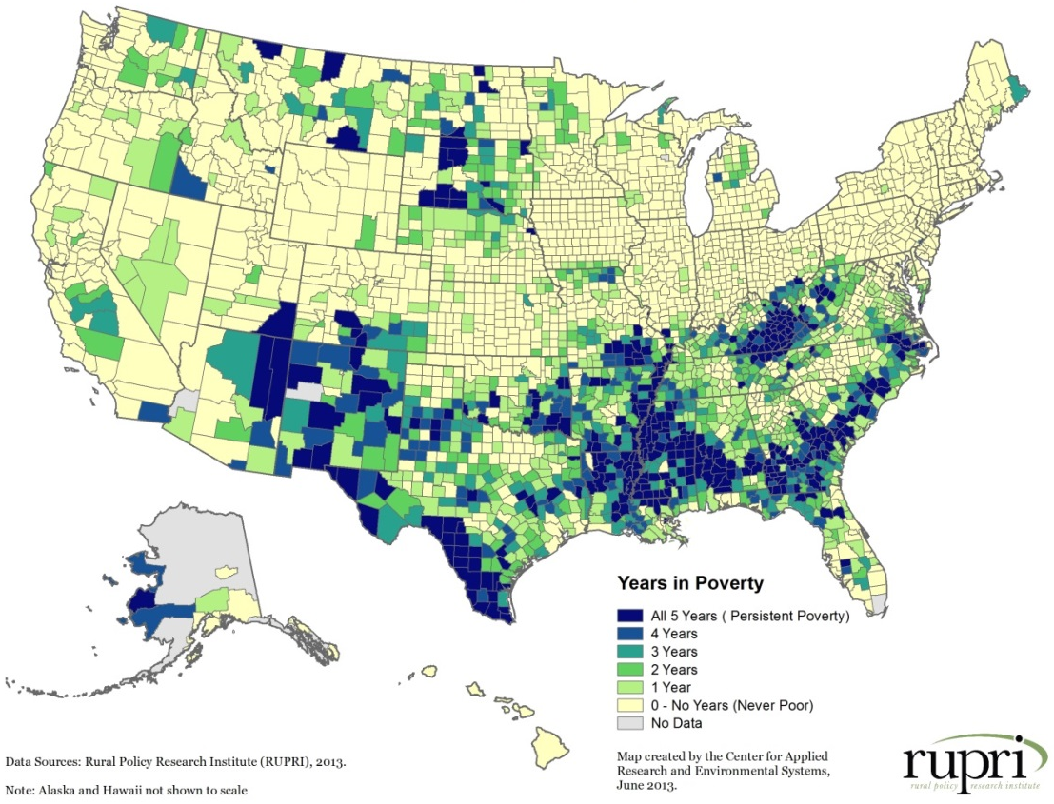
Rural Poverty Is Persistent
Number of Measurement Years High Poverty, 1969-2009
Of 347 persistent poverty counties, 299 or 86% are nonmetro

Slide 29
Poor Rural Americans Face Multiple Challenges
The Geography of Need
An examination of human services needs across the country (8 demographic and 4 economic needs indicators)
Nearly one-third of noncore counties experience three or more risk factors, compared to only 9% of metro counties
10% of noncore counties experience five or more risk factors, compared to only 2 percent of metro counties.
Source: Heflin and Miller 2011. The Geography of Need: Identifying Human Service Needs in Rural America. Rural Policy Research Institute

Slide 30
Combined Risk Factor Index

Slide 31
Counties with Three or More Risk Factors
(Combined Index), by CBSA Status

Slide 32


Slide 33
The Framework for Regional Rural Innovation
New Narratives & Networks
Quality of Place
Collaborative Leadership
Knowledge Networks & Workforce
E-ship & Innovation
Critical Internal Considerations
Wealth Creation and Intergenerational Wealth Retention
Youth Engagement and Retention
Social Inclusion and Social Equity

Slide 34

Charles W. Fluharty
cfluharty@rupri.org
President and CEO
Rural Policy Research Institute
214 Middlebush Hall
University of Missouri
Columbia, MO 65211
(573) 882-0316
http://www.rupri.org/

