Slide 1
OPPORTUNITIES FOR IN-UNIT ACCESS FOR HUD RESIDENTS
Dina Lehmann-Kim
Program Manager
HUD/Office of Public Housing Investments
dina.lehmann-kim@hud.gov
Amber Petty
National Program Coordinator
EveryoneOn
amber@everyoneon.org

Slide 2
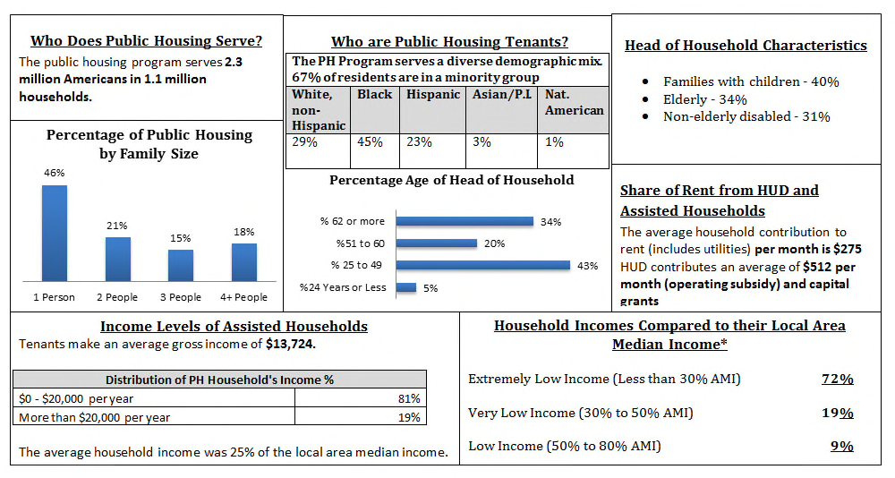
PUBLIC HOUSING

Slide 3
PUBLIC HOUSING
2.3 million individuals housed.
Thirty-four percent, or approximately 780,000 individuals are 62 years or older.
Some are disabled.
Some are living with minor children.
All are low-income.

Slide 4
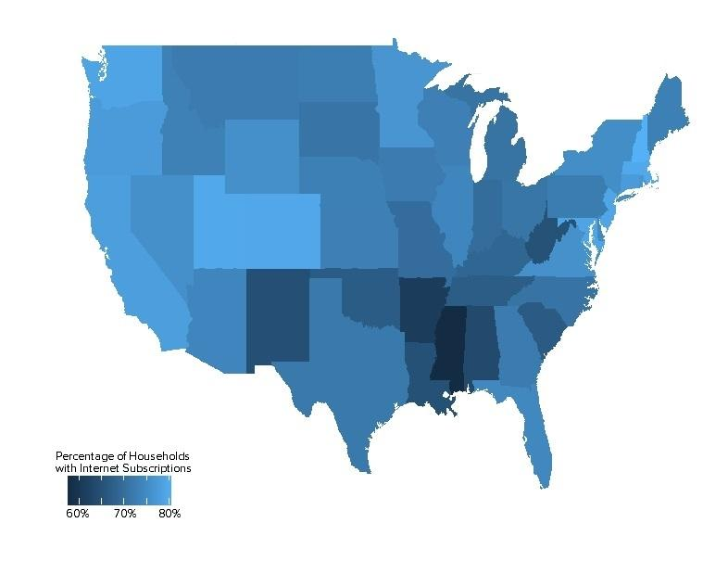
DIGITAL DIVIDE
On average, 24.7 percent of households in the United States are without home access.
According to Pew Research Center, approximately 21 percent of low-income seniors have an Internet connection at home.
Most older adults (77 percent) say they would need assistance prior to using a new technology device.
Cost of devices and Internet service are also a barrier for low-income HUD residents.
Notes:
Pew Study: http://www.pewinternet.org/2014/04/03/usage-and-adoption/, sponsored by Pew Research Center’s Internet & American Life Project and the Gates Foundation
79% of seniors surveyed agree that “people without Internet access are at a real disadvantage because of all the information they might be missing.”
Once online, most seniors make the Internet a daily part of their lives and view it in a positive light.
http://newoldage.blogs.nytimes.com/2013/05/03/helping-seniors-learn-new-technology/?_r=0

Slide 5
BENEFITS OF CONNECTIVITY
Reduced isolation through online social interaction (e.g. Facebook & email).
Health resources & information (e.g. electronic health records & health portals).
Many resources are available or easier to access online (e.g. government programs, benefit information, & online banking).
Notes:
Many providers, including the U-M Health System, now offer patients access to parts of their own medical records via online health portals that include everything from reminders of when they are due for wellness visits and screening tests, to immunization records and lab results, as well as key information on obtaining and using their prescription medications correctly and safely. University of Michigan study finds that less than a third of Americans over the age of 65 use the Internet to keep track of their health.
According to the Centers for Disease Control and Prevention, in 2013, 78 percent of office-based doctors had already adopted electronic health record (EHR) systems that met the government’s standards under the Affordable Care Act, up from 18 percent in 2001.
U of M study: http://www.uofmhealth.org/news/archive/201411/great-digital-divide-healthcare-older-americans-may-be-left

Slide 6
HUD RESOURCES
PUBLIC HOUSING CAPITAL & OPERATING FUNDS
May be used to open & operate a Neighborhood Networks computer center & hire staff to support the center.
In-unit routers (not service) may be purchased with Capital Funds on a uniform basis across one or more developments.
PUBLIC HOUSING ROSS SERVICE COORDINATOR PROGRAM
Service Coordinator can link residents to services or bring services on-site.
Software & hardware purchases for community centers or computer labs.
Notes:
Capital Fund Statute: http://www.gpo.gov/fdsys/granule/USCODE-2010-title42/USCODE-2010-title42-chap8-subchapI-sec1437g/content-detail.html
Operating Fund Statute: http://www.gpo.gov/fdsys/granule/USCODE-2010-title42/USCODE-2010-title42-chap8-subchapI-sec1437g/content-detail.html

Slide 7
HOW WE HELP
EveryoneOn is a national nonprofit devoted to closing the digital divide in America.
There are three primary reasons people are offline, & these are what we work against:
COST
We work to provide access to affordable computers & Internet service for as low as $10 per month.
RELEVANCY
We build awareness of the importance of Internet through national and local outreach.
DIGITAL LITERACY
We provide access to best-in-class content both online & in-person training.
HUD stakeholders like the Public Housing Authorities & the residents they serve are pre-qualified for low-cost offers through: www.EveryoneOn.org/HUD.

Slide 8
EVERYONEON AND ADULTED
From online GED preparation, to language acquisition programs and job training, Internet access is key in today’s digital society.
Yet 47.2 percent of individuals seeking a high school diploma or GED lack home Internet access.
EveryoneOn is committed to working with leaders in adult education to ensure that students are able to access the tools needed to succeed.

Slide 9
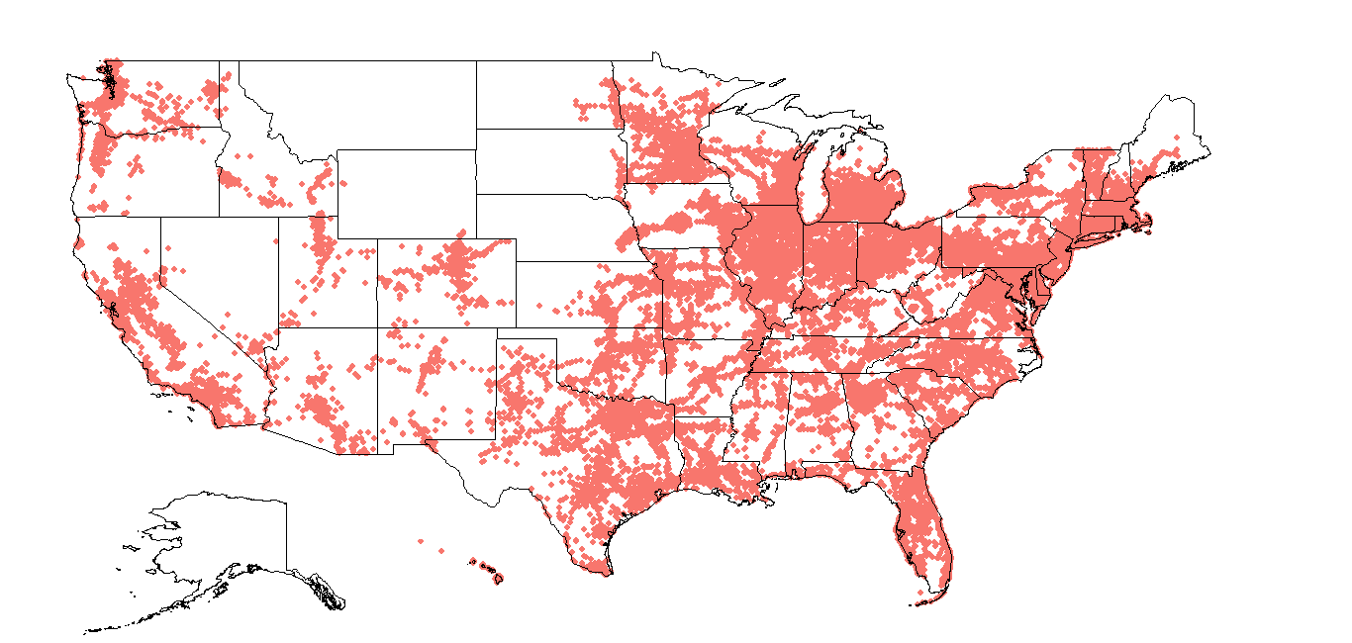
ELIGIBILITY
How do you qualify for our offers?
Live in a zip code with an annual median income less than $35,000.
-- OR --
Be served by one of our over 300 Enrollment Partner organizations.

Slide 10
Anyone in the United States can visit EveryoneOn.org or text ‘Connect’ to 215-45 and discover low-cost Internet service, devices, and free computer and Internet training at over 8,000 sites across the country.

Slide 11
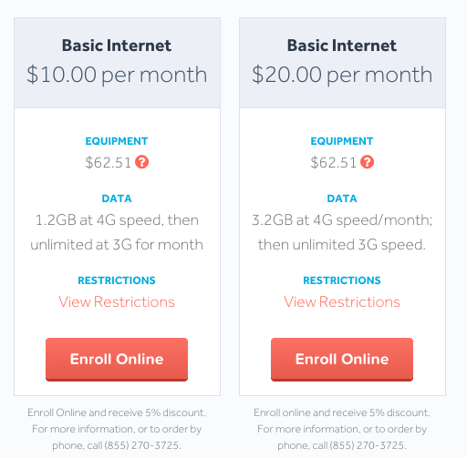
LOW-COST INTERNET SERVICE OFFERS AVAILABLE

Slide 12
OFFERS: DEVICES
We also work with device refurbishers in order to offer affordable devices.
The prices listed under the devices include shipping. All desktops & laptops include Windows 7 Pro, free Microsoft Office software, 90-day warrantee, & tech support.

Slide 13
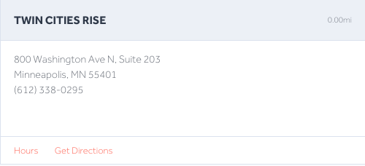
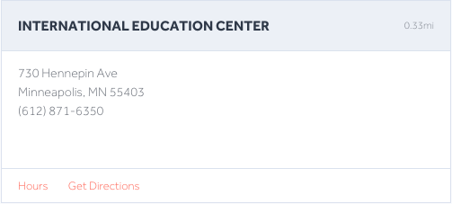
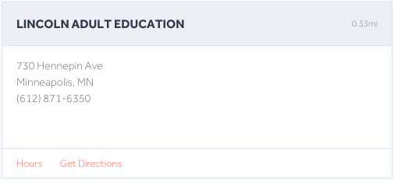
FINDING COURSES NEAR YOU
We have a database of schools, libraries, and community centers across the country that offer digital literacy courses and/or public computing centers.

Slide 14
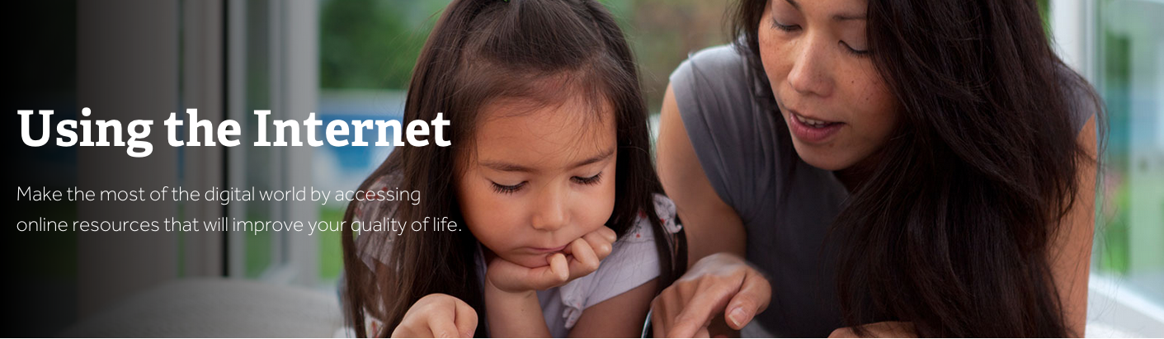
KNOWLEDGE CENTER
EveryoneOn provides a platform of online resources through our knowledge center. With content covering education, financial literacy, career training and much more, our knowledge is a perfect resource for newly connected individuals looking to learn.

