Slide 1
Resources for Learning Facilitators
Heidi.Silver-Pacuilla@ed.gov , U.S. Department of Education, Office of Career, Technical, and Adult Education (OCTAE)

Slide 2
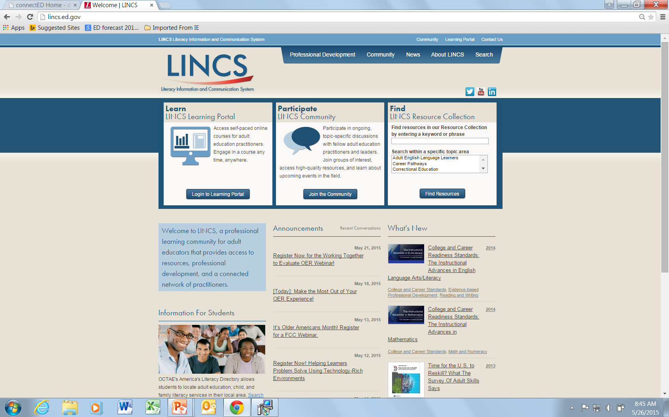

Slide 3
LINCS.ed.gov Makes a Difference
LINCS offers:
A Resource Collection containing high-quality, evidence-based materials in 16 topic areas critical to the field
An online Community of Practice where facilitators can share knowledge and collaborate with peers and experts
A Learning Portal where facilitators can engage in self-paced professional development courses
Four Regional Professional Development Centers (RPDCs) that deploy evidenced-based PD trainings to states
Notes:
Freely available resources and just-in-time online learning made provided by the U.S. Department of Education, Office of Career, Technical, and Adult Education

Slide 4
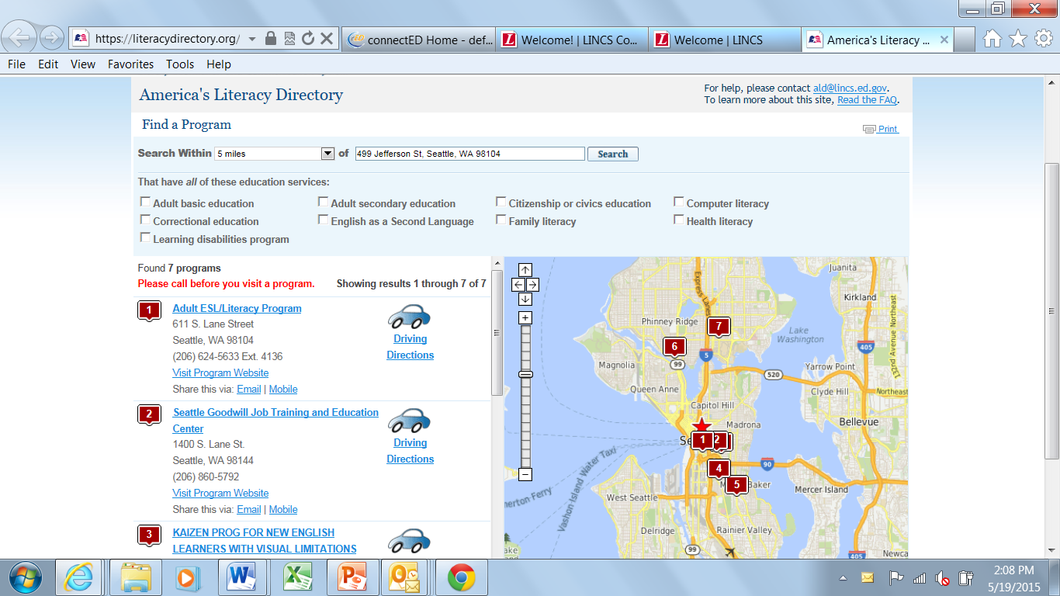
Find a Program by Zip Code

Slide 5
Follow LINCS for Updates
@LINCS_ED
Join our group:
LINCS_ED

Slide 6
Watch for New Resources
Tutor Ready Learning Plans for tutors teaching literacy (Spring 2015) http://literacyworkslincs.learnerweb.org
Lesson plans to help adults get connected to the Internet through initiatives such as Everyone On (Summer 2015)
Adult learner portal will bring links to online learning tools into one handy place for adults (Fall 2015)

