Slide 1
Discovering the
Digital Literacy Dot Gov
Community
Presented by
Gwenn Weaver, Program Officer
National Telecommunications Information Administration (NTIA)
Aaron Low, SF Connected Program Manager
Department of Aging and Adult Services (DAAS) Office on Aging (OOA) – City & County of San Francisco

Slide 2
What is Digital Literacy?
The ability to use information and communication technologies to find, understand, evaluate, create, and communicate digital information, an ability that requires both cognitive and technical skills.
The Report of the Digital Literacy Task Force of the American Library Association, January 2013

Slide 3
What is Digitalliteracy.gov?
An online portal designed to share and enhance the tools necessary to learn computer and Internet skills and to increase digital literacy.
Presently contains:
Workforce-development resources
Curricular material
Links to tutorials
Train-the trainer info
Reports and articles

Slide 4
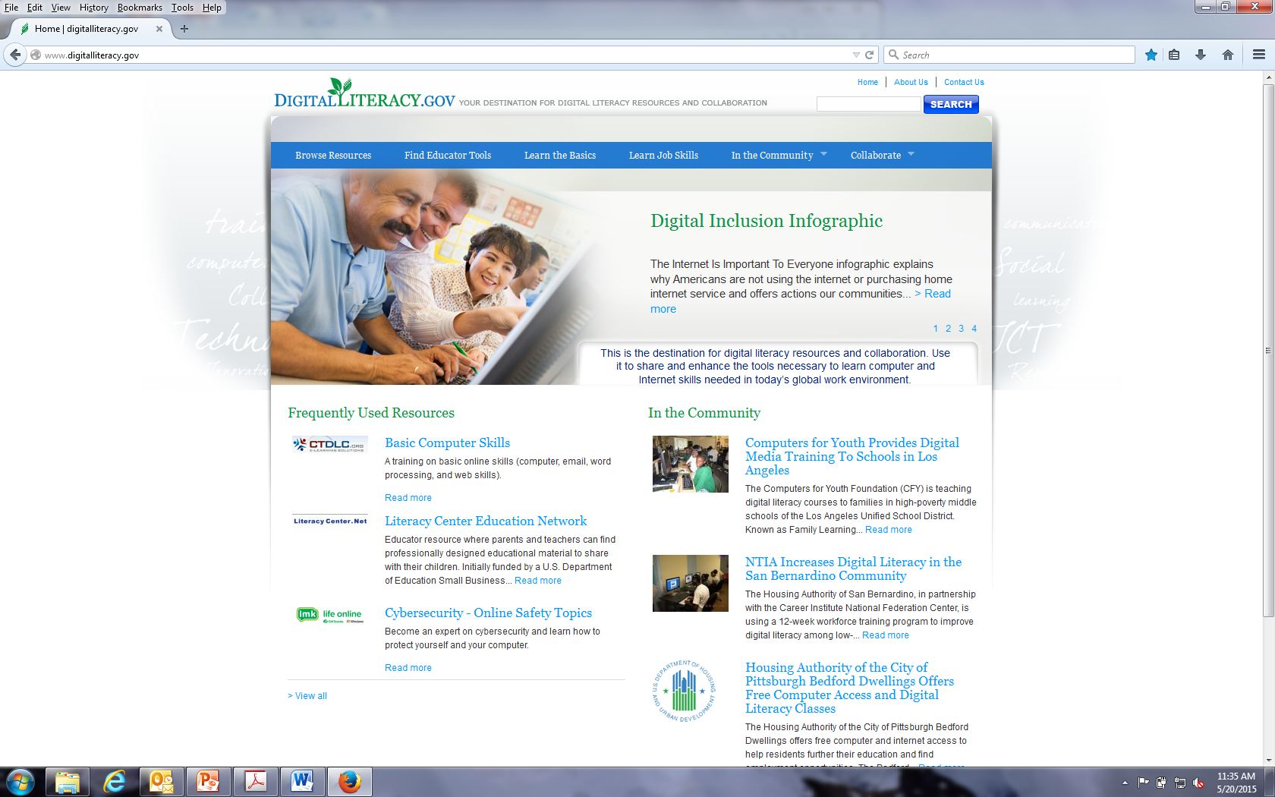
What is Digitalliteracy.gov?

Slide 5
Developed by
National Telecommunication & Information Administration
in collaboration with
Corporation for National and Community Service
Federal Communications Commission
Institute for Museum and Library Services
U.S. Department of Agriculture
U.S Department of Education
U.S. Department of Energy
U.S. Department of Health and Human Services
U.S. Department of Housing and Urban Development
U.S. Department of Labor
With advice and input from outside partners including: American Library Association & MacArthur Foundation

Slide 6
DL.Gov Community Collaboration
Share best practices
Recommend appropriate resources
Provide feedback to help improve the site
Among our initial community collaborators were:
Broadband Technology Opportunity Program Grant Recipients
Public Libraries
State and Local Government agencies
Community Technology programs

Slide 7
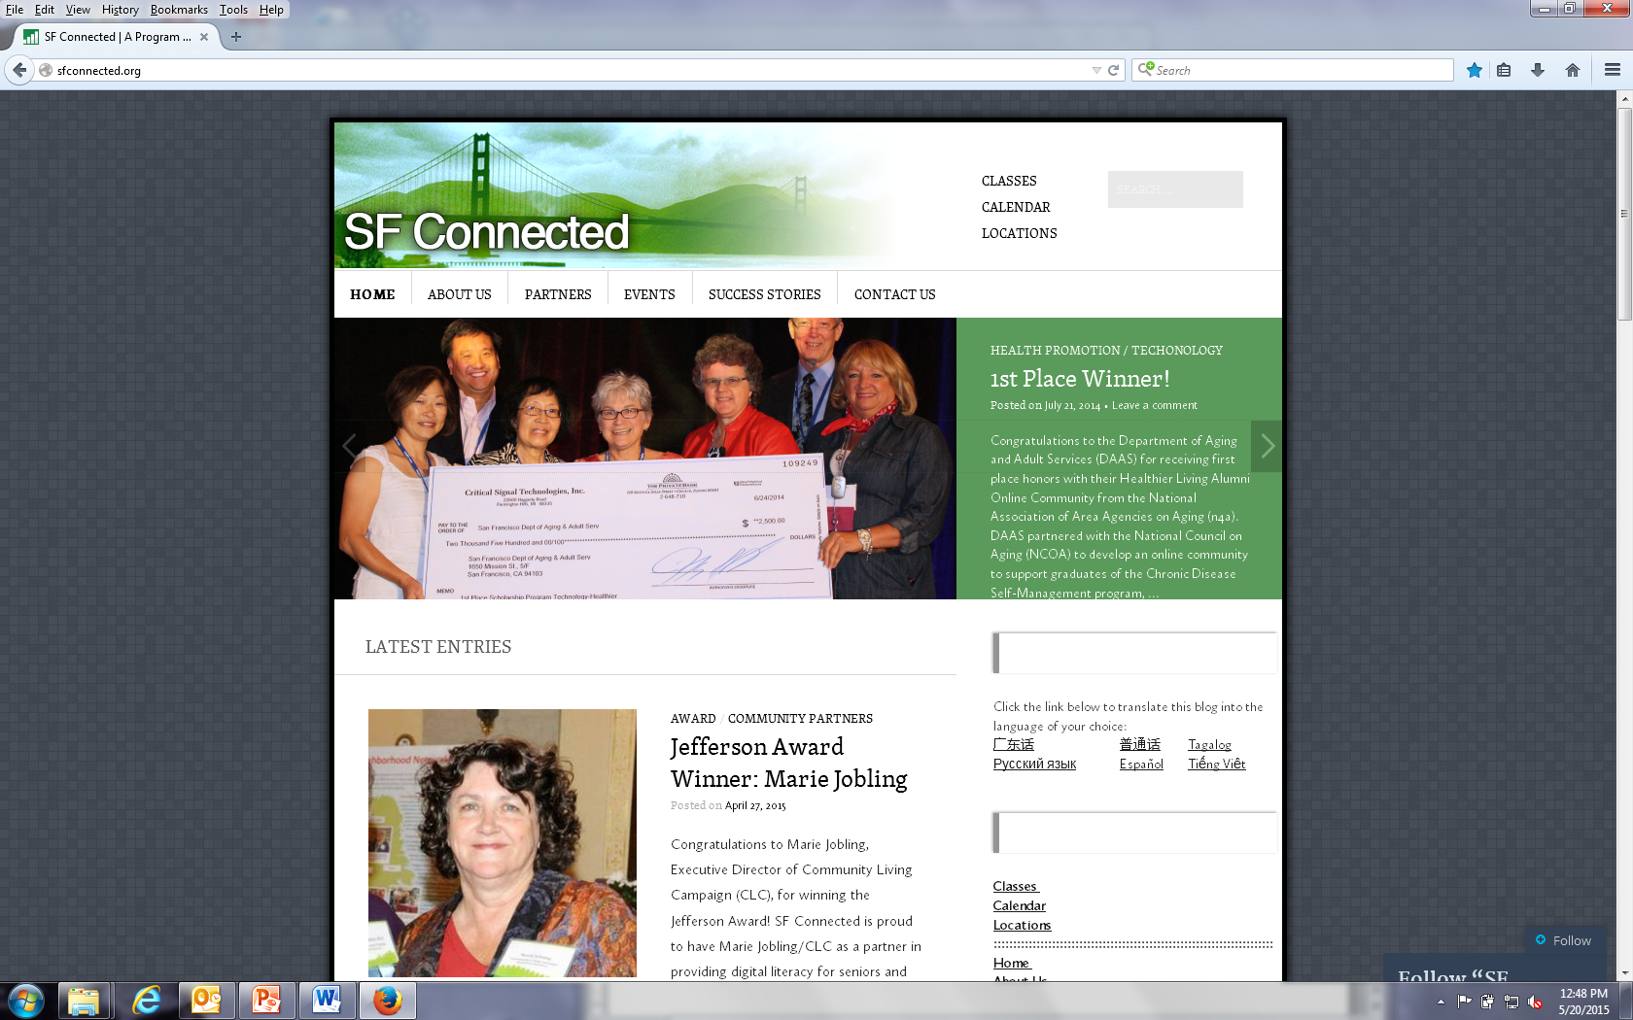
San Francisco Department of Aging & Adult Services SF Connected Program

Slide 8
San Francisco Department of Aging & Adult Services SF Connected Program
Provides free digital literacy training to seniors and adults with disabilities
Developed curriculum in multiple languages
Provide training in six languages (English, Spanish, Chinese, Korean, Russian, and Vietnamese)
Provides on-line support community - CDSMP
Provide technical support

Slide 9
San Francisco Department of Aging & Adult Services SF Connected Program
Won multiple awards from National Association of Area Agencies on Aging (N4A) for its successful programs
Recognized by the City and County of San Francisco as a top 10 innovative program
SF Connected Community Collaboration: The Tech Council

Slide 10
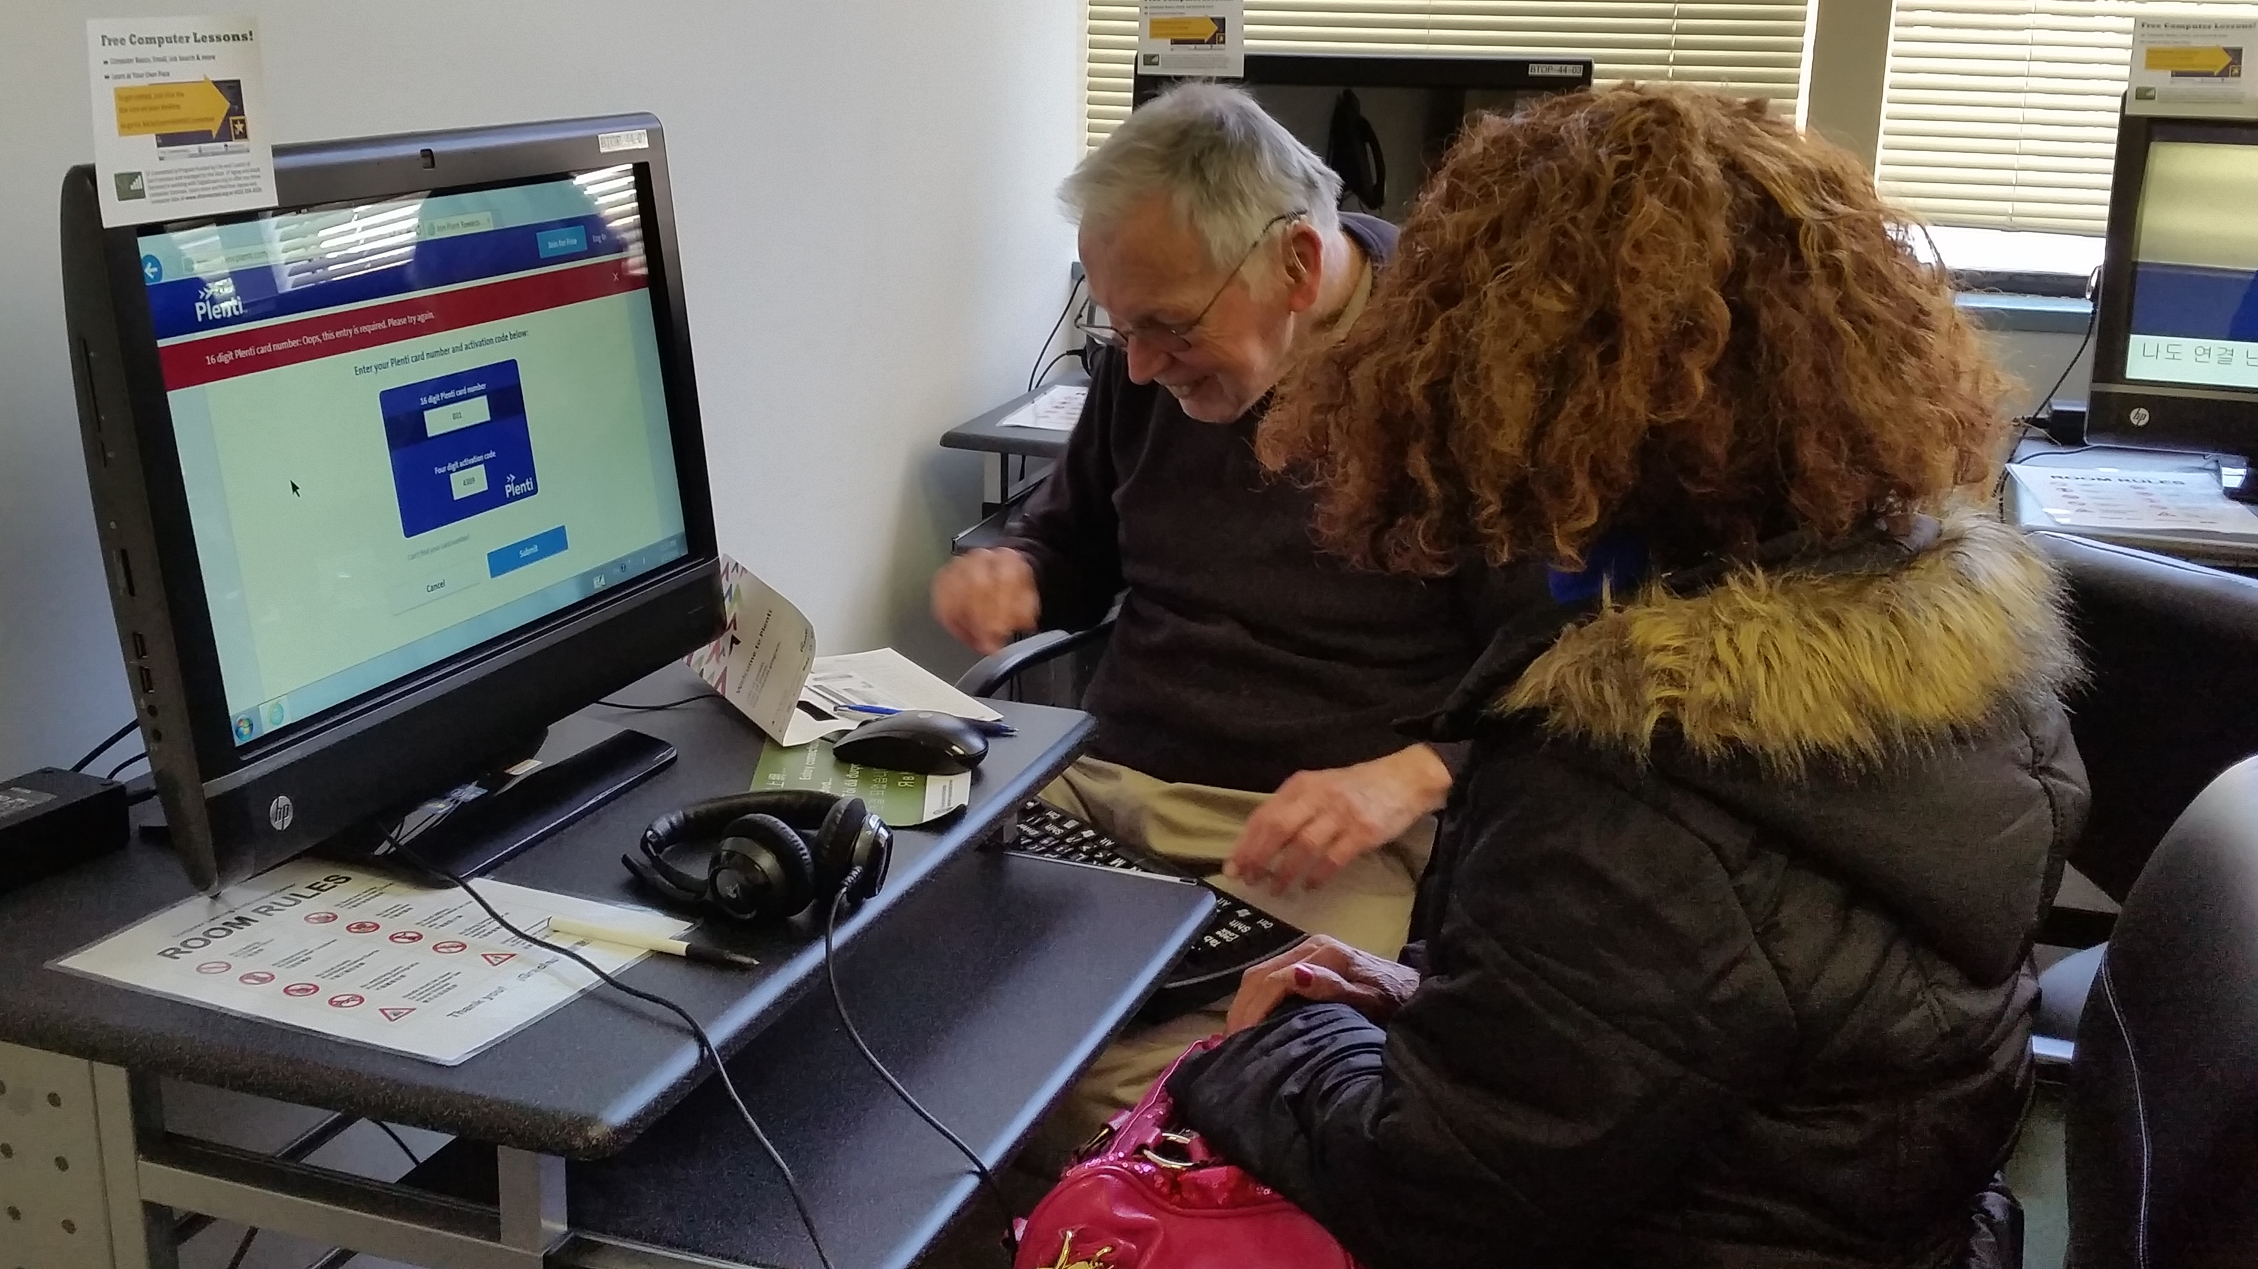
Seniors helping Seniors
Notes:
Art been coming to Stonestown YMCA over 3 years. He used the computer lab that was provided originally by Broadband Technology Opportunities Program (BTOP) and now funded by SF Connected for several years. A few years ago, he noticed that trainers weren’t able to continue training in the lab. Art took it upon himself to fill the void last year and started helping the other seniors using the lab. He provides this support 3 hours 2 to 3 times a week. He has helped over 10 seniors. Some of the assistance he has provided includes helping complete forms. These forms include completing surveys, registering gift cards, and even practicing DMV written tests.

