Slide 1
FCC Summit on Telecommunication and Communication Needs
of People with Cognitive Impairments
EMERGENCY PREPAREDNESS:
TELECOMMUNICATIONS CHALLENGES
FOR PEOPLE WITH COGNITIVE IMPAIRMENTS
Matt Kaplowitz, President and Director of Technology and Innovation
Bridge Multimedia
October 28, 2015

Slide 2
Conditions Often Associated with Cognitive Impairments
Can include:
Attention Deficit Disorder
Aphasia
Autism
Dementia
Down Syndrome
Dyslexia, Dyscalculia
Other learning disabilities
Sensory impairments including: D/HH & B/VI
Stroke
Traumatic Brain Injury (TBI)

Slide 3
Functional Cognitive Disabilities and Intellectual Disabilities
May involve Difficulties or Deficits Including:
attention
daily living skills
math comprehension
memory
problem-solving
reading, linguistic, and verbal comprehension
sensory input
spatial representation
visual comprehension
15-20 percent of the U.S. population has some
form of language-based learning disability
Source: http://www.disabled-world.com/disability/types/cognitive

Slide 4
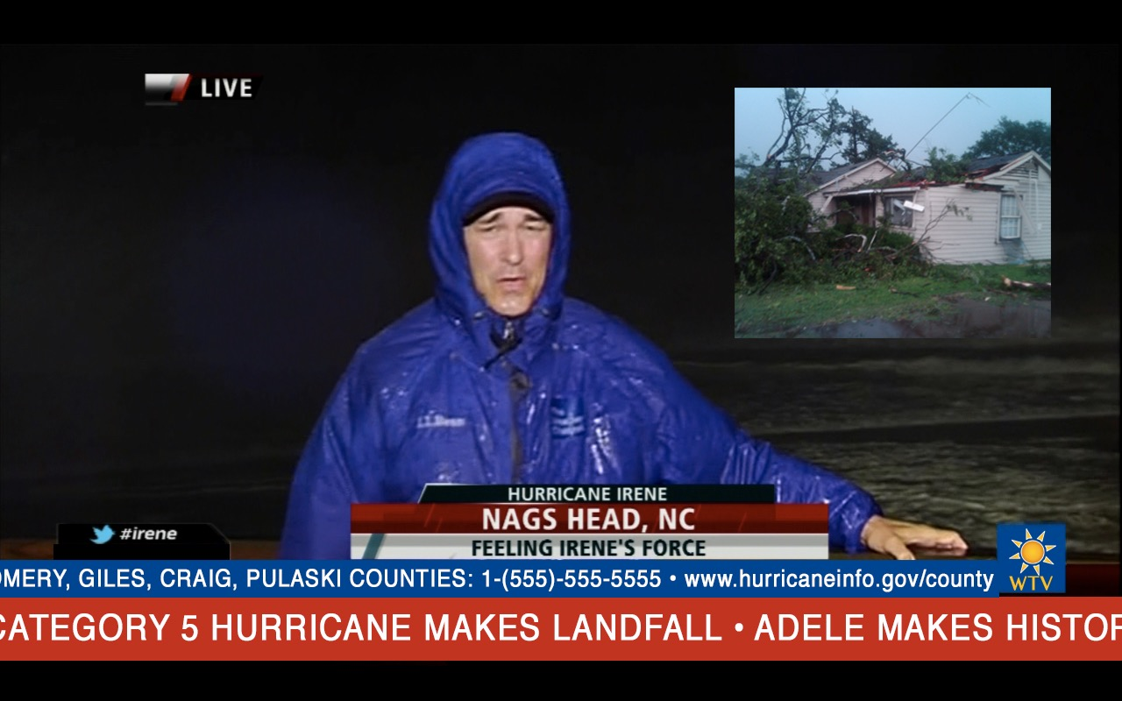

Slide 5
Reducing Telecommunications Challenges
1. “Take Action!” information should stand out.
2. Crawls: emergency and non-emergency information should be clearly differentiated
3. Vocabulary: standards for reading level versus receptive language level should be optimized for broad-based comprehension.
4. Description-embedded language should be utilized.*
*Audio description and captions are beneficial to people with non-sensory impairments.
.

Slide 6
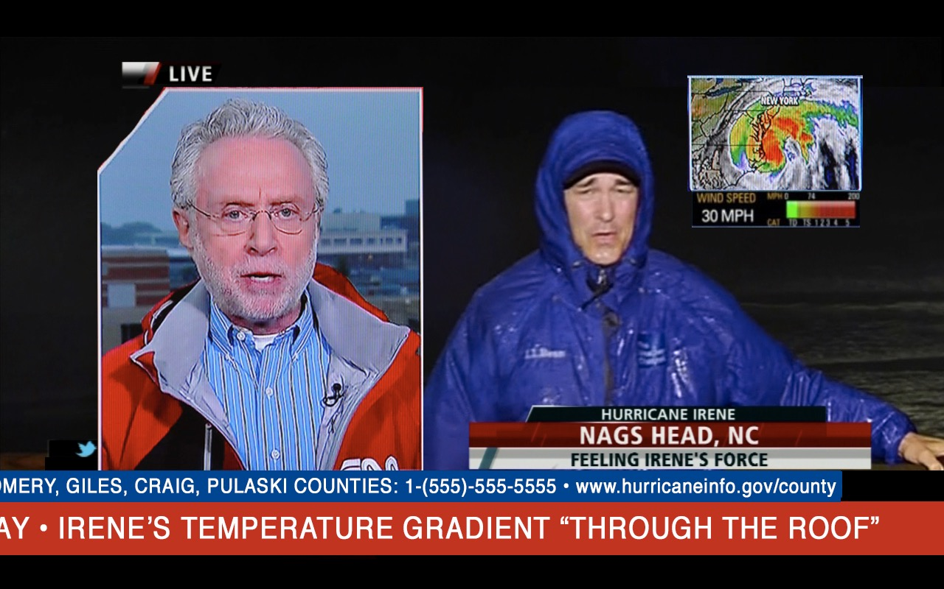

Slide 7
Common Practices that May Cause Difficulties
5. Two reporters in different locations may be difficult to follow.
6. Detailed MAPS should be as full screen as possible.
7. Abbreviations, even generally, familiar ones, such as MPH, should be full-word spoken.
8. Technical vocabulary such as “temperature gradient,” without contextual definitions, should be avoided.
9. Figurative language such as “through the roof,” may be taken literally and should be avoided.

Slide 9
Common Practices that May Cause Difficulties
10. Flashing notifications such as "LIVE" may be distracting.
11. Looped images such as the lightning flash in the box image may be perceived as sequential events.
12. Bright on-screen flashes may trigger epileptic reactions.
Loud sounds, such as thunder, may be frightening.
14. County-only locations may not be recognized or may be unfamiliar.

Slide 10
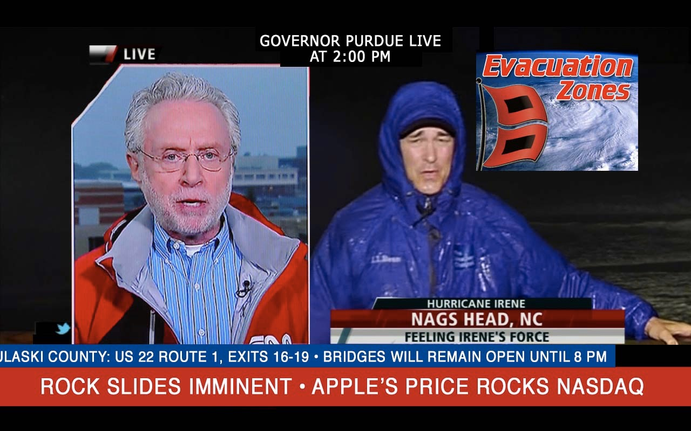

Slide 11
Characteristics Needing Standardization, cont’d
15. The number of recommended on-screen focus-points should be established––differentiated for large screen, tablet, and mobile devices.
16. Font size minimums within maps and other on-screen graphics should be determined. 17. Duration of screen time for essential on-screen text based information should be assessed.
18. Duration of screen time for essential on-screen CAPTION information should be assessed.

Slide 12
Characteristics Needing Standardization, cont’d.
19. Consistent emergency-related terminology should be established for reporters, on-screen text, audio notifications and emergency workers.
20. Consistent use of the same word(s) for the same object(s)
21. Speech intelligibility best practices: i.e., clarity of “m” vs. “n" consonants, etc.
22. Consistent, preferred word pronunciations re: regional and colloquial, e.g.: route (ro͞ot vs. rout), and
address (əˈdres, vs. ˈaˌdres)

Slide 13
Additional interventions to be considered:
23. Alternative versions of the FCC guides for professionals, following language comprehension best practices.
24. Supplementary cognitive disability-friendly web and print based information;
similar to http://www.read.gov/kids, for the general population, but not exclusively children focused.
25. Use of fonts optimized for specific disability populations.
Two examples: Open Source Dyslexia http://opendyslexic.org, a font (free) for individuals with dyslexia •APHpont, a font optimized for low vision individuals reading closed captions.
26. Develop FCC-Standardized picture communication icons, as well as protocols for displaying them consistently across all media formats.

Slide 14
Additional interventions to be considered:
27. Develop FCC-standardized ASL signs that align with FCC-standardized
picture communication icons.
28. Expand color-coding/universal color coding, e.g. “code red,” and “amber alert.”
29. Create a sound effects library of emergency tones, optimized for the deaf/hard of hearing population that is consistent across all telecommunications devices.
30. Standardized graphic, color, picture icon, ASL and sound emergency notification “interruptions” play across ALL channels, screens, and devices, English and Spanish.

Slide 15
Additional interventions to be considered:
31. Text-to-911 enhancements: Communication input to 911 messaging using picture icons for individuals without speech, including ALS, Parkinson’s, M.S., M.D., and ASD.
32. Video Relay Service enhancements: general postings available in multiple communication formats for general information and also in emergencies.
33. Hands-free, single switch and gestural controlled interfaces for 911 communications using standard phone and mobile devices
34. Build out a nationwide buddy/chat system similar to massively multiplayer online game (MMOG) technology. Individuals can self-register for an emergency buddy.

Slide 16
THANK YOU!
www.bridgemultimedia.com

Slide 17
Matthew Kaplowitz, President and Director of Technology and Innovation for Bridge Multimedia since 2002, has guided the development of accessible web and streaming media tools for individuals with disabilities; been the principal designer of a multi-sensory literacy system for young children with disabilities; and since 2010, led the Bridge project team for three five-year ED/OSEP Technology Access grants for video description and captioning. Bridge Multimedia is currently the largest producer of video description for network and cable TV in the U.S.
Kaplowitz is an Emmy, Peabody, and Grammy Award-winning producer, composer, and sound designer as well as an assistive listening systems engineer and A/V systems integration specialist for ADA-compliant installations for major public spaces including the Bronx Zoo/Wildlife Conservation Society, the Intrepid Sea, Air and Space Museum, the Vivian Beaumont Theatre at Lincoln Center, and the Nederlander, Richard Rodgers, and Gershwin Theatres, in New York City.
Since 2006, Kaplowitz has served on the Executive Board of Chimes International, a disability services and behavioral health organization that provides employment primarily through Ability One programs to more than 2,000 individuals with disabilities.
He is married to Suzanne Auerbach and parent of a multiply-disabled daughter.
mkaplowitz@bridgemultimedia.com

