Slide 1
Working Group 8 : Priority Services CSRIC V Meeting
December 21, 2016
Bill Reidway, Chair (Neustar)

Slide 2
WG8 Objectives
Working Group Description:
WG 8 will assess how priority services programs can take advantage of packet-based technologies and recommend protocols that can be used to ensure priority communications upon retirement of TDM.
Deliverables:
Define and describe the services that should be included in a new next-generation government priority communications platform.

Slide 3
WG8 Members
Thomas Anderson (Co-chair / Cisco)
Bill Reidway (Co-chair / Neustar)
Greg Schumacher (Sprint)
Natalie Baker (Intrado)
Chris Oberg (Verizon)
Zachary Johnson (DHS)
Jason Weil (TWC)
John Brzozowski (Comcast)
Lynette Van Someren (Comcast)
Martin Dolly (AT&T/ATIS)
Keylor Eng (AT&T)
Bill Mertka (Motorola/ATIS)
Stacy Hartman (CenturyLink)
Kathryn Condello (CenturyLink)
Matt Tooley (NCTA)
Kevin Beaudry (Charter)
Ingrid Caples (HHS)
Joanne Sechrest (DHS)
Rob Dew (DHS)
Tim Perrier (FCC Liaison)
Ken Burnley (FCC Liaison)
3

Slide 4
WG8 Status Update
CSRIC V WG 8 Regular Meetings
11/10/15: Initial Kick-off meeting held
Regular Meetings Bi-weekly
03/15/16: Face-to-face Working Session
06/08/16: Face-to-face Working Session
11/05/16: Face-to-face Working Session
CSRIC V WG 8 Special Sessions
10/29/15: Co-chairs announced during regular CSRIC meeting
11/18/15: Co-chair briefing held with RADM Simpson (Chief of FCC PSHSB) regarding scope and direction
01/04/16: In person WG briefing held with RADM Simpson
01/13/16: Conference Call briefing held with DHS Office of Emergency Communications
03/14/16: FCC TAC NG Internet Working Group Briefing
05/22/16: CSRIC WG 8 Briefing to Priority Services Users
9/21/16: CSRIC WG 8 Briefing to GETS / WPS Team Forum
CSRIC V WG 8 Report Schedule
End Q1 2016: Use Case / Scope document complete
June 30 2016: Submission of Draft WG8 Report 1
Sept 30 2016: Submission of Final WG 8 Scope Document
March 15, 2017: Final WG 8 Report & Recommendations

Slide 5
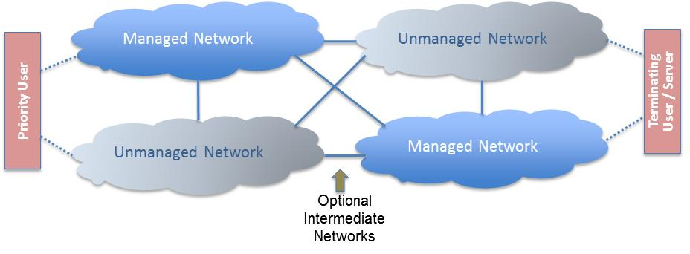
Priority Service Framework
Application Factors
Assuming a multimedia approach
Prioritization within authorized users across services
User Factors:
Establishing a common authentication framework
Accommodating dynamic priority assignment
Domestic / International ingress
Provisioning, ordering, billing
Network Factors
Identifying potential weak links in QoS, security, & resiliency
Assume managed / unmanaged & public / private hybrid scenarios
Voice
Messaging /
Social Media
Video
IoT
Identity
Priority
Geography
Back Office

Slide 6
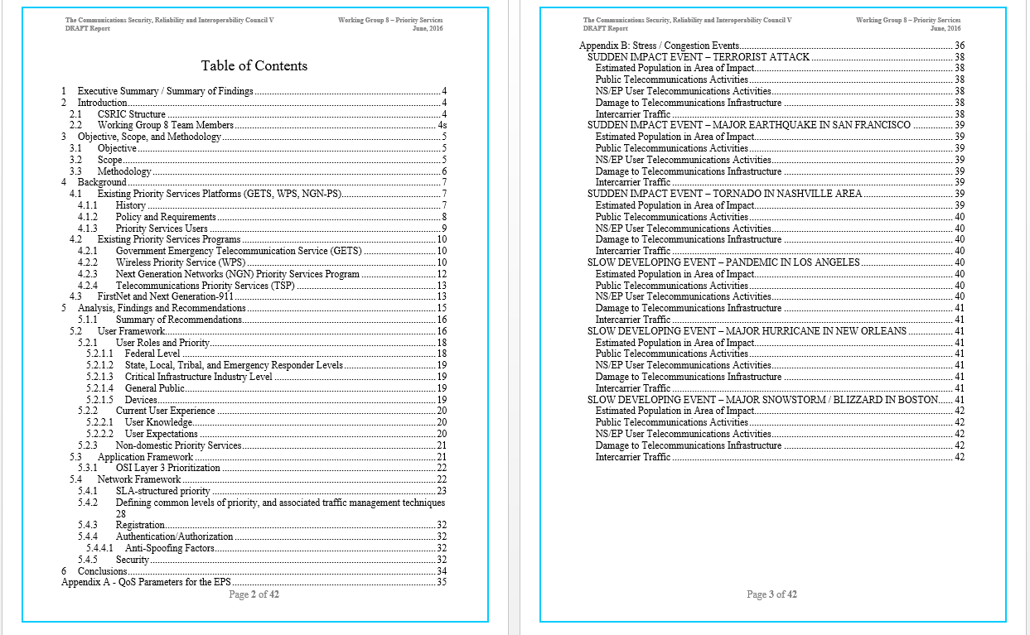
WG Report Table of Contents
6

Slide 7
Draft Report – Recommendations Summary
Preparing for increased volume and scale – further automated ordering / provisioning, measures to addressed increased likelihood of unauthorized access.
Assessing impacts of provision which reduce priority access of certain users under heavy congestion.
Reaffirming existing guidance with respect to user classifications (e.g. FCC R&O 00-242), and clarifying the role of mission-critical application providers, social media, and content providers
Refining the set of application classes that may be needed for priority services treatment, including consideration given to IoT devices
Assessing relative classification of 911 and priority communications in light of network capabilities
Clarifications re: pre-emption of communications for non-priority and lower-priority in an over constrained environment.
Seeking commonality in priority assignment and QoS for communications that cross national borders
FirstNet: Impacts of “local control” provisions
FirstNet: Impacts of pre-emption and prioritization rules

Slide 8
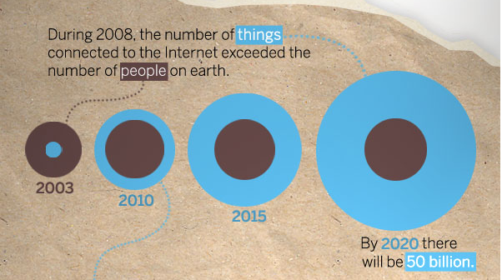
Priority Services & IoT
IoT is so broadly-defined that extant and in-development standards may not cover all emerging use cases
Rapidly expanding commercial applications
Industry are exploring possible mission-critical use cases; anticipating significant autonomous IoT capabilities in near future (2-4 years)
Priority Service scenarios for IoT include:
Environmental sensors
Wearables
Utilities / Infrastructure Mgmt
???

Slide 9
Priority Services & Call Authentication
Extending STIR (Secure Telephony Identity Revisited) / SHAKEN (Signature-based Handling of Asserted information using toKENs) protocols to deliver end-to-end authentication for priority communications
When calls & originating numbers are originated in a service provider network, they can be authoritatively and cryptographically signed by an authorized service provider; as the telephone call is received by the terminating service provider, that information can be verified and trusted.

Slide 10
Next Steps
Continue regular and ad-hoc WG meetings & external briefings
Content development / review for Final WG Report
Provide periodic status updates to Steering Committee and Council
Deliver final report & recommendations, including suggested topics for future CSRICs, in March 2017

