Slide 1
Working Group 6: Secure Hardware and Software – Security by Design Deliverable 2 Status Update
June 22, 2016
Joel Molinoff, Co-Chair (CBS)
Brian Scarpelli, Co-Chair (ACT | The App Association)

Slide 2
WG 6 Objectives
Develop recommendations and best practices to enhance the security of hardware and software in the core public communications network
Develop voluntary mechanisms to demonstrate success of recommendations/best practices

Slide 3
WG 6 Deliverables
March 2016 – Security best practices recommendations
September 2016 – Recommend voluntary attestation framework

Slide 4
WG 6 Members
FN | LN | Organization
Joel | Molinoff | CBS (Working Group 6 Co-Chair)
Brian | Scarpelli | ACT | The App Association (Working Group 6 Co-Chair)
Steven | McKinnon | FCC (Working Group 6 Liaisons)
Emily | Talaga
Andy | Ellis | Akamai
Michael | Stone
Chris | Boyer | AT&T
Brian | Daly | ATIS (AT&T) (Cisco)
Mike | Geller
Jamie | Brown | CA Technologies
Steve | Goeringer | Cable Labs
Rob | Covolo | CenturyLink
Stacy | Hartman
Kevin | Beaudry | Charter
Mike | Geller | Cisco
Lisa | Meyers- McDonald
Eric | Wenger
FN | LN | Organization
Leslie | Krigstein | CHIME
Michael | O’Reirdan | Comcast Cable
Glen | Pirrotta
Kallol | Ray
Jon | Amis | Dell
Gabriel | Martinez | DHS NPPD
Alex | Gerdenitsch | EchoStar
Jennifer | Manner
Bill | Olson | GSA
Peter | Allor | IBM
Ethan | Lucarelli | Wiley Rein (Iridium)
James | Bean | Juniper Networks
Eli | Dourado | Mercatus Center at George Mason University
Angela | McKay | Microsoft
Matt | Tooley | NCTA
Jon | Boyens | NIST
Bryanna | Evans | Nokia
Andrew | McGee
Rao | Vasireddy
FN | LN | Organization
Kazu | Gomi | NTT America
Kimura | Masato
Shinichi | Yokohama
Franck | Journoud | Oracle
Richard | Perlotto | Shadow Server
Patrick | Koethe | Sprint
Jeff | Greene | Symantec
Chris | Roosenraad | Time Warner Cable
Joe | Viens
Darren | Kress | T-Mobile
Michelle | Rosenthal
Robert | Mayer | USTelecom Association
Tom | Soroka
Nadya | Bartol | Utilities Telecom Council
Al | Bolivar | Verisign
Tomofumi | Okubo
Heath | McGinnis | Verizon
Dorothy | Spears-Dean | VITA/ National Association of State 911 Administrators
Peter | Ruffo | ZTE USA
4

Slide 5
Brief Background
Recognizing the advantages of building security in to hardware and software (rather than retrofitting), FCC has urged industry to examine security by design practices for core network equipment
CSRIC IV’s WG 4 Final Report, Cybersecurity Risk Management and Best Practices, provides baseline/model for approach
Deliverable 1 approved by full CSRIC on March 16 (best practices for service providers seeking to manage cybersecurity risks associated with technology obtained from third party vendors, suppliers, and/or integrators for use in their core networks using NIST Cybersecurity Framework).

Slide 6
Report 1 Findings
Function & Categories | Best Practice | Sample NIST CSF Subcategories
IDENTIFY ID.GV ID.RA | Governance, Risk Assessment and Risk Management. Ensure that suppliers have an organizational security policy that governs design, development, and production of the products and services. | ID.GV-1, ID.GV-4, ID.RA-1, ID-RA.3, ID.RA-5, ID.RA-6. PR.IP-1, 2,3,4,6,9, 12
PROTECT PR.AC | Access Controls. Ensure that suppliers limit access to (1) assets and associated facilities used to design, develop, and produce applicable solutions, and (2) the products and services, to authorized users, processes and devices and limit access to only authorized activities and transactions. | PR.AC-1, PR.AC-2, PR.AC-3, PR.AC-4, PR.AC-5
PROTECT PR.DS | Data Security. Ensure that product/service information and records (data) are managed to protect and ensure the confidentiality, integrity and availability of information. | PR.DS-1, PR.DS-2, PR.DS-5, PR.DS-6, PR.DS-7
PROTECT PR.MA | Maintenance. Ensure that suppliers have in place mechanisms for (1) product/service maintenance and repair and (2) secure remote maintenance. | PR.MA-1,2
PROTECT PR.PT | Protective Technology. Ensure that supplier’s relevant information resources are sufficiently hardened. | PR.PT-1, 2,3,4
DETECT DE.AE | Anomalies and Event Detection. Ensure that (1) supplier has tools in place to detect anomalies and events and (2) such events are analyzed to understand attack targets and methods. | DE.AE-2, 4
DETECT DE.CM | Security Continuous Monitoring. Ensure that supplier information system and assets relevant to products and services are monitored to identify events and verify the effectiveness of cybersecurity measures. | DE.CM-1,2,4,5,7
DETECT DE.DP | Detection Processes. Ensure that suppliers have in place detection processes and procedures for identifying security events that may impact products and services. | DE.DP-4
RESPOND RS.RP RS.CO | Response Planning and Communications. Ensure that supplier has in place a process to remediate product/service security vulnerabilities to detected events and that responses are coordinated externally. | RS.RP-1, RS.CO-4
RESPOND RS.AN RS.MI | Analysis and Mitigation. Ensure that supplier is conducting analysis to ensure adequate response and support recovery activities relevant to products and services. | RS.AN-1,2,3 RS.MI-1,2
RECOVER RC.RP | Recovery Planning. Ensure that suppliers have in place recovery processes and procedures covering the products and services that can be executed and maintained to ensure the timely restoration of relevant systems and assets affected by cybersecurity events. | RC.RP-1

Slide 7
Deliverable 2: Voluntary Assurances
WG 6 has aggregated existing assurance efforts connected to standards/best practices as a resource
Have received/are planning presentations on existing assurance efforts connected to standards/best practices
Holding bi-weekly calls
Held in-person meeting on June 22 (AM)

Slide 8
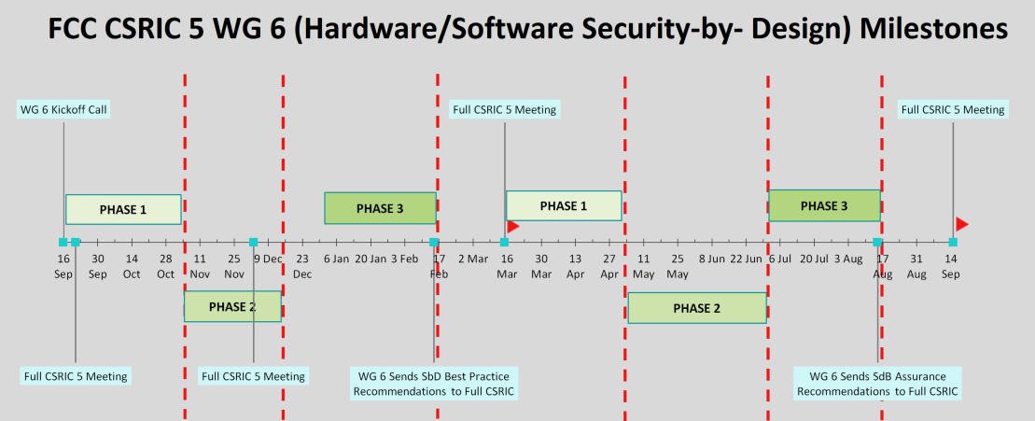
WG 6 Schedule
PHASE 1: Define Objectives, Scope, & Methodology
PHASE 2: Analysis & Determine Findings
PHASE 3: Conclusions & Recommendations
: Deliverable Adopted by Full CSRIC 5

Slide 9
Next Steps
Work to find consensus on voluntary assurances for 2nd deliverable
Continue bi-weekly conference calls
Provide periodic status updates to Steering Committee and Council
On schedule to complete report in time for September 2016 full CSRIC meeting

