Slide 1
Technological Advisory Council
Supporting the Transition to IP
Reference Architecture for
Future Broadband Networks
Extended Presentation

Slide 2
IP Transition Reference Architecture Effort
A high level architecture that depicts a Service Provider that can provide various services to a user (i.e., consumer or enterprise)
  The services include broadband Internet access and often include communications and/or video service
  The architecture will describe how these services
      Are supported by the underlying transport networks
      Interconnect with the service layer infrastructure of other service providers
Each plane (service and transport) can be functionally divided as below
Transport Plane
Functional separation =network topology
Access | host attachment
Regional | Transport within a region, aggregation, mobility mgmt
Core | Transport between regions, service plane attachment
Service Plane
Functional separation reflects proximity to the served user
Edge | Near the served user
Core | Not (necessarily) near user
Additional planes (e.g., management) are similar but not illustrated

Slide 3
Layered Network Design
Application Complexes
Peering Complex
Hosts / Users
latency–sensitive functions
latency–tolerant functions
Service
Logic
Service Plane
Service
Logic
edge
core
Transport
Logic
Transport
Logic
access
regional
core
UNI
Transport Plane
NNI
Logical
Physical
  Service Plane elements (hosts, servers, gateways, etc.,)
  attach physically to the transport plane and logically to the service plane
  Service Plane functions may be near the served user
  (e.g., if latency sensitive) or centralized
Simplified Representative Diagram – actual designs will vary

Slide 4

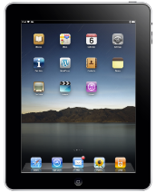
Perspective on Service Provider VoIP
Customer Access
Equipment
Traffic here is marked and carried according to
service provider policy. If VPNs are used, traffic
is typically MPLS –encapsulated.
A VoLTE mobile combines
all 3. A Cable Modem or
ONT combines the bottom
two (the top one in that
case is typically an analog
phone). A customer-owned
VoIP device might combine
the top two, and e.g.,
connect into an Ethernet
port on the bottom one.
Customer
Interface
Analog
Application
servers
PSTN
Gateways
VoIP
Adaptation
VoIP (user assigned
QoS markings)
PSTN
Access
Router
Broadband
Access
Network
Regional
Network
or VPN
Core
Network
or VPN
Other
VoIP
Networks
Service
demarcation
Authentication
and Policy Servers
Access
SBC
Peering
SBC
QoS markings assigned by Service Provider (user
assigned QoS markings are sometimes “tunneled”).
Marking details vary by Service Provider and
access technology.
IP network
VoIP
Roaming
Partner
(Mobile)
Transport and QoS
marking is subject to
bilateral agreement.
Internet –based
Applications
Internet
Internet –attached device
(fixed, nomadic or mobile)
Roaming
Mobile Device

Slide 5
Perspective on Service Provider VoIP – (Description for prior slide)
Three elements of customer access equipment
  Customer interface-(analog)->VoIP adaptation-(voip)->Service demarcation
    A VoLTE mobile combines all three
    A cable Modem or ONT combines the VoIP adaptation and service demarcation, the customer interface in that case is typically an analog phone
    A customer-owned VoIP device might combine the customer interface and VoIP adaptation, and connect into an Ethernet port on the service demarcation
QoS markings assigned by the Service Provider at the service demarcation
  Marking details vary by Service Provider and access technology
  User assigned QoS markings are sometimes “tunneled”
Traffic in the Regional and Core Networks/VPNs is marked and carried according to service provider policy
  If VPNs are used, traffic is typically MPLS –encapsulated.
Transport and QoS marking between networks is subject to bilateral agreement

Slide 6

VoIP vs. PSTN Interconnection
LATA
SP POTS
customer
TDM
VoIP
SP POTS
customer
LATA
OTT VoIP
customer
SP VoIP
customer
SP VoIP
customer
OTT VoIP
customer
Circuit
Switch
PSTN
Circuit
Switch
PSTN
GW
PSTN
GW
PSTN
GW
IP network
PSTN
GW
VoIP
Interconnect
IP network
IP network
SP VoIP
Call Server
SP VoIP
Call Server
OTT VoIP
Call Server
OTT VoIP
Call Server
SBC
PSTN Interconnection
  Calling network must deliver call to geographic area of called party. Many points of interconnection.
  “default route” to terminate calls to any NANP number (including VoIP devices)
VoIP Interconnection
  Interconnection is subject to bilateral agreement. Points of interconnection are usually centralized.
  Calls can be routed to whatever numbers the terminating network advertises as IP-reachable
Simplified Representative Diagram – actual designs will vary

Slide 7
Access Technologies Described
Access Network
  Digital Subscriber Line(DSL) and hybrid Fiber/xDSL technologies (xDSL)
  Fiber to the Premises (FTTP/FTTH)
  Hybrid Fiber Coax (HFC)
  LTE
  Satellite
  Other wireless
    Wifi, Wimax,
  Evolution paths for access technologies
In-Home Network
  WiFi
  Multimedia over Cable Alliance (MoCA 2.0)
  Power Line Networking: HomePlug AV, IEEE Std 1901-2010
  Structured cabling (e.g. Ethernet)
  Phone wiring: HomePNA ITU G.hn standard

Slide 8
Physical versus Logical Architecture
Physical
  Cabling, nodes, layout, physical-layer features
Logical (layer 2)
  Each access architecture provides a means of separating traffic into distinct “flows” that can be given separate QoS treatment
  We describe how each architecture accomplishes this
Boundary of layer 2 network: location of first layer 3 router
  Divides access network from metro network

Slide 9
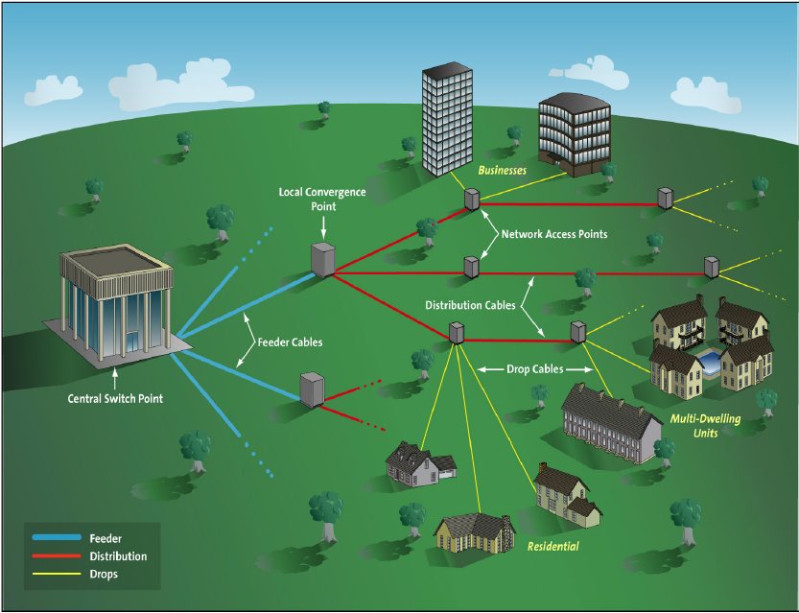
Elements in a Typical Telco Physical Architecture

Slide 10
Physical Architecture
Feeder Cables
  Carries traffic serving multiple endpoints form an “office” to a neighborhood
  (local convergence point, LCP, or serving area interface, SAI)
Distribution Cables
  Carry traffic for one or more households from LCP to the curb (network access point)
Drop Cables (above ground) or service wire (underground)
  Carry traffic from curb to dwelling unit
Depending upon the architecture
  Cables may be fiber, twisted pair or coax
  Local convergence point and/or network access point could host a patch panel, a DSLAM, an optical splitter, an Ethernet switch, or a fiber/coax interface.
As bitrates increase, fiber must be pushed further into neighborhoods

Slide 11
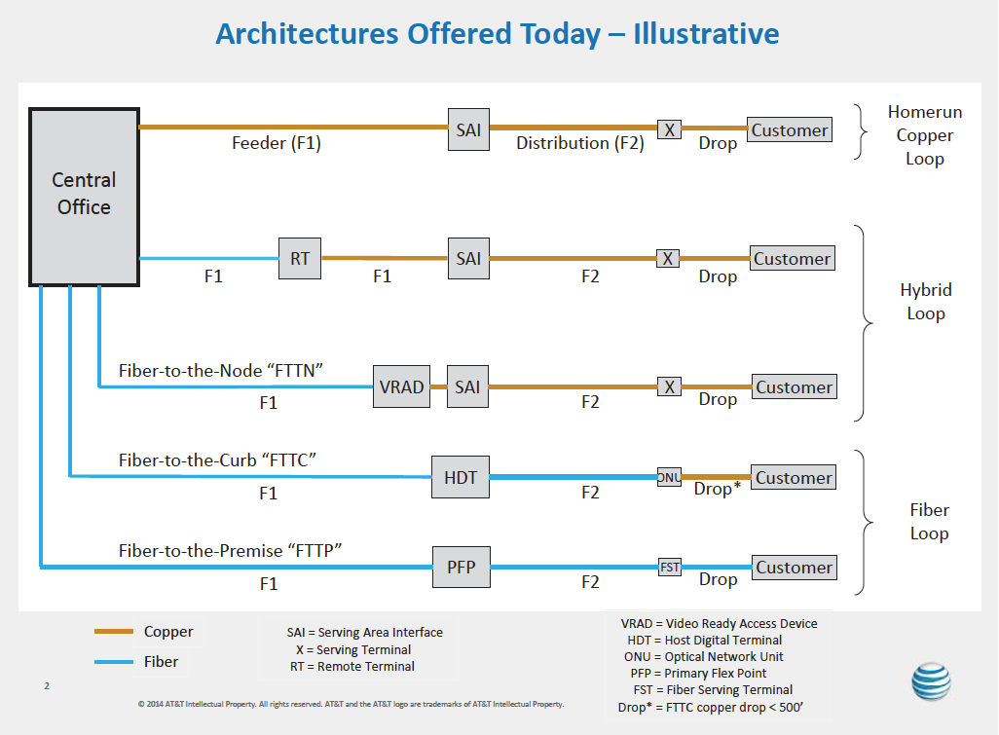

Telco Architectures offered today
-48v

Slide 12


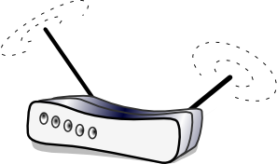



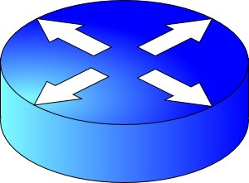

Logical Architecture – wired networks
(In HFC AN and BNG are integrated into CMTS)
Service
Flows
VLANs
Home
Network
Regional
Network
RG
Access
Link(s)
Access
Node
Layer 2
Aggregation
Network
Ethernet
Switch
BNG
Customer
Access network extends from Residential Gateway (RG) to Broadband Network Gateway (BNG)
Flow management between AN and RG depends upon the architecture
Flow management in the Ethernet Aggregation Network similar across architectures (i.e. VLANs) but may differ from how flows are managed between the AN and the RG
  In HFC AN and BNG are integrated and there is no aggregation network and thus no VLANs
In Metro Network flows are typically distinguished by layer 3 QoS tags and/or separate VPNs
Adapted from http://www.broadband-forum.org/technical/download/TR-101_Issue-2.pdf

Slide 13
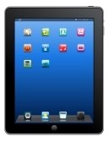


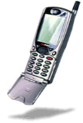
Logical Architecture: Mobile Wireless LTE Network
Service
Flows
GTP tunnels
Radio
Access
Network
Evolved Packet
Core (EPC)
Ethernet
Backhaul
Serving
Gateway
(SGW)
eNodeB
Typically no residential gateway: transmission direct to end nodes
  RG may be used with Fixed Wireless service
GTP: General Packet Radio Service—GPRS—Tunneling Protocol

Slide 14
Telco Architectures offered today: xDSL
-48v

Slide 15
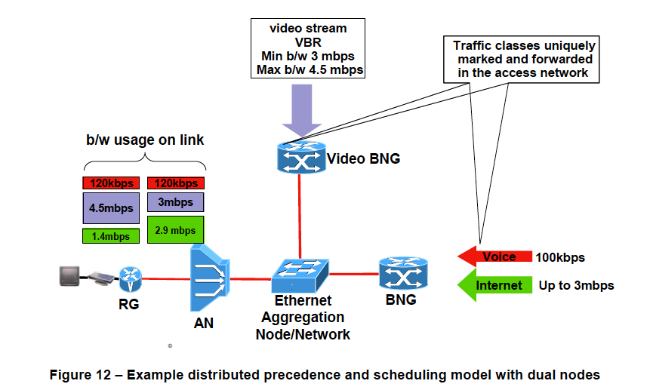
xDSL logical architecture
http://www.broadband-forum.org/technical/download/TR-101_Issue-2.pdf

Slide 16
Traffic separation in xDSL networks
Legacy xDSL used ATM virtual circuits to separate flows
Current technology is packet based
Flow separation by
  Point-to-point protocol over Ethernet (PPPoE)
  VLAN and QoS tagging
Double VLAN tagging
  S-tag for service class
  C-tag for individual consumer flow
May use single VLAN per household and flow (1:1); or
Traffic to/from multiple households aggregated onto a single VLAN at the DSLAM (N:1)

Slide 17
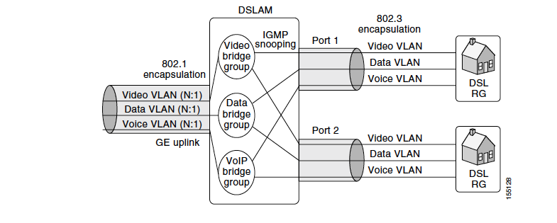
VLANs in Triple Play DSL architectures N:1 model
Ethernet Aggregation
Access Node
http://www.cisco.com/application/pdf/en/us/guest/products/ps6902/c2001/ccmigration_09186a00806ac309.pdf

Slide 18
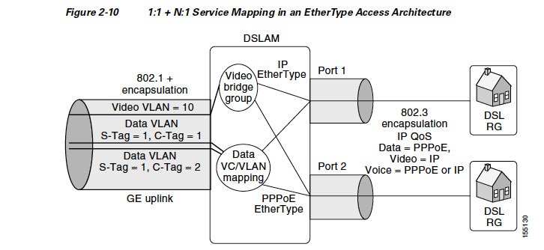
1:1 vs N:1 VLAN mapping in xDSL
http://www.cisco.com/application/pdf/en/us/guest/products/ps6902/c2001/ccmigration_09186a00806ac309.pdf

Slide 19
Telco Architectures offered today: FTTP
-48v

Slide 20
Typology of FTTH
FTTH
P2P
Ethernet
P2MP
Active Ethernet
PON
(T)WDM-PON
NG-PON2
TDMA-PON
EPON
BPON
GPON
DPoE

Slide 21
Glossary
P2P: Point-to-point (individual links from CO to premises)
P2MP: Point-to-multipoint (feeder to neighborhood, then branching)
PON: Passive Optical Network (optical signal on feeder passively split)
TDMA-PON: PON where traffic to multiple households multiplexed in time
(T)WDM-PON: PON using combination of Wavelength Division Multiplexing and TDMA
EPON: Ethernet Passive Optical Network
DPoE: DOCSIS Provisioning of EPON
BPON: Broadband Passive Optical Network (ATM based)
GPON: Gigabit Passive Optical Network (Generic Framing)
NG-PON: Next Generation PON

Slide 22
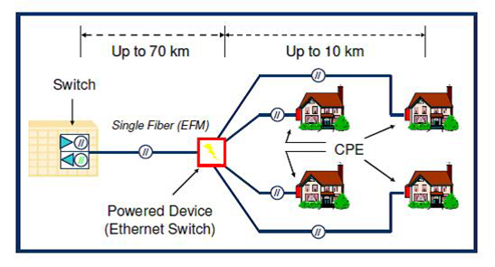
Active Ethernet
Active Ethernet uses single fiber from CO to neighborhood where there is an active Ethernet Switch
While previous typology slide describes this as point (CO) to multipoint, some sources refer to this architecture as a variant of P2P because there is a direct link (P2P) from the neighborhood Ethernet switch to the premise
http://www.glits.biz/graphics/Nov2011/active-ethernet.png

Slide 23
PON Standards
Two different families of standards for PON networks
IEEE standards
  EPON or Ethernet in the First Mile (EFM)
    Based on Ethernet framing over fiber
    Flow management similar to xDSL using VLAN tagging
    Video carried as IPTV
ITU Standards
  ATM-based (deprecated but significant installed base)
    BPON (G.983)
      622 Mbps down/155 Mbps up
  Packet based
    GPON (G.984) (Most common in the U.S. today)
      1.2 Gbps and 2.4 Gbps down/155 Mbps, 622 Mbps, 1.2 Gbps and 2.4 Gbps up
    XG-PON (10G-PON) (G.987)
      10 Gbps down/2.5 Gbps up
    NG-PON2 (G.989) emerging standard
    Combines WDM and TDMA to support both P2P and P2MP

Slide 24

Typical Fiber GPON Access Architecture for providing voice, data and video
Fiber
Distribution
Frame
Fiber
Distribution
Hub (1 x 32)
Fiber
Distribution
Terminal
OLT
Voice/Data
WDM
ONT
V-FDF
Linear Video
Feeder
Distribution
(4 Fibers)
Drop
EDFA
Central Office
Outside Plant
OLT (Data) and EDFA (Video) output are combined using a WDM in the Fiber Distribution Frame (FDF) and transmitted to the Outside Plant over a feeder fiber
A splitter located at the Fiber Distribution Hub (FDH) splits the optical power evenly to be shared between 32 or 64 customers
Each 1x32(64) splitter feeds 32(64) distribution fibers to serve 32(64) homes in a neighborhood. The drop fiber connects the ONT to the distribution fiber at the Fiber Distribution Terminal (FDT)
Separate wavelength for linear video (1550 nm)
Voice and data carried as cells/packets (1490 nm down/1310 nm up)

Slide 25
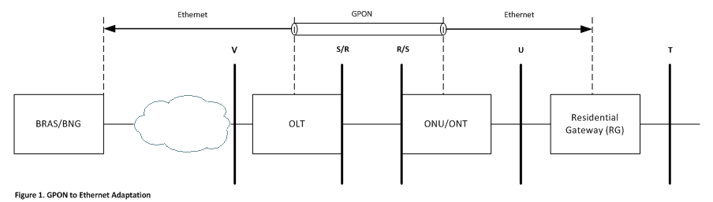
Service Flows in GPON
BRAS/BNG: Broadband Network Gateway
OLT: Office Line Terminal
ONU/ONT: Optical Network Termination (Unit)
In Ethernet Aggregation Network, flows managed using S-tags and C-tags (as in xDSL)
Between OLT and ONU/ONT flows managed using T-CONTs and GEM ports
https://sites.google.com/site/amitsciscozone/home/gpon/gpon-vlans-and-gem-ports

Slide 26
T-CONTs and GEM Ports
T-CONT: A traffic bearing object within an ONU/ONT that represents a group of logical connections, and is treated as a single entity for the purpose of upstream bandwidth assignment on the PON. In the upstream direction, it is used to bear the service traffic. Each T-CONT corresponds to a service traffic of one bandwidth type. Each bandwidth type has its own QoS feature.
ALLOC_ID: Each T-CONT is identified by the ALLOC_ID uniquely. The ALLOC_ID ranges from 0 to 4095. It is allocated by OLT i.e. a T-CONT can only be used by one ONU/ONT per PON interface on the OLT.
GEM Port: A GPON Encapsulation Method (GEM) port is a virtual port for performing GEM encapsulation for transmitting frames between the OLT and the ONU/ONT. Each different traffic-class (TC) per UNI is assigned a different GEM Port. Each T-CONT consists of one or more GEM Ports. Each GEM port bears one kind of service traffic i.e. a T-CONT type.
GEM Port ID: Each GEM Port is identified by a port ID uniquely. The Port ID ranges from 0 to 4095. It is allocated by the OLT i.e a GEM port can only be used by a single ONU/ONT per PON interface on the OLT.
https://sites.google.com/site/amitsciscozone/home/gpon/gpon-vlans-and-gem-ports

Slide 27
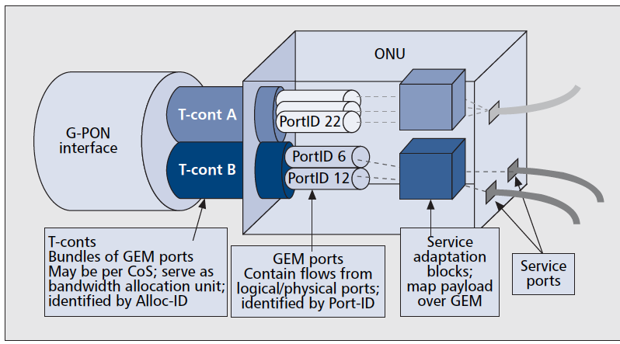
Relationship between T-CONT and GEM Ports
http://dx.doi.org/10.1109/MCOM.2007.344582

Slide 28
NG-PON2 (G.989)
Multiple wavelengths on a feeder fiber each representing an XGPON OLT; or
Wavelength specific splitter provides dedicated wavelength to each endpoint for Point-to-Point operation (no TDMA).
Up to 1:256 split ratio
Tunable lasers/receivers so ONTs can support any wavelength
Standards scheduled for completion in 2014
Commercial products emerging at end of 2014.

Slide 29
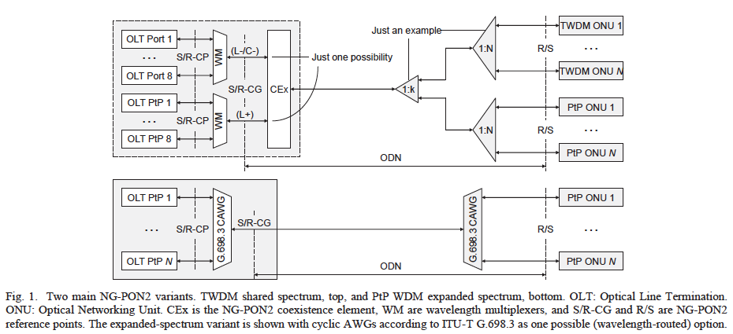
NG-PON2
Source: http://ieeexplore.ieee.org/xpl/articleDetails.jsp?tp=&arnumber=6839965

Slide 30
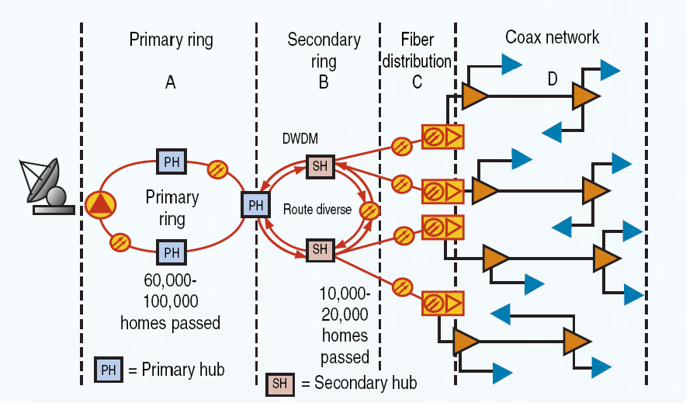
Typical Cable MSO HFC Architecture
Master
Hub
Local
Origination
Source: http://www.cedmagazine.com/contents/pdf/1105-fiber-topo.pdf

Slide 31
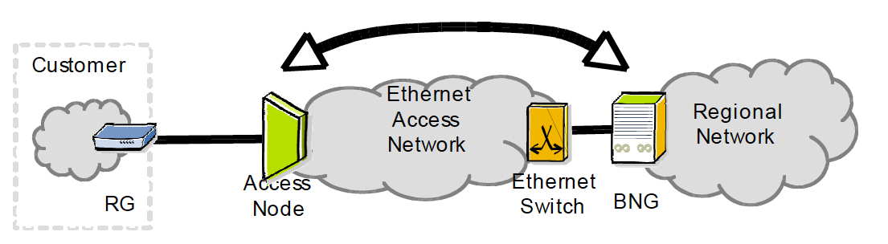
DOCSIS vs Generic Logical Architecture
CMTS
In today’s DOCSIS the Access Node (Cable Modem Termination System –CMTS) is also the Broadband Network Gateway (router)
  No Ethernet aggregation network
Future cable architectures may separate router and access node functionality (distributed Converged Cable Access Platform—CCAP)

Slide 32
Service Flows in DOCSIS 3.0
“The MAC Domain classifies downstream packets into downstream "service flows" based on layer 2, 3, and 4 information in the packets. The MAC Domain schedules the packets for each downstream service flow to be transmitted on its set of downstream channels.” [emphasis added]
“The principal mechanism for providing QoS is to classify packets traversing the DOCSIS RF interface into a Service Flow and then to schedule those Service Flows according to a set of QoS parameters.”
QoS parameters include:
  Traffic Priority
  Token Bucket Rate Shaping/Limiting
  Reserved (Guaranteed) Data Rate
  Latency and Jitter Guarantees
  Both Static and Dynamic QoS Establishment
  Two-Phase Activation Model for Dynamic QoS
http://www.cablelabs.com/wp-content/uploads/specdocs/CM-SP-MULPIv3.0-I24-140403.pdf

Slide 33
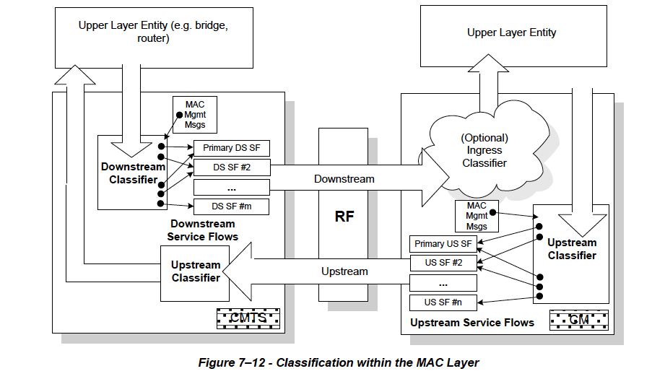
Service Flow classification in DOCSIS 3.0
http://www.cablelabs.com/wp-content/uploads/specdocs/CM-SP-MULPIv3.0-I24-140403.pdf

Slide 34
LTE
LTE is the emerging dominant standard for mobile
Designed to support voice as VoIP (e.g. packet VoLTE)
Service flows in LTE are referred to as “Bearers”
  A handset may have multiple bearers for e.g. signaling, VoLTE, Internet access
Handset may support multiple “contexts”—each with its own endpoint IP address and supporting traffic via unique bearers to different core IP networks

Slide 35
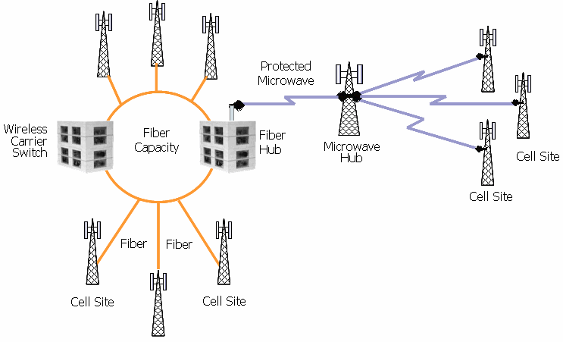
LTE Physical Architecture
Physical network
Components
Radio link
Backhaul
  Fiber
  P2P or P2MP wireless
Increasing use of small cells➔ need for fiber deeper into neighborhoods
Femtocells that use wired broadband to the home for backhaul
Source: http://www.ttmi.info/services.php

Slide 36
LTE
Packet Network
PGW: Packet Data Network Gateway
SGW: Serving Gateway
MME: Mobility Management Entity
PGW
Signaling Path
Bearer path
Evolved Packet Core (EPC)
MME
SGW
LTE Radio Access Network (RAN)

Slide 37
LTE
The first router, defining the boundary between the access network and the EPC, may be located at the ENodeB, or at a backhaul concentration point serving several ENodeBs.
MME manages establishment of a bearer channel from the User Equipment (UE) to the Serving GateWay (SGW)
Packet data network GateWay (PGW)
  enforces QoS policy as set by the Policy Rules and Charging Function Server (PCRF)
  Controls IP address allocation service
Traffic may be tunneled using GPRS Tunneling Protocol (GTP) between eNodeB and PGW
  Core generally has much more capacity than Radio Access Network (RAN) and thus congestion/prioritization generally not an issue.
  Layer 3 DSCP or 802.11p QoS bits used as needed to mark priority
    Leased backhaul service (e.g. carrier Ethernet) may not support 802.11p
SGW manages mobility as UE moves among eNodeB towers
SGW and PGW may be integrated (more common in Europe than NA)

Slide 38
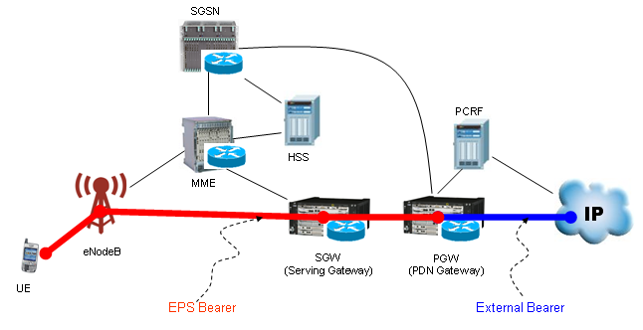
EPS Bearer
Source: http://www.sharetechnote.com/html/Handbook_LTE_EPS_Bearer.html

Slide 39
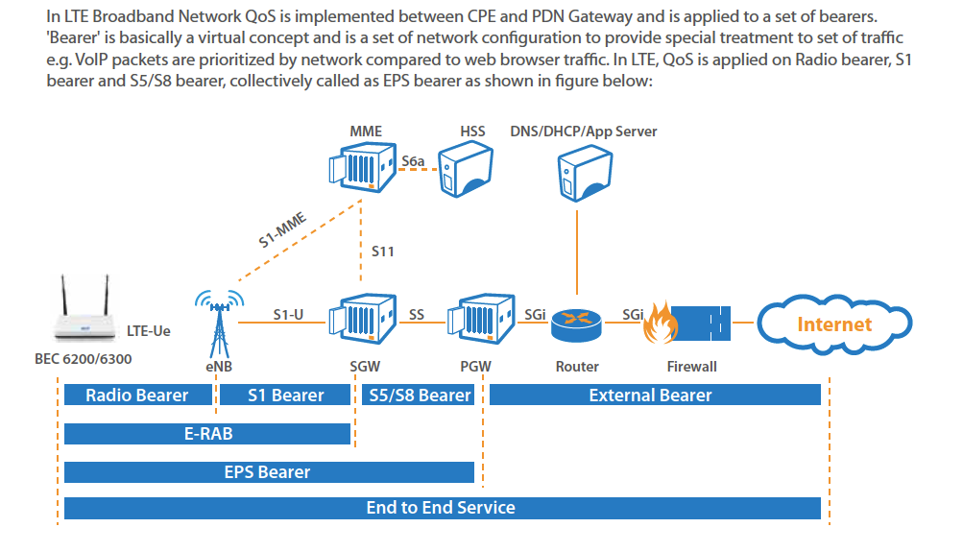
Bearers in LTE
Source: http://www.bectechnologies.net/main/newsletter_images/QoS.pdf

Slide 40
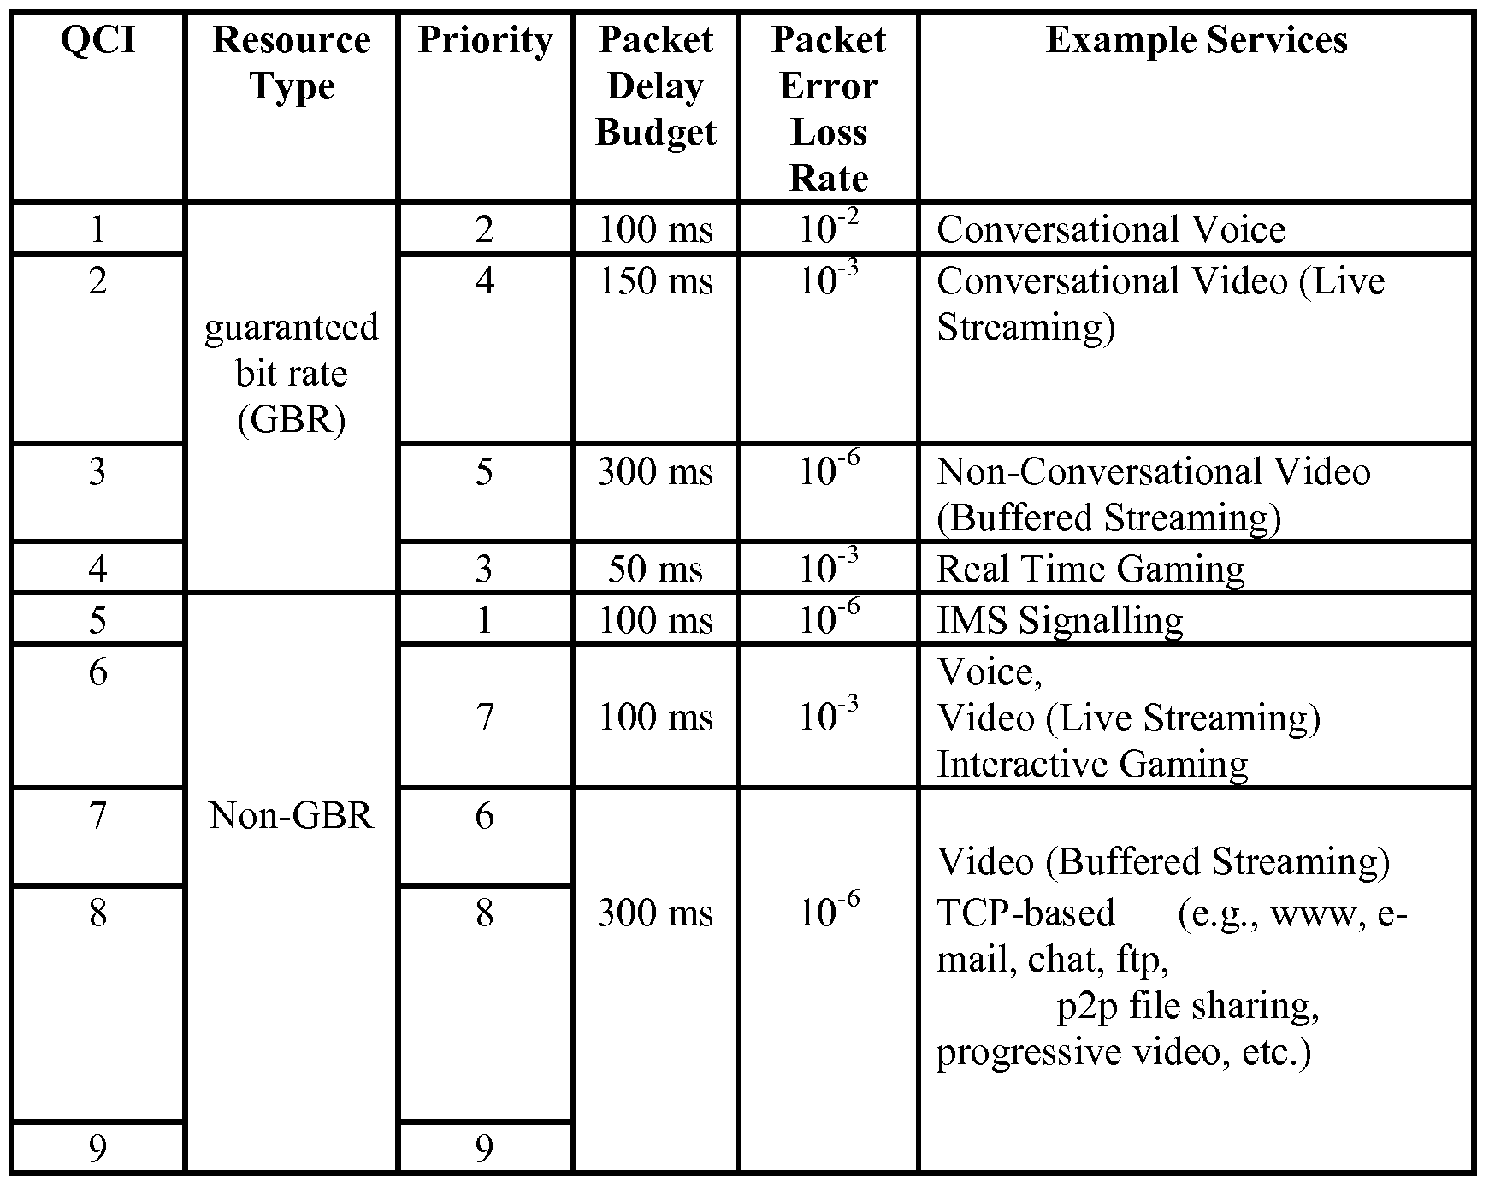
Standardized QoS Characteristics
QCI: QoS Class Identifier
Classes vary by
  Bit rate guarantee
  Latency
  Packet loss probability
UE will typically have three bearers:
  Signalling QCI=5
  VoLTE QCI=1
  All other data QCI=9
Bearers may also have an “Allocation and Retention Priority” – priority level for establishing and retaining the bearer.

Slide 41
Multiple PDNs Reachable
PDN 1
Public Internet
PDN 2
Local Carrier Svcs
PDN 3
Private Enterprise
PGW
PGW
MME
SGW
UE supports multiple “contexts”
each with own IP address

Slide 42
Other Wireless
There are many fixed wireless ISPs (WISPs)
Use a variety of wireless technlogies
  802.11 (WiFi)
  802.16 (WiMax)
WiFi with directional antennas can cover 10s of kilometers
Point-to-point wireless backhaul from APs to a wired concentration point for backhaul to the Internet
QoS managed using 802.11p

Slide 43
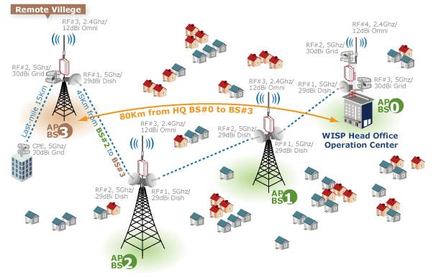
Example WISP Architecture
Source: http://www.infotelonline.com/wifi.html

Slide 44
Satellite Broadband Reference Diagram
The edges of the satellite broadband network are represented by two interfaces,
the user-to-network (UNI) and network-to-network (NNI) interfaces
Thousands of customers within a spot beam (a spot beam is like a sector in LTE)
  Ka-band beam bandwidths are typically 500MHz but can be significantly larger
The transport network is a fiber network that connects the access network to the core network
There are several nodes within the Core Network, which connect access network to the data processing nodes (which can be physically co-located within the Core Node) and the Internet

Slide 45
Satellite Access: Logical Components
The Indoor Unit (IDU) and the ODU are on customer premises
  the rates served to the customer can vary from 10Mbps-1Gbps
SAN-RF provides RF connectivity to the Satellite and baseband to the Satellite base stations
Satellite base stations serve the same function as eNodeB in LTE networks, CMTS in Cable networks and OLT in GPONs
  QoS primitives on satellite broadband are Service Flows, identical to Cable
Access Signaling serves a similar purpose as MME in LTE networks
  Establishes service (similar to call-setup/teardown) based on subscriber’s profiles
If necessary, web acceleration is used to accelerate TCP/HTTP sessions over satellite
Notes:
Bridging function at base station can be layer 2 bridging, or layer 3 depending upon the service that the customer wants.

Slide 46
Traffic separation summary
All access architectures have a mechanism for separating traffic to a subscriber into separate “service flows”
Multiple service flows of the same “service class” may be given common treatment either within a household or across a neighborhood
Service flows can be provided specific QoS
  Guaranteed data rate
  Jitter/latency constraints
  Traffic shaping
Service flows may be static or dynamically provisioned
At a minimum, access network typically treats(facilities-based) voice, video, and Internet access as separate service flows with unique QoS
This separation is maintained between the Access Node and the Residential Gateway using a mechanism specific to the architecture
Most architectures have an Ethernet aggregation network (link) between the ANs and the first router (Broadband Network Gateway)
  Flows managed using 2 layers of VLAN tags in the Ethernet Aggregation network
Upstream of the BNG, flows signaled using layer 3 QoS tags. Public Internet and Carrier provisioned services may travel over separate VPNs based on separate MPLS LSPs.
Bilateral agreements between operators to honor traffic classification

Slide 47
How access technologies can evolve to higher bitrates per customer
There is no fixed technological limit on the speeds/household available using HFC, xDSL, FTTH, LTE or satellite.
Issue is the cost of upgrading to realize higher speeds
Higher speeds often means pushing fiber deeper into neighborhoods.
  This can have significant civil engineering costs
May also require changing access node electronics and CPE;
  changing CPE is typically more costly, as more numerous.
Reducing bit rate per video stream through better compression can increase capacity available for other broadband applications.

Slide 48
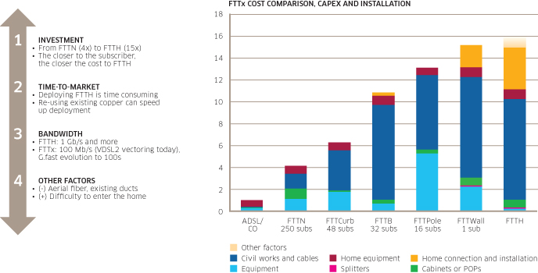
How xDSL Costs Change as Fiber is Pushed Deeper in the Loop
Source: http://www2.alcatel-lucent.com/techzine/the-numbers-are-in-vectoring-2-0-makes-g-fast-faster/

Slide 49
xDSL
Approaches:
  Move DSLAM closer to customer
    Costly; requires pushing fiber deeper into neighborhood
  Move to technologies with higher bit-rate at any given distance
    ADSL➔VDSL➔G.fast
    Dynamic Spectrum Management (vectoring)
    Fastest speeds available only for very short copper loops
      E.g. < 200 meters
  Bonding
    Use multiple copper pairs per household if available

Slide 50
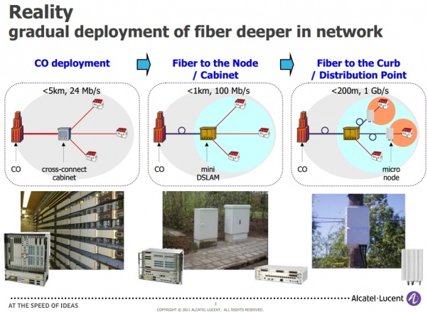
Longer fiber, shorter copper ➔ higher speeds
Source: http://www.pcper.com/news/General-Tech/GFast-Delivers-Gigabit-Broadband-Speeds-Customers-Over-Copper-FTTdp

Slide 51
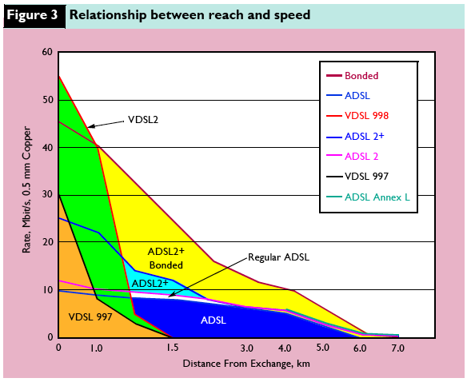
xDSL Reach vs Bandwidth
Source: Marshall, “IPTV Thrives on a Fiber Rich Diet,” The Journal of The Comm. Network, 6,1, January–March, 2007

Slide 52
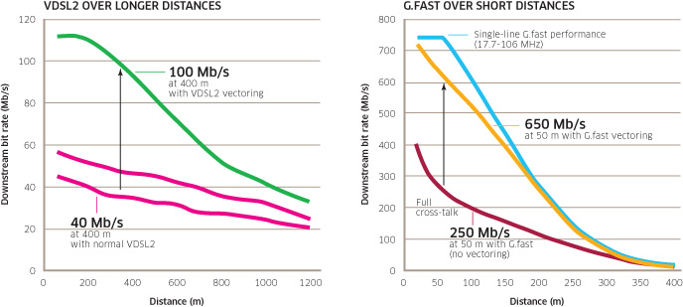
VDSL2 vs G.Fast, with and without Vectoring <1 km loop
Source: http://www2.alcatel-lucent.com/techzine/fixed-access-stay-ahead-of-the-ultra-broadband-curve/

Slide 53
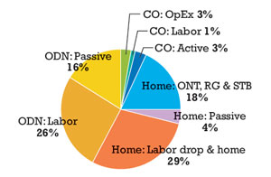
Why G.fast?—drop costs are 29% of an FTTH deployment?
Source: http://www.lightwaveonline.com/articles/print/volume-28/issue-5/applications/plan-now-for-tomorrows-ftth-networks.html
Notes:
Saving the 29% of FTTH cost that is accounted for by the drop to the home is one motivation for Fiber to the Distribution Point + G.fast

Slide 54
Problems in US residential neighborhoods
Current copper deployment architecture determines feasibility of technologies like G.fast
  Where loops are buried, it may be more than 200m from house to nearest manhole where electronics could be placed
  In lower density suburbs there may be too few homes reachable from a pole to support the DSLAM cost at the pole.
Percentage of homes reachable using G.fast depends on neighborhood.
G.fast better suited to MDUs
  65% of US households live in single family dwellings

Slide 55
Measures to increase capacity per household in HFC networks
Free up more spectrum within the cable for IP services
  Move to all digital to free up spectrum
  Move to MPEG-4 to reduce spectrum needed for broadcast TV
  Use IP for delivery of all services, rather than segmenting dedicated capacity to each type of Video Delivery
  Use spectrum within the cable above 750 MHz
    requires better splitters, new amplifiers
Drive fiber deeper
  Reduce households per service group by converting amplifiers to mini fiber nodes
  Requires more feeder fibers, or WDM to carry more feeder wavelengths
Change from DOCSIS 3.0 to 3.1 for more bits/Hz
Improve SNR through incremental plant improvement to realize higher bits/Hz
UPSTREAM:
  Need to move from low-split to mid-split or add a high-split: requires changing amplifiers.
Issues with changing out legacy CPE (e.g. set-tops).

Slide 56
Increasing bitrate per home in HFC
Upgrade to HFC Phase I mFN
Local hub
FN
Local
hub
FN
mFN
mFN
Analog
TV
Emerging
Services
Analog
TV
Emerging
Services
5
50
500
750
1G
5
50
500
750
1G
Phase II mFN
Local Hub
MuxNode
mFN
mFN
TV
TV
DTV
DTV
DOCSIS
DOCSIS
New IP
New IP
New IP
New IP
50 Homes Passed
Analog
TV
Emerging
Services
Fiber
Coax
5
50
500
750
1G
Source: AT&T

Slide 57
Upgrade path for FTTH
BPON: 622 Mbps for up to 32 households 20 Mbps/HH
GPON 2400 Mbps for up to 64 households 38 Mbps/HH
XGPON 10,000 Mbps for up to 128 households 78 Mbps/HH
NGPON-2 up to 2400 Mbps per household 2400 Mbps/HH
Three ways to increase capacity per household:
  Reduce split ratio
    Requires having prepositioned additional feeder fibers
  Move to higher bit rate on the fiber
    Requires changing opto-electronics at both ends, but no change to outside plant
  Move to WDM with wavelength per premise
    For NGPON-2 may need to replace splitter with AWG grating
  Combinations of these are likely
Improve compression efficiency for video
  More bps available for other services

Slide 58
Wireless
Wireless technology changing more rapidly than wireline
More spectrum
Greater sectorization
MIMO to get more bits/Hz
Smaller cells
  Fewer users per radio
LTE already maximizes bits per Hz at any given SNR
Off-load to WiFi
Self Optimizing Networks (SON): optimize power, tilt of sectors to reduce interference to other cells
Simultaneous reception from multiple basestations (temporal correlation of interference)
No civil construction cost for the link from cell tower to handset
  More cells➔civil costs for cell sites and backhaul
CPE naturally replaced on shorter cycles than fixed CPE

Slide 59
Evolution of Satellite-Delivered Broadband
Increase downlink spectrum by shifting uplink to a higher band
Tighter spot beams (and more spot beams) allowing:
  Greater frequency reuse
  Fewer subscribers per beam resulting in more bits per subscriber
  Greater ability to adjust power allocated to each beam
  Requires more ground stations for uplink capacity
More bits per Hz using
  Improved modulation and coding schemes
    E.g. adaptive coding and modulation
  Dual polarization
  Higher transmit power
Falling costs for user terminals
Average speeds of 25 Mbps/household possible, with up to 100 Mbps

Slide 60
Observations on technology evolution paths
All technologies reviewed have an upgrade path to higher bitrate/user
Significant speed improvements universally (with the exception of satellite) involves pushing fiber deeper into neighborhoods
The relative costs of alternative access technologies may change at higher speeds, e.g.
  At lower speeds FTTN and xDSL is far cheaper to deploy than FTTH
  At much higher speeds, upgrading to FTTH may be less costly than upgrading to Fiber to the Pole + g.Fast
Not all neighborhoods can economically support all upgrade approaches
  Low density
  Legacy copper plant configuration (e.g. drop lengths)

Slide 61
Premises Networking Alternatives
WiFi
Multimedia over Cable Alliance (MoCA 2.0)
Power Line Networking: HomePlug AV, IEEE Std 1901-2010
Structured cabling (e.g. Ethernet)
Phone wiring: HomePNA ITU G.hn standard
Percentage of Households with Home Network
 | Jan 2009 | Jan 2010 | Jan 2011 | Jan 2012 | Jan 2013 | Jan 2014
Home Network (wired or wireless) | 34 | 40 | 48 | 54 | 61 | 62
Source: CEA

Slide 62
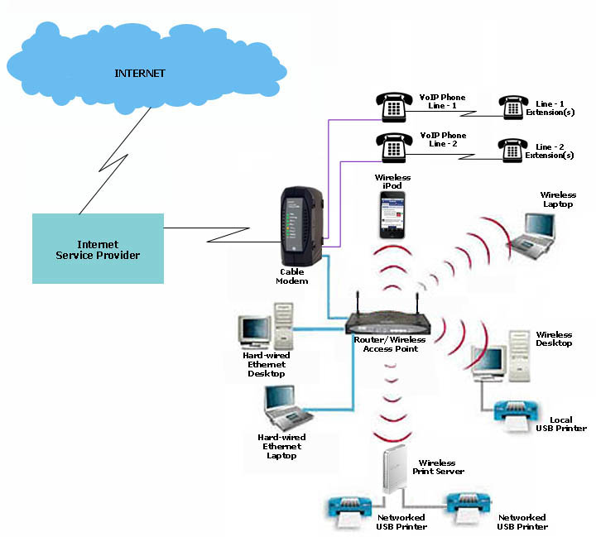
WiFi
Most common home networking
choice (57.8% of all HH*)
  Computing
  Home entertainment
  Security
Wireless routers also support
wired Ethernet
VoIP not typically supported via
WiFi today
  Integrated MTA supports
  analog phone pairs
  Wired Ethernet connected
  VoIP phone
WiFi may be combined with other
technologies
*Source: https://gigaom.com/2014/11/06/survey-says-only-65-percent-of-broadband-households-have-wi-fi/

Slide 63
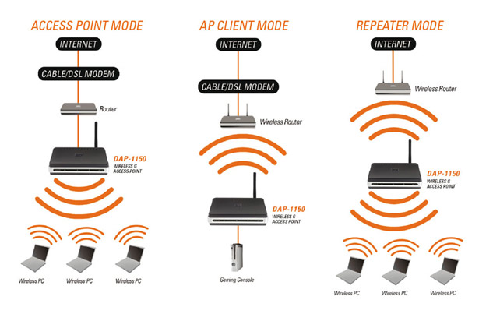
Wifi Bridging and Repeater Modes

Slide 64
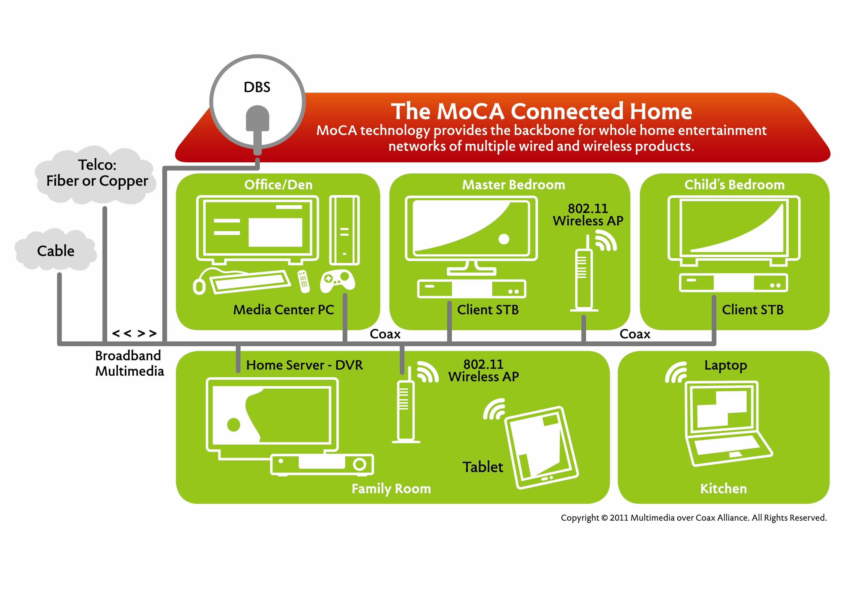
Multimedia over Coax

Slide 65
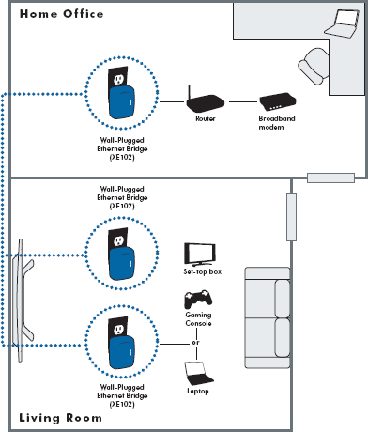
HomePlug

Slide 66
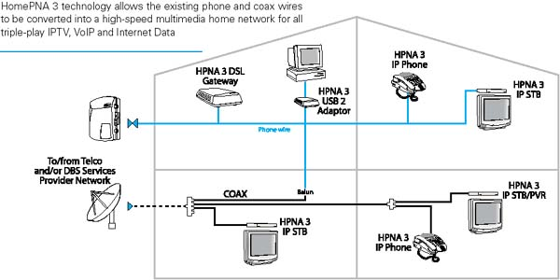
HomePNA
G.Hn supports the use of both twisted pair and coax

Slide 67
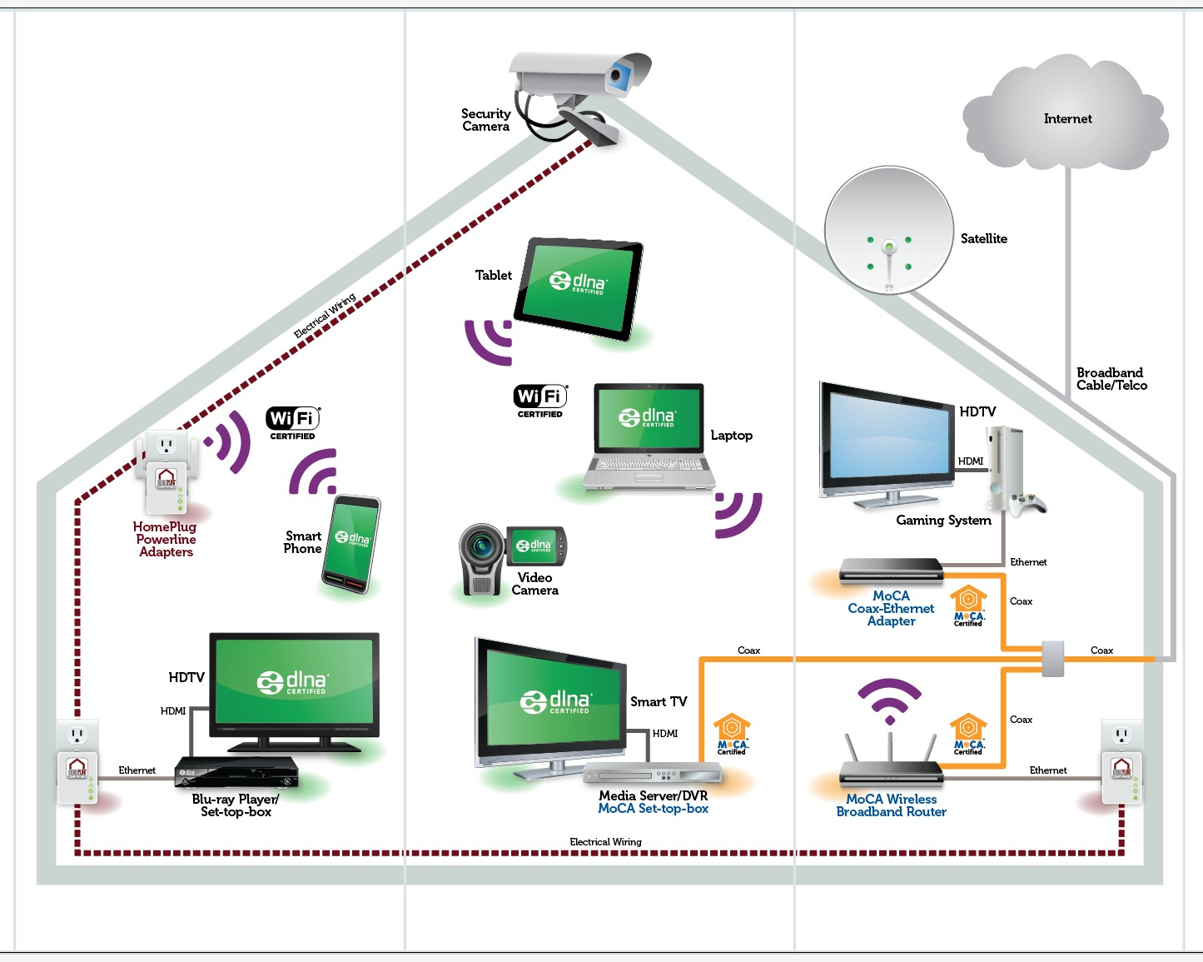
Multiple technologies often deployed together

Slide 68
Home Network Issues
Wired VoIP to the home today typically terminates at an MTA
  The handset is still analog (or cordless)
  Limits the provision of ancillary IP-based services (e.g. SMS to the handset, HD voice, conversational video)
    Implications for persons with disabilities
As noted by last year’s Resiliency report, battery support for Residential Gateway, WiFi access points, MOCA/HomePlug adapters, and cordless phones varies widely.
  Operators moving to user supported batteries for RG
  Typically no battery backup for other active elements in home network
  Public safety implications
    Alarm monitoring
    E911 access
Support for distinct service flows within home network?

Slide 69
Home Network Issues (continued)
Wired VoIP to the handset will change user expectations about phone behavior
  The role of dialtone as an indicator of network operational status
  Picking up an extension to join a call
  With the PSTN, consumers could assume CPE would just work (fax machines, alarm systems, healthcare monitors);
  Greater variation in VoIP (codecs, MTAs) means greater likelihood of mismatch
    E.g. Conventional fax doesn’t work over compressed bitrate VoIP codecs.
Residences shifting to mobile phone only
  Mobile supporting VoLTE or VoWiFi may become most common VoIP handset
Phone numbers may no longer map 1:1 with the home (wired) or a device (mobile)
  “follow-me” calling
  Implications for number allocation
  Will WiFi VoIP phones behave more like today’s cordless phones or more like cellphones?

Slide 70
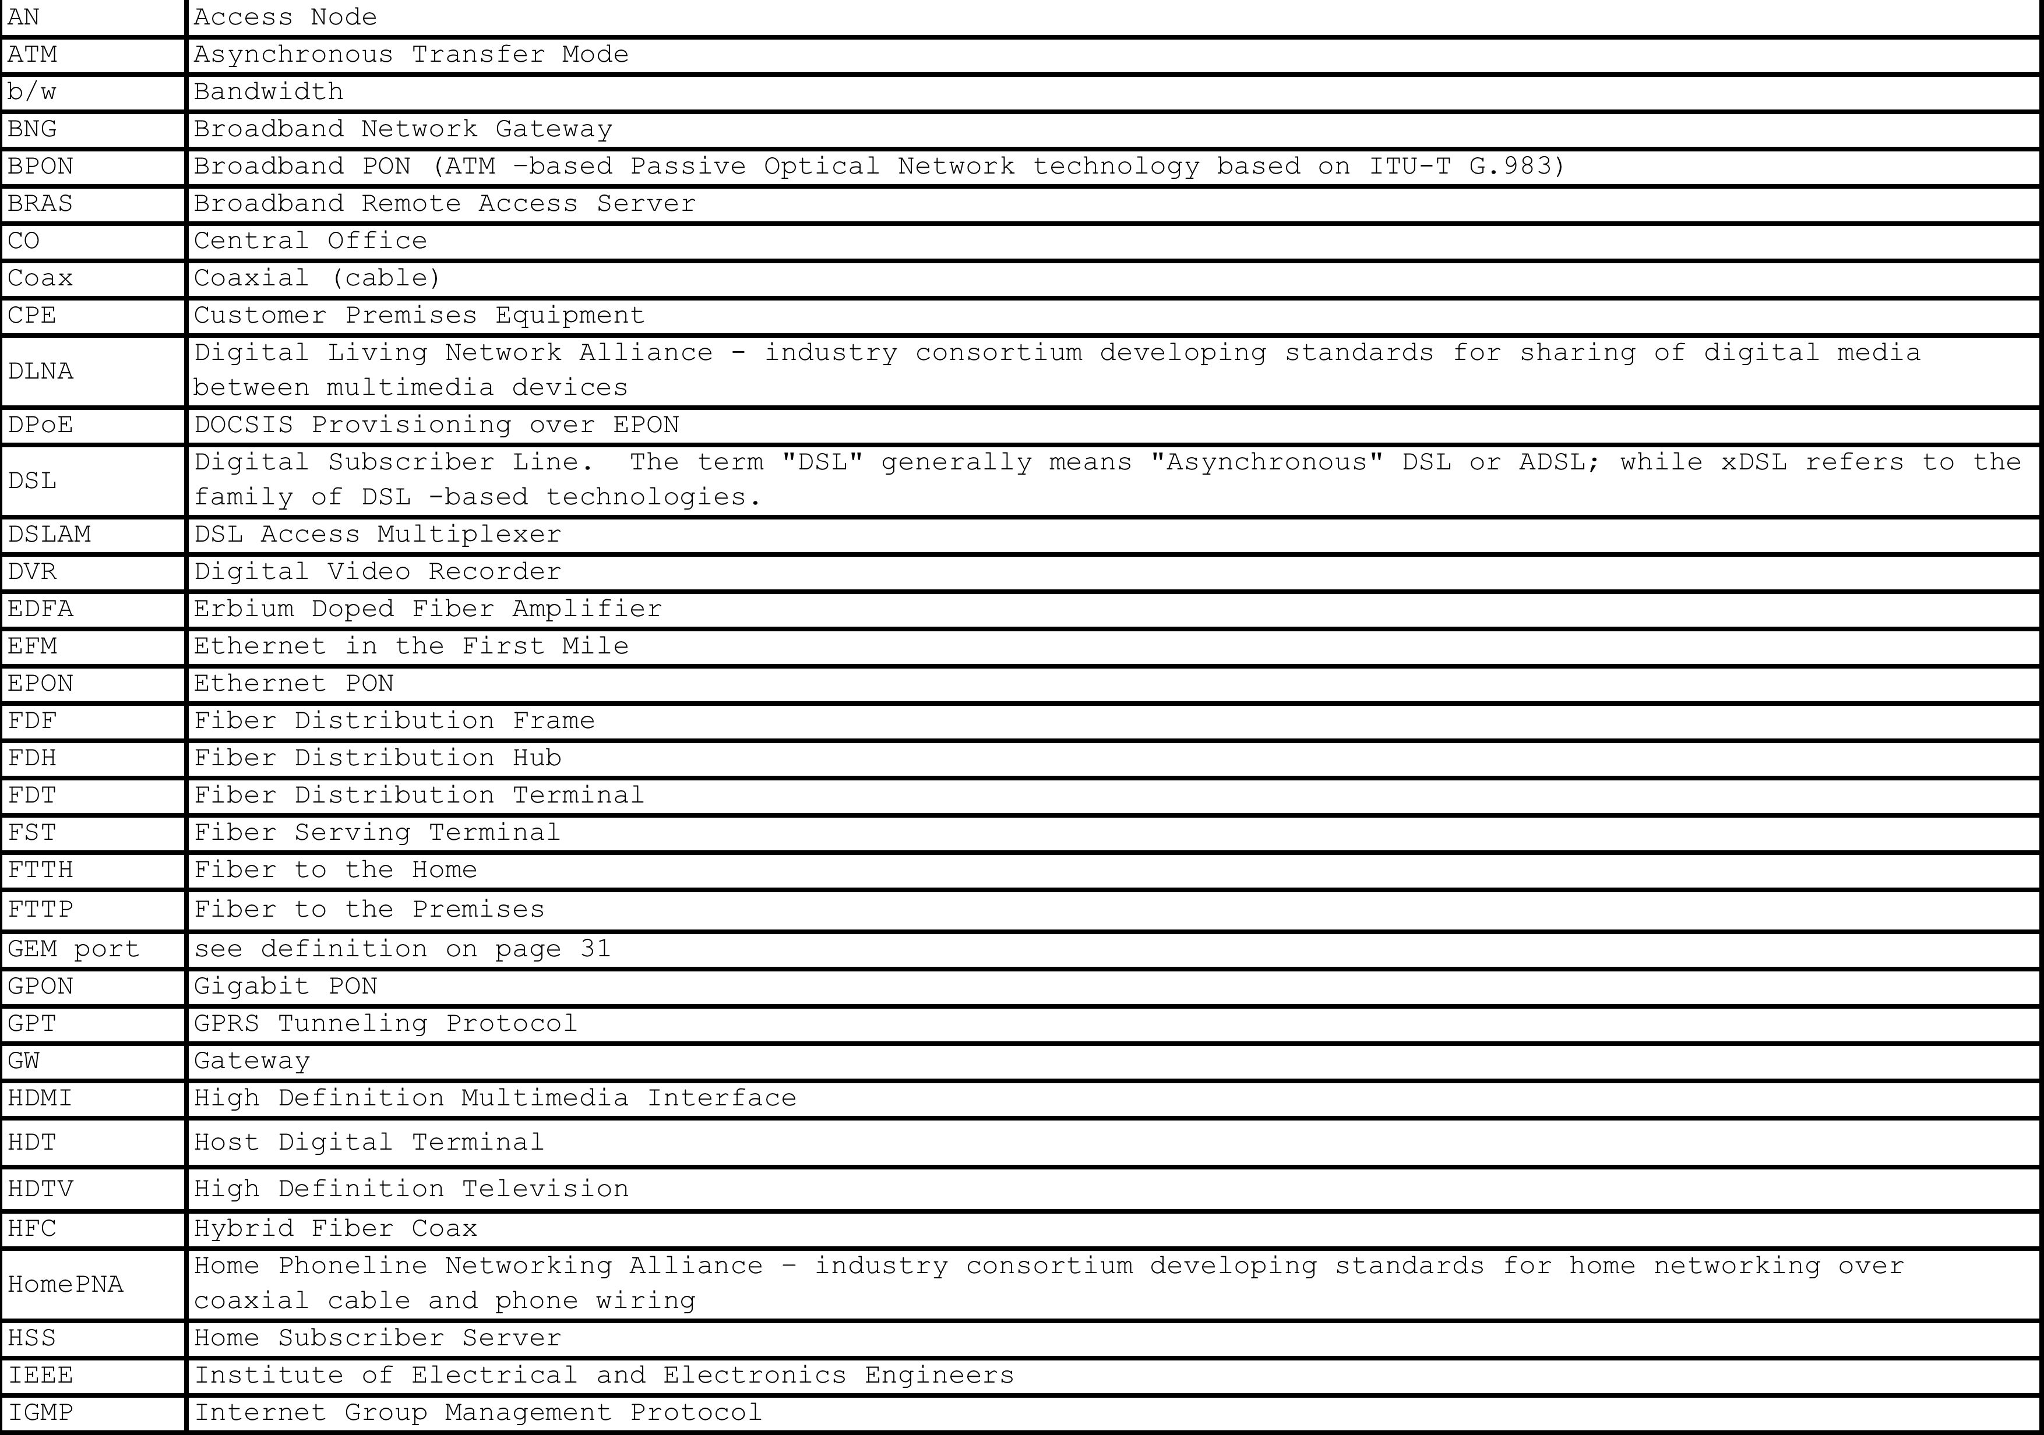
Acronyms

Slide 71

Acronyms (continued)

