Slide 1

Internet Essentials
Conquering the Digital Divide
FCC Diversity Advisory Committee
March 2012

Slide 2
The Broadband Adoption Experiment
One of the first programs of its type to directly confront the digital divide by providing affordable access to quality home Internet service, a discount-priced computer, and training to low income families
Participating families receive:
XFINITY Internet Economy Tier Service for $9.95 per month*
Option to purchase a computer for $149.99*
Access to online, in print and in person digital literacy training
Principal
Components
There are no additional fees: no modem rental charges, no deposit or activation fees
Credit check is not required
As XFINITY Internet customers, participants gain other benefits at no extra charge, including Norton Security Suite, a $160 value
Benefits to
Participants
* Plus applicable taxes
2

Slide 3
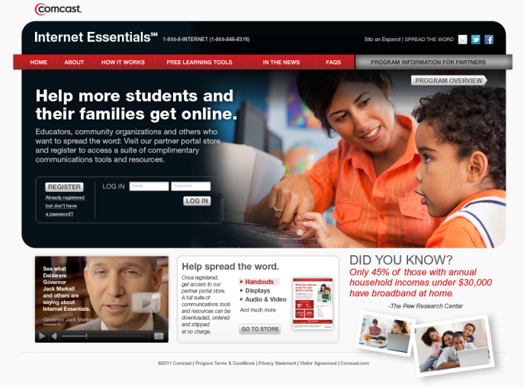
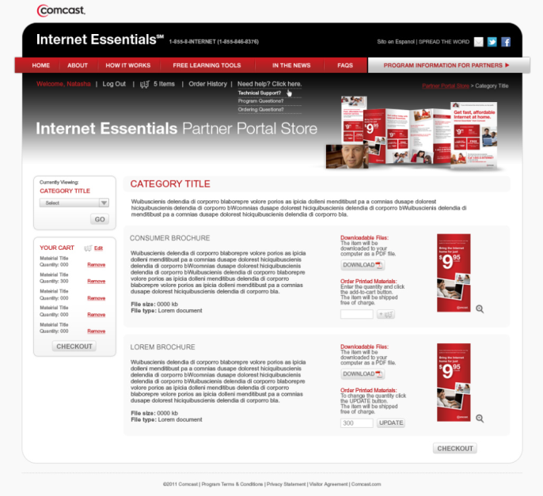
We created an online portal (www.internetessentials.com/partners) where educators and third-parties can go to learn how to spread the word
Partner Portal
The online partner portal has an array of tools available to help build awareness and spread the word
Partners can download or order complimentary printed materials to distribute in schools, display in their community, or share with colleagues – Over 12 million pieces of collateral have been ordered and shipped.
Materials available include handouts, posters, newsletter pieces, banner ads, videos, talking points, reference guides and more
Over 24,000 individuals have registered on the portal

Slide 4




Outreach to School District Superintendents was done via in-person meetings, emails, telephone conversations and distribution of Superintendent Kits
Superintendent Kit
Key-Shaped Flash Drive
Content includes:
  DE Testimonial Video
  Link to InternetEssentials.com
  Link to InternetEssentials.com/partner
School officials & CBOs register online at the Internet Essentials Partner Portal
Superintendent Brochure
* School principals received a letter under separate cover during the summer

Slide 5
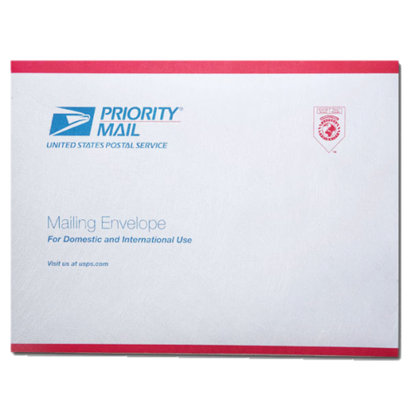
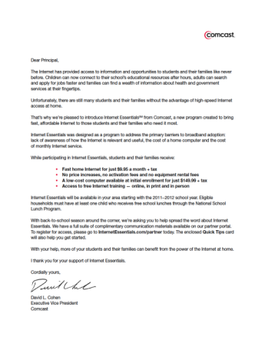



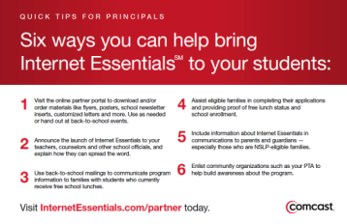
In addition, Principal Mailers were sent directly to school principals at schools within the Comcast footprint
Principal Mailer
Each mailing contains the following pieces of materials, targeted for principals and their schools:
  Addressed USPS Priority Mail Envelope
  Inner Envelope
  Cover Letter
  Brochure
  “Quick Tips” Card

Slide 6
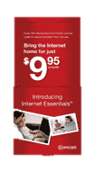
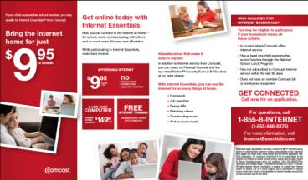

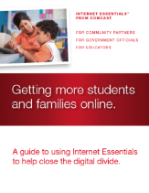
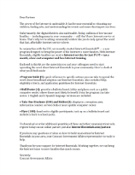

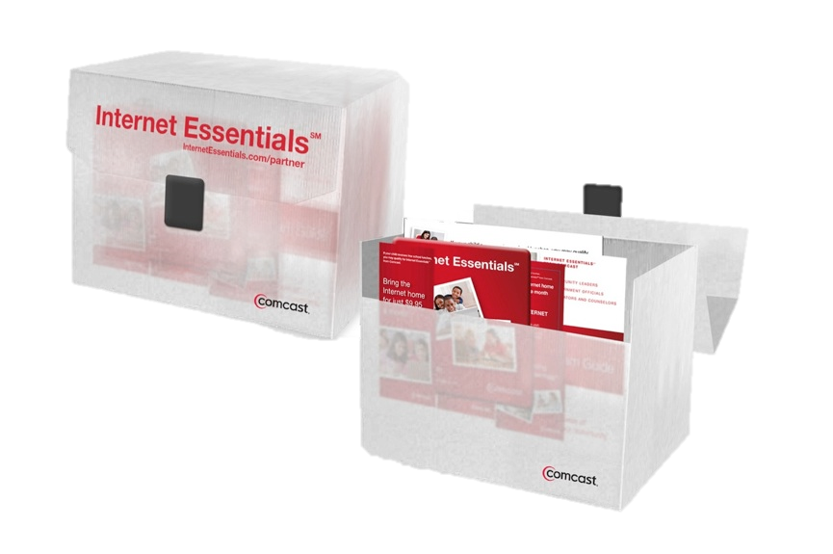

We also provided partners with a turn-key toolkit that includes all the key materials to promote Internet Essentials in their community or organization
CBO Toolkit
Frosted plastic briefcase w/ handle and latch closure
1 Bilingual cover letter
1 English Partner Program Guide
100 Bilingual flyers
100 Bilingual brochures
1 English brochure holder
4 Posters (2 English, 2 Spanish)
3 IE Pens

Slide 7
We have briefed over 3,000 government officials, community and education organizations around the country on Internet Essentials and how they can help
Federal
Congressional
Federal Communications Commission
National Telecommunications and Information Administration
Office of Science and Technology Policy, White House
U.S. Department of Agriculture
U.S. Department of Education
State and Local
Governors
State Elected Officials/Departments of Education/Secretaries of Education/State Associations
Local Elected Officials/School Districts/Superintendents
Community Based Organizations (DE examples)
  Metropolitan Wilmington Urban League Chapter
  Wilmington PAL, New Castle PAL, Hockessin PAL
  Food Bank of Delaware
  Latin American Community Center
  Boys and Girls Club of Delaware – chapters in New Castle County
  Rodney Street Tennis and Tutoring Association
  YMCA branches across New Castle County
  New Castle County Library System
  West End Neighborhood House
  Delaware Money School
Intergovernmental Associations
National Governors Association
US Conference of Mayors
National League of Cities
International City/County Management Association
National Association of Counties
National Association of Black County Officials
Hispanic Elected Officials Association
National Association of Black Elected Officials
National Conference of Black Mayors
National Conference of Black Sate Legislators
National Hispanic Caucus of State Legislators
Strategic Partnerships and Community Organizations
National Council of La Raza
National Urban League
NAACP
League of United Latin American Citizens
Minority Media and Telecommunications Council
Asian American Justice Center (AAJC)
Boys and Girls Clubs
City Year
United Way Worldwide
American Library Association
National Education Associations
American Association of School Librarians
American Federation of Teachers (AFT)
American Library Association
Consortium of School Networking (CoSN)
Council of Chief State School Officers
Council of the Great City Schools
Education Commission of the States
EDUCAUSE
International Society for Technology in Education (ISTE)
National Academy of Education
National Academy Foundation
National Association of State Boards of Education
National Association of Elementary School Principals
National Association of Secondary School Principals
National Association for Media Literacy Education (NAMLE)
National Association of School Superintendents (NASS)
National Association of Social Workers
National Education Association
National Parent Teacher Association
National Rural Education Association
National School Boards Association
National Superintendents Roundtable
Council of Urban Boards of Education (CUBE)
National Science Teachers Association
National Staff Development Council
State Educational Technology Directors Association

Slide 8
Key Accomplishments and Milestones as of 12/22/11
While we continue to analyze and make adjustments to Internet Essentials, we have achieved a number of key accomplishments and met several milestones after only a few months of the program. They include:
Publicizing the program across more than 4,000 school districts and over 30,000 schools;
Partnering with over 3,000 governors, mayors, local, state and federal legislators, and community-based organizations to promote Internet Essentials and engage eligible families in their communities;
Offering nearly 300 in-person digital literacy training sessions with more than 1,250 individual attendees;
Empowering nearly 100,000 Comcast employees to directly connect eligible families in their communities;
Distributing over 5,500 computers at less than $150 each.
8

Slide 9
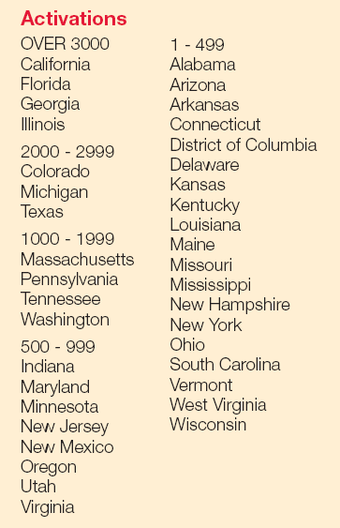
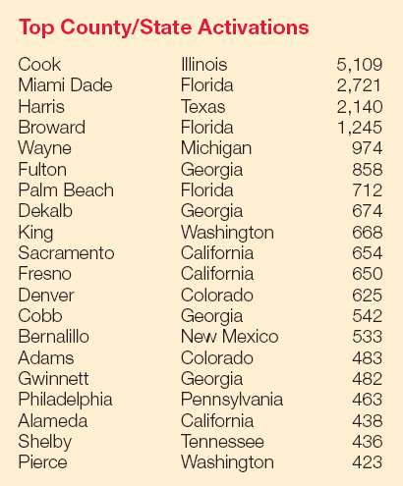
Internet Essentials Activations
First Five Months (as of 12/22/11)
9

Slide 10
2012 Program Enhancements
Based on what we have learned from the continuous feedback that we have gathered from potential customers and our community partners, we are announcing a set of key enhancements to Internet Essentials
Expanding the eligibility criteria to include families with children qualified to receive free and reduced school lunches as part of the National School Lunch Program (NSLP)
Doubling the speed of the broadband connection to up to 3 Mbps downstream and up to 786 Kbps upstream
Enabling our community-based organization partners the ability to purchase Internet Essentials in bulk to reach more eligible families in their communities
Streamlining the approval process for families whose students attend schools with the highest percentage of National School Lunch Program (NSLP) participation
Expanding and enriching our online and in-person digital literacy training efforts
Working with Connect to Compete to reduce the hardware costs for Internet Essentials eligible families and to promote the importance of digital literacy and broadband adoption
10

